Slide 1
Payday Wage Claim How to File a Wage Claim Using a Paper Form
Texas Workforce Commission
Wage and Hour Department

Slide 2
How to File a Wage Claim
By Faxing or Mailing a Paper Form
By Completing an Online Form
Step 1: Download a Wage Claim form (PDF)
You can get a Wage Claim form at a Workforce Solutions office.
Step 2: Complete and sign the form. You can type your information directly on the form or print the form and complete it by hand. You must complete and submit all requested information.
Step 3: Print the form and mail or fax to TWC, along with any supporting documents.
Step 1: Go to the Online Wage Claim
Step 2: Enter your User ID and password. New users must create a User ID.
Step 3: Select “Start New Wage Claim” and complete and submit all requested information. Use this tutorial for help completing the online form.
Step 4: If you need to submit documents to support your claim, print the cover page that is given after you submit the form.

Slide 3
Completing a Payday Wage Claim Online
Step 1: Download Wage Claim form (PDF)
Step 2: Complete the form.
Step 3: Fax or Mail the form and supporting documents to TWC. We cannot accept wage claims by e-mail or phone.
Don’t have a printer? TWC’s Workforce Solutions Offices provide printer and fax services.

Slide 4
Necessary Information
When completing the Payday Wage Claim, you’ll need:
Information about your employer, such as business name and address, phone number, and the address where you worked.
The amount of unpaid wages and how you calculated this amount.
The specific dates you worked and were not paid.
Make sure you:
Completely fill out the form.
Complete the last page to certify the information is correct and sign the form before submitting it.
Mail or fax documentation to support your claim.

Slide 5
Your wage claim may be delayed if…
The claim is not detailed and complete. Include each type of unpaid wages and how you determined the amount you are owed.
There is not enough information to contact your employer.
You were not an “employee” of the business. If unsure, file a claim and TWC will investigate.
You were employed by a close relative such as your mother, grandfather, or father-in- law. If you are unsure, file a claim and TWC will investigate.
The employer filed for bankruptcy. You can file a claim for owed wages in bankruptcy court. If you don’t know, file a claim and TWC will investigate.
You were employed by a federal, state, or local governmental agency such as a school district. You may be able to file a claim with the US Department of Labor (USDOL).
Your wage claim is filed later than 180 days after the date the unpaid wages were due to be paid. You may be able to file a claim with USDOL.
You file against more than one employer on one claim. File a separate wage claim for each employer.

Slide 6
Wage Claim Form
Download a Wage Claim form (PDF)
Or
Get a form from your local TWC Workforce Solutions Office
Type information directly on the form or print the document and complete it by hand. If written by hand, write clearly in ink so we can read your information.

Slide 7
Claimant Information
Tell Us About Yourself:
Complete the Claimant Information section with information about you.
We need this information so we can contact you about your claim.
Download a Wage Claim form (PDF)

Slide 8
Employer Information
Tell Us About Your Employer:
Complete the Employer Information section with information about your employer.
We need this information so we can contact your employer.
Download a Wage Claim form (PDF)

Slide 9
Employment Information Questions 1-5
Tell Us About Your Employment: Questions 1-5
Type of work / Job title
Date you started working (MM/DD/YYYY)
Whether you are still working OR separated. If no longer working, enter the date you separated (MM/DD/YYYY)
Reason you are no longer working
Scheduled paydays (1st workday of the month? 1st and 15th of the month? Other?)
Pay rate – How much and how often were you paid (Hourly? By the Mile? Salary?)
Work schedule (Hours per day, Days per week, or other schedule)
Whether your compensation agreement was oral or written.
Whether you worked in Texas
Whether taxes were deducted

Slide 10
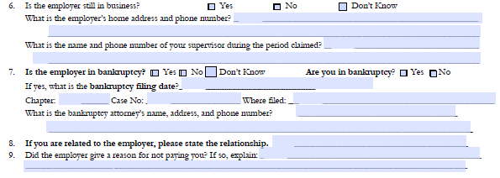
Employment Information Questions 6-9
Tell Us About Your Employment: Questions 6-9
Whether the employer is still in business
Your employer’s home address and phone number, if known
Your supervisor’s name and phone number
Whether you or your employer is in bankruptcy.
If in bankruptcy, include the Chapter & Case number, where filed, and the bankruptcy attorney’s contact information.
Your relationship to the employer, if applicable
The reason the employer gave for not paying you
Download a Wage Claim form (PDF)

Slide 11
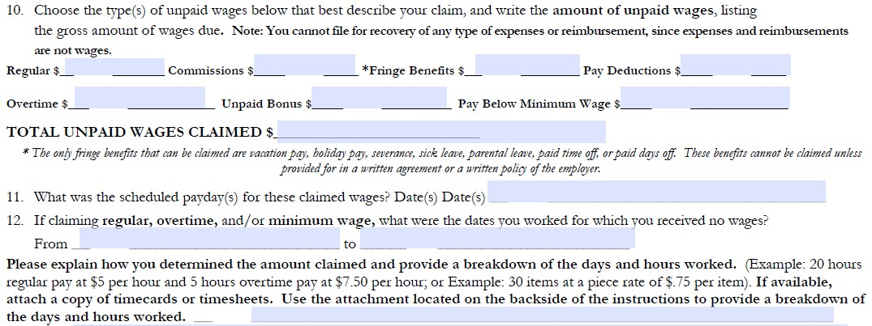
Wage Information Questions 10-12
Tell Us About Your Unpaid Wages: Questions 10-12
The gross amount of wages owed for each of the types listed
The total amount of unpaid wages claimed on this form
The scheduled payday for the unpaid wages (Date you expected to be paid)
The dates you worked for which you received no wages
Note: Expenses, per diem, and fuel reimbursements are not wages and TWC is not able to rule on those types of claims.

Slide 12
Wage Information Attachment
Tell Us About Your Unpaid Wages:
Follow the instructions on the Wage Claim Form Attachment to explain in detail how you calculated the amounts claimed.
Make copies if you need more pages.
If claiming Commission or Bonus, provide a breakdown of how you calculated the amount.
Download a Wage Claim form (PDF)

Slide 13
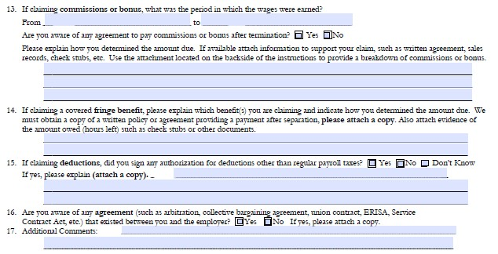
Wage Information Questions 13-17
Tell Us About Your Unpaid Wages: Questions 13-17, if applicable
Commission/Bonus: The date wages were earned (MM/DD/YY) and how you calculated the amount due
Fringe Benefit: The type of benefit claimed and how you calculated the amount due
Deductions: Whether you signed an authorization for deductions
Attach documentation to help support your claim.
If claiming Commission or Bonus, provide a copy of the employment agreement and supporting documentation.

Slide 14
Certify and Sign
You must complete this section and sign for your wage claim to be accepted. Completing this section indicates your information is true and correct. You must provide:
Your full name
Your date of birth (MM/DD/YY)
Your complete address
County and State where you competed this form
Date signed (MM/DD/YY)
SIGNATURE
Chapter 61 Texas Labor Law Code provides that a penalty may be assessed against employers that act in bad faith in not paying wages. The same penalty can be assessed for wage claims brought in bad faith.

Slide 15
Submit Your Wage Claim Form and supporting documents
Send the completed Wage Claim Form and any documents to support
your claim for unpaid wages.
Fax: 512-524-6211
E-mail wageandhour@twc.texas.gov
Mail: Texas Workforce Commission
Wage and Hour Department
101 East 15th Street, Rm 514
Austin, TX 78778-0001
Tips:
Do not send originals
Always send good quality copies
Do not use highlighter or colored paper
Don’t have a printer or scanner? TWC’s Workforce Solutions Offices
provide printer and fax services.

Slide 16
Need Help?
Questions or to amend your claim: 800-832-WAGE (9243) or 512-475-2670
TDD for the hearing impaired: 800-735-2989
More information: Texas Payday Law
Download a Wage Claim form (PDF)

