Slide 1
CDER System Upgrade
Cash Draw & Expenditure Reporting System

Slide 2
Presenter & Panel Members
Presenter
Irene Tanguma, Director, Payables, Payroll & Travel
Panel Members
Tim Urbanovsky, Director, Accounting & Financial Reporting Services
Natalie Quintanilla, Manager, CDER Payables
Cristal Martinez, Financial Systems Support
Gabriel Wood, Financial Systems Support

Slide 3
Topics: This Session
What is the CDER system
CDER upgrade overview
Transition timeline
Training requirements
New CDER system sneak peak

Slide 4
What is the CDER system?
The CDER system is the Texas Workforce Commission’s online Cash Draw and Reporting System.
TWC’s CDER system is used by nearly all grantees to perform the following:
Draw Cash
Report Expenditures
Submit Financial Closeout Packages

Slide 5
Current CDER system
Current System
CDER pay request
TWC’s Financial
System
USAS (Comptroller payment system)

Slide 6
Current: CDER Cash Draw Process Time
Day 0 | Day 1 | Day 2 | Day 3
"Cash Request" made in the CDER system. Data interfaces to WRAPS (TWC’s accounting system) overnight and a voucher is created. | Voucher draw data appears on the Cash Management database at a summary level. Accountant reviews data for accuracy and requests summary draw amounts from the Federal/State fund source. Deposit journal created in WRAPS, to be interfaced to the Uniform Statewide Accounting System (USAS) (Texas Comptroller’s Office). Vouchers and deposit journal are interfaced to USAS overnight. | Federal/state fund source wires money to USAS/ Treasury. USAS deposit journal is matched to the wire. If it matches, the deposit is accepted. Vouchers from Day 1 are processed for payment. If the deposit is unsuccessful, then the cash is not available and the voucher is not processed. Voucher and deposit data is interfaced from USAS to WRAPS, then from WRAPS to the CDER system overnight. | Early morning, money is transferred from USAS/Treasury to Grantee’s bank.

Slide 7
New CDER system
New System
USAS (Comptroller payment system)
TWC’s Financial
System
CDER pay request

Slide 8
New: CDER Cash Draw Process Time
Current process requires a “Day 0” overnight data interface from CDER to WRAPS to create a WRAPS voucher. Moving the CDER system into WRAPS will eliminate that first overnight step.
Day 1 | Day 2 | Day 3
New: WRAPS voucher creates same day as “Cash Request” submission. Voucher draw data appears on the Cash Management database at a summary level. Accountant reviews data for accuracy and requests summary draw amounts from the Federal/State fund source. Deposit journal created in WRAPS, to be interfaced to the Uniform Statewide Accounting System (USAS) (Texas Comptroller’s Office). Vouchers and deposit journal are interfaced to USAS overnight. | Federal/state fund source wires money to USAS/ Treasury. USAS deposit journal is matched to the wire. If it matches, the deposit is accepted. Vouchers from Day 1 are processed for payment. If the deposit is unsuccessful, then the cash is not available and the voucher is not processed. Voucher and deposit data is interfaced from USAS to WRAPS, then from WRAPS to the CDER system overnight. | Early morning, money is transferred from USAS/Treasury to Grantee’s bank.

Slide 9
CDER System Transition
Legacy system close-out
New system Access

Slide 10
Legacy System Close-Out
Final cash draw deadline is 8/21/2025
Grants close-out due by 8/31/2025 need to be finalized by 8/26/2025
System data will be migrated over to the new system

Slide 11
New System
Go-Live is expected on 9/2
Data from the legacy system will be migrated over.
New credentials to access the system will be required.

Slide 12
Access to the New System
All users will be required to take training before access is issued.

Slide 13
CDER Training
All existing users from the legacy system will be sent training materials with instructions and deadlines to complete the training.
Due to volume of accounts needing new credentials, you are encouraged to finish the training as soon as possible.
Ideally, everyone will complete their training in August and have their login credentials prior to go-live

Slide 14
Training
First time CDER users, please contact CashDraw.TA@twc.texas.gov to request training materials
Any existing user that has not received the training materials email by 8/15/25 will need to contact CashDraw.TA@twc.texas.gov

Slide 15
New CDER, New Look

Slide 16
Changes
What will change:​
How users access the application.​
Modifications to appearance and specific navigation paths might occur.
System hours 7am to 7pm.​
What won’t change:​
CDER system will largely have the same functionality, rules, and user permissions as the current version.​
The new system name will still be known as the CDER system.​

Slide 17
CDER Dashboard Tiles

Slide 18
Cash Draw-Payment Tile

Slide 19
Cash Draw-Expense Tile

Slide 20
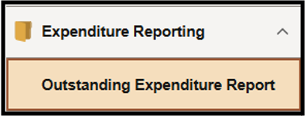
Cash Draw-Reports Tile

Slide 21
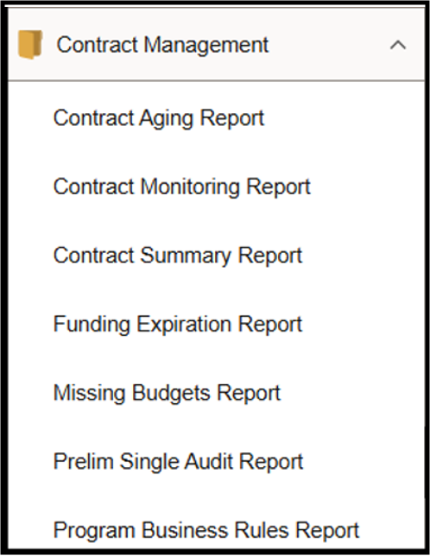
Expenditure Reports

Slide 22
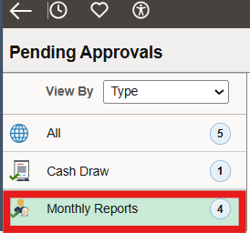
Approvals Tile

Slide 23
Questions
Contacts:
Cash Draw Technical Assistance: CashDraw.TA@twc.texas.gov
CDER Payables: Payables.CDER@twc.texas.gov
Financial Reporting’s “Contract and Grant Expenditure Reporting” mailbox: CAGER@twc.texas.gov

