Slide 1
Session 8: Cost Principles & Factors Affecting Allowability of Costs
Texas Workforce Commission Financial Conference
July 23-25, 2025

Slide 2
Presenter
Jenny Noren
TWC Financial Initiatives

Slide 3
Topics
The “Lingo”
Allowable costs versus unallowable costs
General factors affecting allowability of costs

Slide 4
The “Lingo”
Cost
Cost objective
Direct and indirect costs
Total cost of an award
Project cost

Slide 5
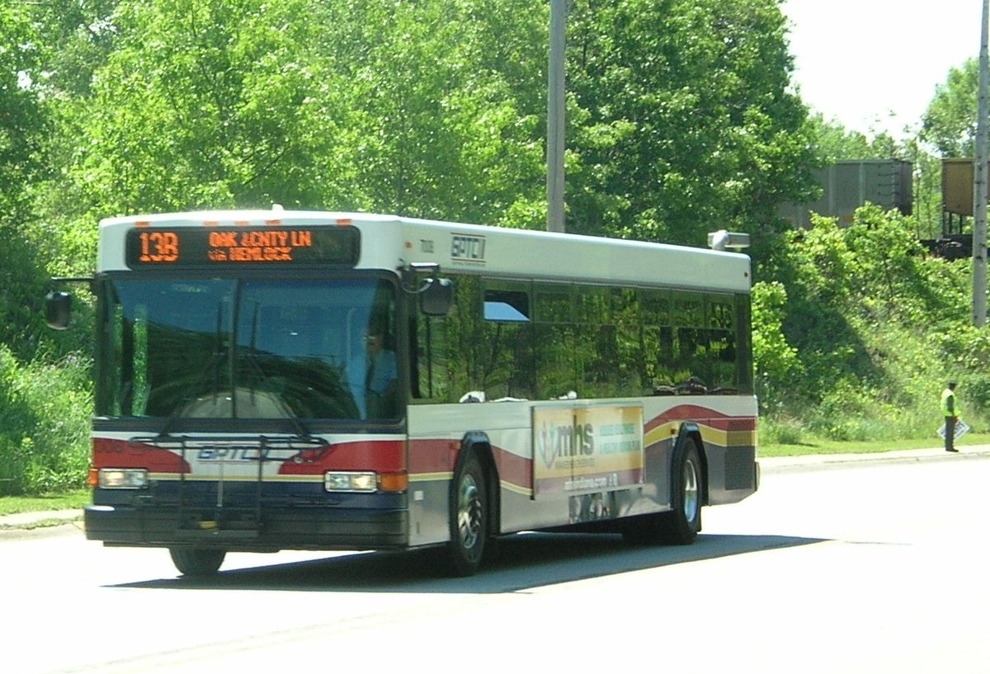
Cost
Cost is the value of resources used to acquire goods and services. In simpler terms, the amount paid to acquire something.
Salaries, wages & fringe benefits
Building rent, utilities, repairs, maintenance, modifications
Professional & consulting services
Transportation & other client services
Office supplies
Computing devices

Slide 6
Cost Objective
Examples
Organizational unit
Division, department, unit
Major function
Physical location
Workforce Solutions Office, entity headquarters, campus
Activity
Counseling, intake, etc.
Program
Assistance Listings program
Grant award
Cost category
Administrative costs
Customer group
A cost objective (or cost object) is anything for which a separate measurement of cost is needed or desired.
Intermediate cost objectives (e.g., cost pool)
Final cost objective (e.g., grant award)
Intermediate cost objectives accumulate indirect costs for allocation to one or more other intermediate cost objectives or to final cost objectives. A final cost objective is a final accumulation point; it includes both direct and indirect costs.

Slide 7
Direct Costs & Indirect Costs
A cost is assigned to a particular cost objective as either a direct cost or an indirect cost.
Direct Cost
Can be identified specifically with a particular final cost objective or can be assigned to such activities relatively easily with a high degree of accuracy.*
Direct costs can be traced to final cost objectives in a cost-effective way.
Indirect Cost (also known as Facilities & Administration (F&A) Costs)
Incurred for a common or joint purpose.
Benefits multiple cost objectives.
Not readily assignable to cost objectives specifically benefitted without effort disproportionate to the results received.
Allocated to final cost objectives.
*Note: Any direct cost of minor amount may be treated as an indirect cost for reasons of practicality where such accounting treatment for that item of cost is consistently applied to all federal and non-federal cost objectives.

Slide 8
Total Cost of an Award: Allowable Direct Costs + Allocable Indirect Costs – Applicable Credits
Direct Costs
Indirect Costs
Applicable Credits
Receipts or reduction-of-expenditure-type transactions that offset or reduce costs.
Purchase discounts
Rebates or allowances
Recoveries or indemnities on losses
Insurance refunds or rebates
Adjustments of overpayments or erroneous charges
Must credit these amounts against allowable costs of the grant award(s) as a cost reduction or cash refund, as appropriate.

Slide 9
Total Cost Versus Total Project Cost
Total Cost is not the same as Total Project Cost.
Total Cost: allowable direct costs + allocable indirect costs – applicable credits Total Project Cost: total allowable costs + cost sharing*
Total Project Cost:
Allowable direct costs
+ Allocable Indirect Costs
- Applicable Credits
= Total Cost
+ Cost Sharing
= Total Project Cost
*Cost sharing refers to required cost sharing and voluntary committed cost sharing, including cost sharing from third party in-kind contributions. Leverage and match are examples of cost sharing.
Notes:
Sources.
Total cost: 2 CFR 200.402; UGMS, Part II, Attachment A, D. Composition of Cost, 1. Total cost.
Applicable credits: 2 CFR 200.406 Applicable credits; UGMS, Part II, Attachment A, C. Basic Guidelines, 4. Applicable credits.
Project cost and cost sharing: 2 CFR 200.83 Project cost; project cost is not defined by or used in UGMS.

Slide 10
Allowable Cost Versus Unallowable Cost
“Allowable costs” concept
Improper payments
Questioned costs
Collection of unallowable costs
Allowable cost basis
Cost principles

Slide 11
Is this cost allowable?
Translation: Can I charge this to the grant award?

Slide 12
The Allowable Costs Concept
“Recipients of assistance awards are expected to use the assistance funds for the purposes for which they were awarded, subject to any conditions that may attach to the award. Expenditures or costs that meet the grant purposes and conditions are termed ‘allowable costs.’ An expenditure which is not for grant purposes or is contrary to a condition of the grant is not an allowable cost and may not be properly charged to the grant.”
Source: U.S. Government Accountability Office (GAO), Principles of Federal Appropriations Law (Red Book), 3rd ed., 2016 rev., ch. 10, § G.1.a, p. 10-111, GAO-16-464SP (Washington, D.C.: Mar. 2016)

Slide 13
Improper Payments: Definition (See Improper Payments in 2 C.F.R. § 200.1; similar in TxGMS Appendix 2)
Any payment that should not have been made or that was made in an “incorrect amount” under statutory, contractual, administrative, or other legally applicable requirements.
“Incorrect amounts” are overpayments or underpayments that are made to eligible recipients. It also includes any payment that was made to an ineligible recipient or for an ineligible good or service, or payments for goods or services not received (except for such payments authorized by law).
When an agency’s review is unable to discern whether a “payment” was proper as a result of insufficient or lack of documentation, this payment should also be considered an improper payment. When establishing documentation requirements for payments, agencies should ensure that all documentation requirements are necessary and should refrain from imposing additional burdensome documentation requirements.
The term “payment” in this definition means any disbursement or transfer of Federal funds (including a commitment for future payment, such as cash, securities, loans, loan guarantees, and insurance subsidies) to any non-Federal person, non-Federal entity, or Federal employee, that is made by a Federal agency, a Federal contractor, a Federal grantee, or a governmental or other organization administering a Federal program or activity.
Also see definition of improper payment in OMB Circular A–123 Appendix C, part I.A.1.

Slide 14
Questioned Costs (See Improper Payments and Questioned Cost in 2 C.F.R. § 200.1; similar in TxGMS App. 2)
A cost that is questioned by the auditor because of an audit finding:
Which resulted from a violation or possible violation of a statute, regulation, or the terms and conditions of the award, including for funds used to match federal (UG)/state (TxGMS) funds;
Where the costs, at the time of the audit, are not supported by adequate documentation; or
Where the costs incurred appear unreasonable and do not reflect the actions a prudent person would take in the circumstances.
A questioned cost should not be considered an improper payment until the transaction has been completely reviewed and is confirmed to be improper.

Slide 15
Collection of Unallowable Costs (2 C.F.R. § 200.410; TxGMS)
UG (Federal Awards)
TxGMS (for State Awards)
Payments made for costs determined to be unallowable by either the Federal awarding agency, cognizant agency for indirect costs, or pass-through entity, either as direct or indirect costs, must be refunded (including interest) to the Federal Government in accordance with instructions from the Federal agency that determined the costs are unallowable unless Federal statute or regulation directs otherwise.
Payments made for costs determined to be unallowable by the state awarding agency or pass-through entity, either as direct or indirect costs, must be refunded (including interest) to the state government in accordance with instructions from the state agency that determined the costs are unallowable unless state statute or rule directs otherwise.

Slide 16
Allowable Costs Basis
Allowable costs are determined on the basis of:
Program legislation
Regulations, rules, and other requirements
Program and other regulations
Office of Management and Budget (OMB) “Uniform Administrative Requirements, Cost Principles, and Audit Requirements for Federal Awards” (Uniform Guidance or UG)
Texas Grant Management Standards (TxGMS)
Federal program guidance
TWC rules
TWC issuances (e.g., WD Letters, AEL Letters, program guides)
TWC Financial Manual for Grants and Contracts (FMGC)
Terms and conditions of the grant award
Federal award issued by the federal awarding agency
TWC grant award

Slide 17
Cost Principles
The UG and TxGMS prescribe cost principles for determining the allowability of costs.
Basic Considerations
Composition of cost (total cost = allowable direct + allocable indirect - applicable credits)
Factors affecting allowability of costs
Prior approval
Statutory requirements may limit allowability of costs
Collection of unallowable costs
Direct Costs and Indirect (F&A) Costs
Special Considerations for certain entity types
Selected Items of Cost
Appendices addressing certain cost allocation plans and indirect cost rates

Slide 18
General Factors Affecting Cost Allowability
The Ten General Allowability Factors Listed in the UG and TxGMS

Slide 19
Factors Affecting Allowability of Costs (2 C.F.R. § 200.403; TxGMS)
“Except where otherwise authorized by statute, costs must meet the following general criteria in order to be allowable…”
(Continued on the next slides.)

Slide 20
1. Necessary (2 C.F.R. § 200.403; TxGMS)
Factor:
Costs must be necessary for performance of the award.
TWC Comments:
Case-by-case determinations.
Considers such factors as:
Purpose of the award (including underlying federal award, if applicable)
Explanation of need
Circumstances surrounding the cost in question
Whether the cost has a logical relationship to the award
Whether the activity is required, such as by law, regulation, etc.

Slide 21
2. Reasonable (2 C.F.R. §§ 200.403 and 200.404; TxGMS)
Factor:
Costs must be reasonable for performance of the award.
Reasonable Cost Defined:
A cost is reasonable if, in its nature and amount, it does not exceed that which would be incurred by a prudent person under the circumstances prevailing at the time the decision was made to incur the cost.
The question of reasonableness is particularly important when the entity is predominantly state or federally-funded.
(Continued on the next slide.)

Slide 22
Reasonable (continued)
Considerations:
In determining whether a cost is reasonable, consideration shall be given to:
Generally recognized as ordinary and necessary for the operation of the entity or the performance of the award;
Restraints and requirements imposed by such factors as: sound business practices, arms length bargaining, laws and regulations, and the terms and conditions of the award;
Market prices for comparable goods or services;
Whether individuals acted with prudence in the circumstances, considering their responsibilities to the entity, its employees, the public at large, and the government; and
Significant deviations from the entity’s established practices, which may unjustifiably increase the award’s cost.

Slide 23
3. Allocable (2 C.F.R. §§ 200.403 and 200.405; TxGMS)
Factor:
Costs must be allocable to the award in accordance with applicable cost principles.
Allocable Cost Defined:
A cost is allocable to an award or other cost objective if the cost is assignable to that award or cost objective in accordance with relative benefits received. (More on next slide.)
This standard is met if the cost:
Is incurred specifically for the award;
Benefits both the award and other work of the entity, and can be distributed in proportions that may be approximated using reasonable methods; and
Is necessary to the overall operation of the entity and is assignable in part to the award in accordance with applicable cost principles.

Slide 24
Allocable – Relative Benefit Received
What is the cost?
Which cost objective(s) does it benefit?
Organization-wide cost?
Benefits a specific organizational unit only—such as division, department, unit?
Jointly benefits two or more specific awards?
Incurred specifically for a single award?
Can the benefit be traced directly to a specific award?
Does the cost jointly benefit two or more cost objectives, but is not readily assignable to the individual cost objective specifically benefitted without effort disproportionate to the results received?
Direct allocation
Cost allocation plan
Indirect cost rate
If a joint benefit, what is a reasonable measure of benefit received? (continued)

Slide 25
Allocable – Relative Benefit Received (continued)
Examples of bases for measuring benefit received:
Modified total direct costs
Direct labor
Full-time equivalents
Direct share of total square footage used
Number of participants enrolled
Number of participant completions
Basis must result in fair, equitable, distribution; must not distort.
Relationship between the cost being measured and the basis used to measure benefit received.

Slide 26
Allocable – Limitation on Cost Shifting
A cost allocable to a particular federal/state award may not be charged to other federal/state awards—such as to overcome fund deficiencies or to avoid restrictions imposed by statutes, regulations, or the terms and conditions of the awards).
Would not preclude funding decisions for costs that are allowable under two or more awards in accordance with existing statutes, regulations, or the terms and conditions of the awards.
This: Participant is co-enrolled in Program A and B. Participant is eligible for the same training services under both programs. Decide which program pays.
Not This: Intake is an allowable activity under all my awards, so I don’t need to allocate. I can just pick one award and charge all my intake costs to that award until I deplete that award’s intake budget. Then, I can charge all intake costs to another award, and so on.

Slide 27
Audience Participation #1
True or False. Our Workforce Board receives annual funding allocations from TWC for multiple programs. This year, we earned a performance bonus from TWC. We received those funds in a separate award that included a mix of funds from multiple programs that we already administer. We plan to use the additional funds to either refresh some computers for the benefit of all programs or give performance bonuses to various staff across all the programs we administer. We can charge those costs to this new award without having to worry about the programs that those costs benefit, right?
Answer: To be discussed during the conference.

Slide 28
4. Conform to Limitations (2 C.F.R. § 200.403; TxGMS)
Factor:
Costs must conform to any limitations or exclusions set forth in UG or TxGMS (as applicable) or in the award, as to the types or amount of cost items.
Examples:
UG and TxGMS cost principles
Program-specific restrictions from statute or regulation (e.g., WIOA Title I prohibits foreign travel and applies salary limitations)
Federal award limits (e.g., salary limitations; DOL consultant fee limits)
Federally imposed application of restricted indirect cost rates (e.g., AEFLA)
Statutorily imposed match requirements that limit federal/state share of cost
Administrative cost limits
Limits that TWC imposes under a specific award—such as equipment prohibitions, out-of-state travel, cost-per requirements, leverage, etc.

Slide 29
5. Consistent with Policies & Procedures (2 C.F.R. § 200.403; TxGMS)
Factor:
Costs must be consistent with policies and procedures that apply uniformly to both grant-financed and other activities of the entity.
TWC Comments:
This factor is concerned with consistency and to some degree, supplanting, and ultimately about the award not being charged in excess of its allocable share of costs.
Related: From an earlier slide, one of the conditions for considering whether a cost is Reasonable is whether the cost reflects significant deviations from the entity’s established practices, which may unjustifiably increase the award’s cost.

Slide 30
Audience Participation #2
True or False. Our organization has an established annual process for evaluating employee performance and uses that process for giving raises or occasional one-time additional performance-related payments to employees. Our TWC grant award is about to expire and we have some funds remining in that award. We want to use those remaining funds to give a one-time additional payment to the employees that worked so hard on that award. We don’t need to go through our normal performance evaluation process, right?
Answer: To be discussed during the conference.

Slide 31
6. Consistent Treatment (2 C.F.R. § 200.403; TxGMS)
Factor:
Costs must be accorded consistent treatment. A cost may not be assigned to a grant award as a direct cost if any other cost incurred for the same purpose in like circumstances has been allocated to the award as an indirect cost.

Slide 32
7. Determined in Accordance with GAAP (2 C.F.R. § 200.403; TxGMS)
Factor:
Costs must be determined in accordance with Generally Accepted Accounting Principles (GAAP), except, for state and local governments and Indian tribes only, as otherwise provided for in the UG.
TWC Comments:
GAAP is established by the Financial Accounting Standards Board (FASB) and Governmental Accounting Standards Board (GASB). It promotes consistent treatment of “like” transactions by similar entities, which lends to stakeholder understanding of financial information and comparison of financial data among different entities.

Slide 33
8. Double-Counting (2 C.F.R. § 200.403; TxGMS)
Factor:
For federal awards, costs must not be included as a cost or used to meet cost sharing or matching requirements of any other federally-financed program in either the current or a prior period. (UG)
For state awards, costs must not be included as a cost or used to meet cost sharing or matching requirements of any other state financed program in either the current or a prior period. (TxGMS)
TWC Comments:
No double-billing: If you charge a cost to one award, you receive payment for that cost under that award. Charging that cost to both that award and another would result in the government paying for the same cost twice.
Cost sharing/matching: Costs charged to one federal award can’t be used toward the cost sharing or matching requirement for another federal award (unless authorized by statute). The same applies for state awards.

Slide 34
9. Adequate Documentation
Factor:
Costs must be adequately documented.
TWC Comments:
Documentation that verifies the expenditure amount and appropriateness to the grant award
May include, but is not limited to travel and mileage records, time records, invoices and statements, contracts and subaward documents, and billing records, as well as written explanation or justification for policy deviations and other unusual events.
TWC monitors frequently cite insufficient or absence of documentation as reason for questioning costs.
Topic continues on the next slide.

Slide 35
Adequate Documentation: How Much is Enough?
Case-by-case.
Burden of proof rests with you to show that you used grant funds for allowable uses.
Higher burden of proof for:
Costs not specifically addressed by cost principles or program requirements
Unusual or unordinary costs
Costs that deviate from your own policies
Written justification shows your rationale and efforts
Why is cost necessary and reasonable for performance of the award?
Are similar costs allowable or unallowable?
Caution: Written justification does not automatically make it allowable.

Slide 36
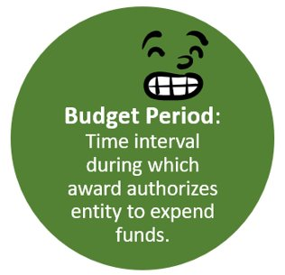
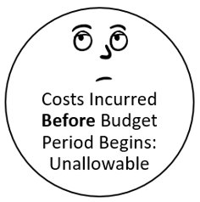
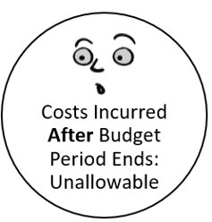
10. Budget Period (2 C.F.R. § 200.403; TxGMS “period of performance”)
Factor:
Costs must be incurred during the approved budget period.
*Exceptions: Authorized pre-award costs and allowable closeout costs, if any.

Slide 37
Who Can I Call for Help?
TWC grant manager
Especially if you have a detailed grant award budget with TWC and have questions about use of that award.
TWC program support staff
TWC’s Fiscal Technical Assistance mailbox at fiscal.ta@twc.texas.gov.
This Photo by Unknown Author is licensed under CC BY-NC

Slide 38
Need More Information?
For questions about this session, e-mail TWC’s Fiscal Technical Assistance mailbox at fiscal.ta@twc.texas.gov.

