Slide 1



apprenticeship
TEXAS style

Slide 2




Program overview
Session Overview
What is Apprenticeship?
Components
Texas Industry Recognized Apprenticeship
  Apprenticeship training model
  Funding Available
Registered Apprenticeship
  Apprenticeship training model
  Funding Opportunities
    Chapter 133 (TWC Rule Chapter 837)
      Related Classroom Training
      Pre-Apprenticeship $5.6 M FY24/FY25
    Apprenticeship Expansion
      Critical Skills
      Healthcare
      Possible Request for Applications
  Tax Refund Pilot
    Application open each year January 1 – March 31
TWC “New” Rule – Chapter 839
  Transitioning Veterans
  Tax Refund Pilot – Certification submitted to Comptroller Office – May 31st
    Next application open January 1, 2024
TWC “Rule Revision” Chapter 838
  IRAP - $20 Million for FY24/FY25

Slide 3
Apprenticeship in TEXAS
Registered Apprenticeship
Department of Labor – Office of Apprenticeship
And
Texas Industry Recognized Apprenticeship
(TIRA)

Slide 4
What is Apprenticeship?
TEXAS style
Components of Apprenticeship
1) Employer Involvement: Employers are the foundation of every program. They define skill requirements, recruit apprentices, provide on-the-job training and validate related instruction.
2) Related Classroom Instruction: Apprenticeships combine on-the-job learning with technical education at community colleges, technical schools, apprenticeship training schools, provided on-line or in-person.
3) Structured On-the-Job-Training: Apprentices get hands-on training from an experienced mentor at the job site.
4) Rewards for Skill Gains: Apprentices receive increases in pay as their skills and knowledge increase. Progressive wage increases help reward and motivate apprentices as they advance through their training.
5) Occupational Credential: Every graduate of an Apprenticeship program receives a recognized credential.

Slide 5



What is registered apprenticeship
What is Apprenticeship?
TEXAS style
Texas Industry Recognized Apprenticeship is an employer-driven talent development model that combines on-the-job learning with related classroom instruction. Apprentices earn and learn at the same time. It is a proven training model for businesses to recruit, train, and retain highly skilled workers.
PAID JOB
EDUCATION
CREDENTIALS
Apprentices earn a competitive wage from day one
Structured learning and on-the-job training help apprentices advance professionally
Upon completion apprentices receive an industry recognized credential
Training 26 Weeks Maximum

Slide 6
Texas Industry Recognized Apprenticeship
(TIRA)
NEW in TEXAS
88th Legislative Session
  $20 Million in Funding $10 Million in each of FY24 and FY25

Slide 7
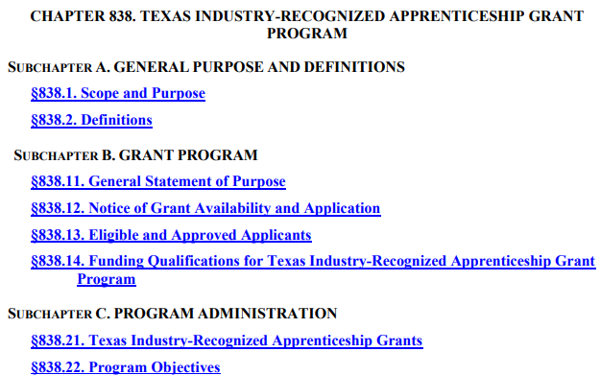
Texas Industry Recognized Apprenticeship
(TIRA) 2 of 9
Chapter 838. Texas Industry-Recognized Apprenticeship Grant Program

Slide 8
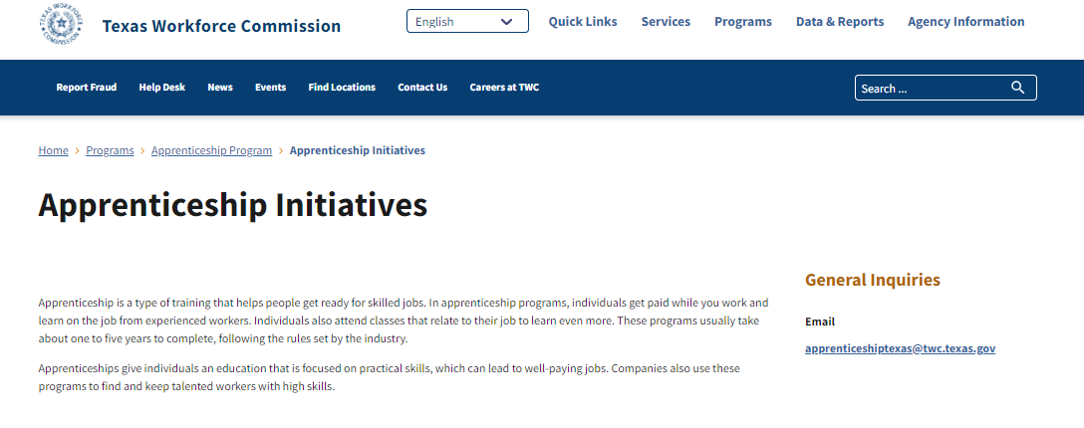
Texas Industry Recognized Apprenticeship
(TIRA) 3 of 9
Application link below
  www.twc.texas.gov/programs/apprenticeship/initiatives
Notes:
Desk Aide -

Slide 9
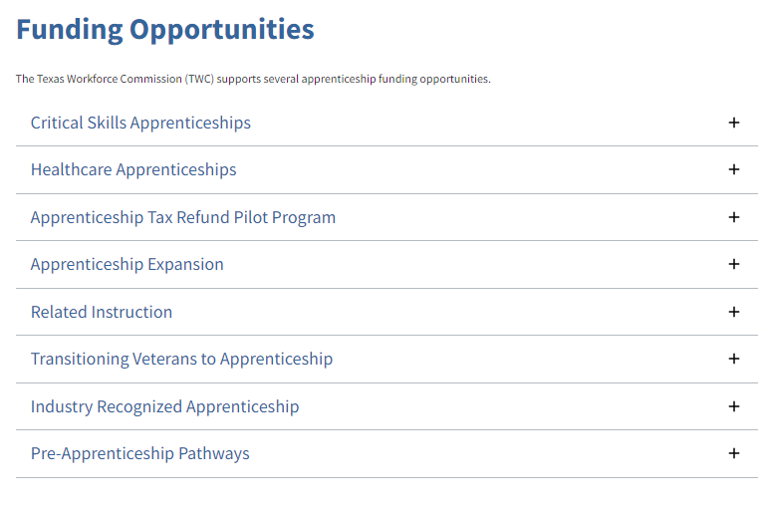
Texas Industry Recognized Apprenticeship
(TIRA) 4 of 9

Slide 10
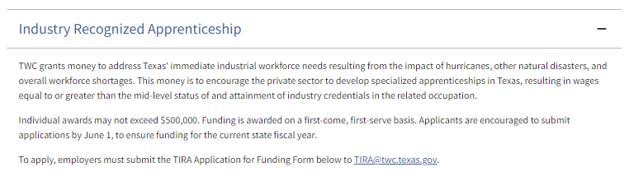
Texas Industry Recognized Apprenticeship
(TIRA) 5 of 9

Slide 11

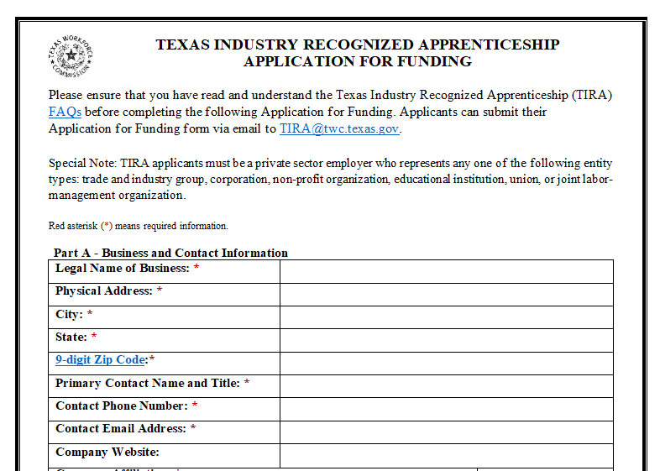
Texas Industry Recognized Apprenticeship
(TIRA) 6 of 9
ONLY 4 Pages

Slide 12
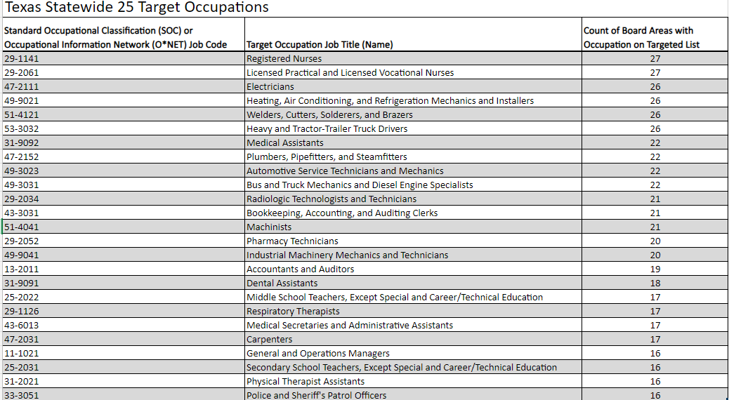
Texas Industry Recognized Apprenticeship
(TIRA) 7 of 9
Private Sector Employers Only

Slide 13
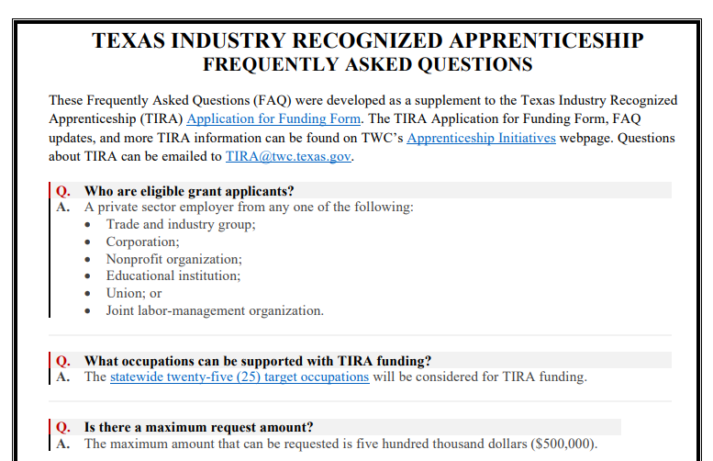
Texas Industry Recognized Apprenticeship
(TIRA) 8 of 9

Slide 14
Texas Industry Recognized Apprenticeship
(TIRA) 9 of 9
Summary of Frequently Asked Questions:
Applications from Private Sector Employers only
Maximum amount of Award $500,000
Maximum cost of training per apprentice (participant) $10,000 (must be reasonable)
Training Program length 26 weeks or less
Apprentice (participant) must
  Be full-time employee during training.
  Remain employed full-time for 12 consecutive months after the completion of training
  Earn a wage equal to or above the workforce area’s minimum self-sufficiency wage level.
  Obtain Industry Credential in related occupation
Application submission TIRA@twc.texas.gov
INTERESTED ?????
Reach out to TIRA@twc.texas.gov
  Our Apprenticeship TEAM is waiting

Slide 15
What is registered apprenticeship 2 of 2
TEXAS style
What is Apprenticeship?
Registered Apprenticeship is an employer-driven talent development model that combines on-the-job learning with related classroom instruction. Apprentices earn and learn at the same time. It is a proven solution for businesses to recruit, train, and retain highly skilled workers.
College Credit Crosswalk
PAID JOB
EDUCATION
CREDENTIALS
Apprentices earn a competitive wage from day one
Structured learning and on-the-job training help apprentices advance professionally
Upon completion apprentices receive a national industry recognized credential
Minimum 1 year program – up to 5 years

Slide 16
Registered Apprenticeship
Department of Labor – Office of Apprenticeship
  Multiple Funding Opportunities
    Texas Education Code – Chapter 133 (Texas Legislature Funded)
      Related Classroom Training
      Pre-Apprenticeship Pathways
      Transitioning Veterans to Apprenticeship
    Apprenticeship Tax Refund Pilot Program
    Apprenticeship Expansion – Department of Labor Grant Funding
      Request for Application (RFA) – as funding available
      Critical Skills
      Healthcare

Slide 17
Registered Apprenticeship
    Texas Education Code – Chapter 133 (Texas Legislature Funded)
      Related Classroom Training
      Pre-Apprenticeship Pathways
      Transitioning Veterans to Apprenticeship

Slide 18
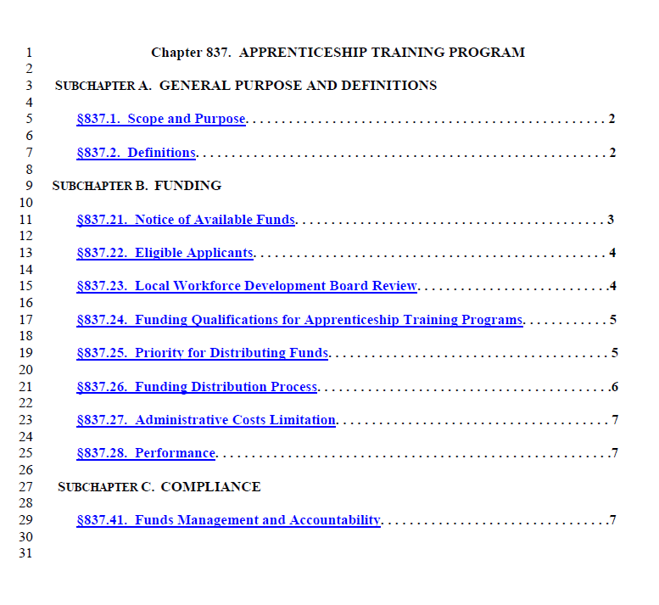
Texas Education Code, Chapter 133 overview
Texas Education Code - Chapter 133 - Overview
Texas Workforce Commission Rule – Chapter 837

Slide 19
Registered Apprenticeship

Slide 20
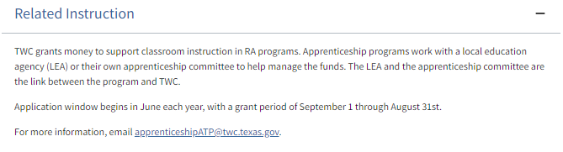
Registered Apprenticeship 2 of 2
    Texas Education Code – Chapter 133 (Texas Legislature Funded)
    Related Classroom Training
Eligible Applicants are Local Education Agencies or Apprenticeship Committees

Slide 21
Pre-Apprenticeship

Slide 22
Pre-Apprenticeship Pathways

Slide 23


TWC Logo

Slide 24
Apprenticeship Expansion

Slide 25
Critical Skills Apprenticeships

Slide 26
Healthcare Apprenticeships

Slide 27


State Apprenticeship Expansion
Funding at a Glance (TWC DOL Awards 2016 – 2021)
$27.9 Million
(Expires 06.30.25) 6
State Apprenticeship Expansion, Equity and Innovation
$10,000,000
2,000 New Apprentices
40 New RAPs
60 Expanded RAPs
200 Engagements
600 Pre-Apprentices
304 Completers
$15.00 Median Earnings
(Expires 06.30.24) 5
State Apprenticeship Expansion
$9,450,000
4,821 New Apprentices
30 New RAPs
50 Expanded RAPs
7 New Youth RAPs
500 Pre-Apprentices
1,748 Certificates
(Expires 06.30.23) 4
Apprenticeship State Expansion
$5,441,041
2,061 New Apprentices
33 New RAPs
66 Expanded RAPs
300 Pre-Apprentices
60% Capacity Bldg.
2 & 3
State Apprenticeship Expansion
$2,874,430
1,902 New Apprentices
30 New RAPs
60 Expanded RAPs
750 Engagements
1
ApprenticeshipUSA State Accelerator
$200,000
State Apprenticeship Expansion Plan

Slide 28

By the numbers, rounds 2 and 3
State Apprenticeship Expansion By the Numbers
State Apprenticeship Expansion | Rounds 2 & 3
Deliverables (Ending 4.30.2021) | Target | Performance | Percent of Target
Employer Engagements | 750 | 752 | 100%
Number of New Registered Apprentices | 1,902 | 2,948 | 154%
Number of New Registered Programs | 30 | 32 | 107%
Number of Expanded Registered Programs | 60 | 79 | 132%
Number of Women in Apprenticeship | 60 | 544 | 907%

Slide 29
By the numbers, round 4
Apprenticeship Sate Expansion By the Numbers
Apprenticeship State Expansion | Round 4
Deliverables (As of 12.31.22) Grant Expires 06.30.23 | Target | Performance | Percent of Target
Pre-Apprentices | 300 | 406 | 135.33%
Number of New Registered Apprentices | 2,061 | 2,447 | 118.72%
Number of New Registered Programs | 33 | 41 | 124.24%
Number of Expanded Registered Programs | 66 | 72 | 109.09%
Capacity Building | 60% | 45% | 76.67%

Slide 30
By the numbers, rounds 5 and 6
State Apprenticeship Expansion Funding Specific to (TWC DOL Awards 2020 – 2021)
Current Activity Toward Deliverables
34 Contracts Initiated
Commission Initiatives
  Critical Skill
    $4 Million Commitment
      $2 Million WIOA Statewide
      $2 Million Apprenticeship Expansion
      $4,000 Cost Per
      1,000 Apprentices Trained
  Healthcare
    $15 Million Commitment
      $10 Million WIOA Statewide
      $5 Million Apprenticeship Expansion
      $6,000 Cost Per
      2,500 Apprentices Trained
(Expires 06.30.25) 6
State Apprenticeship Expansion, Equity and Innovation
$10,000,000
2,000 New Apprentices
40 New RAPs
60 Expanded RAPs
200 Engagements
600 Pre-Apprentices
304 Completers
$15.00 Median Earnings
(Expires 06.30.24) 5
State Apprenticeship Expansion
$9,450,000
4,821 New Apprentices
30 New RAPs
50 Expanded RAPs
7 New Youth RAPs
500 Pre-Apprentices
1,748 Certificates

Slide 31
Funding awards
State Apprenticeship Expansion Funding Specific to (TWC DOL Awards 2022)
Current Activity Toward Deliverables
Request for Application for $1.5 Million
  Closed February 7, 2023
  Approved to fund 10 projects totaling $2,137,213
    Deliverables well under way with these contracts
  Eligible Applicants
    Workforce Boards
    Community College
    Education Service Centers
Note: RFA was open to supporting K-12 Teacher Registered Apprenticeship
(Expires 06.30.26) 7
Apprenticeship Building America
$3,660,090
900 New Apprentices
40 New RAPs Developed
10 Expanded RAPs
400 of the 900 New Apprentices from - Underrepresented Populations
400 Employer Engagements
$31.6
Million
DOL Apprenticeship Expansion Opportunity for $2.2 Million should be awarded late June 2023

Slide 32


Apprenticeship navigators
Apprenticeship Navigators

Slide 33





Roles & Responsibilities
Currently, there are 23 Apprenticeship Navigators, and you will see the distribution across TEXAS on the next slide. Their responsibilities include:
Facilitating the creation and expansion of Registered Apprenticeship Programs
Creating more apprentices
Creating more pre-apprentices
Engaging with employers
Increasing diversity
WHAT IS AN APPRENTICESHIP
NAVIGATOR?
Coordinating stakeholder roundtable events
Organizing local recruitment and awareness events

Slide 34
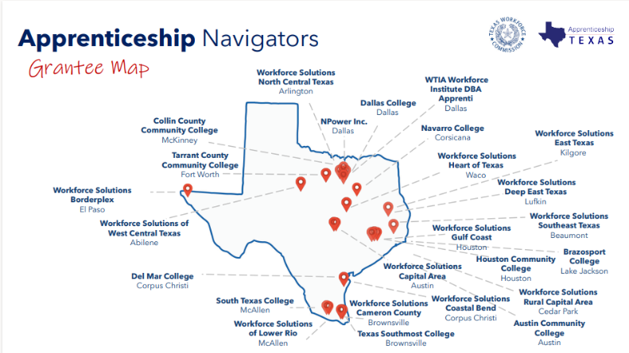
Grantee Map

Slide 35
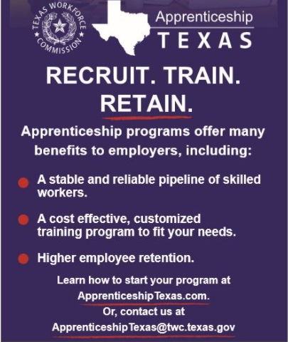

Employer Benefits

Slide 36
Texas Workforce Commission
Registered Apprenticeship
  Currently Approved
              Computer Programmer
              Paralegal
              Data Analyst
              Cyber Defense Incident Reporter

Slide 37
Apprenticeship Tax Refund Pilot Program

Slide 38
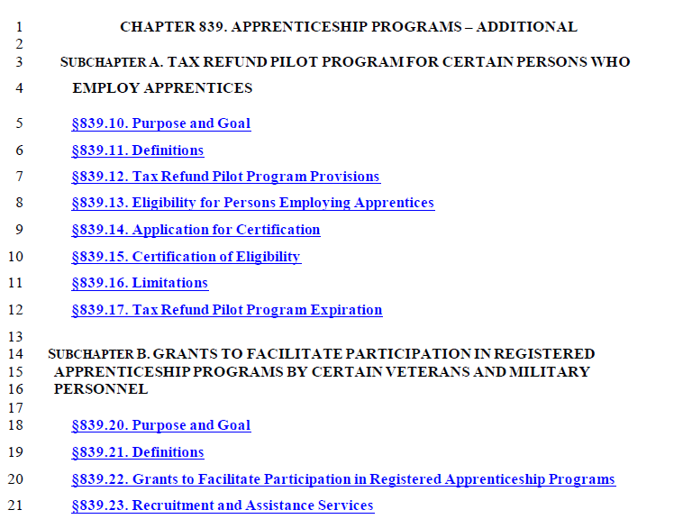
Texas tax refund
Texas Tax Refund Pilot and Veterans Transition
Texas Workforce Commission Rule – Chapter 839

Slide 39

Save the Date

Slide 40
Program overview 2 of 2
THANK YOU!
ApprenticeshipTexas@twc.texas.gov

