Slide 1
Adult Education and Literacy Advisory Committee
March 26, 2025 @ 1:30 pm
Virtual Meeting

Slide 2
Agenda
TWC Welcome/Opening Remarks
AEL Updates
Texas Workforce Investment Council Adult Education Demographic Report
Outline Strategic Plan Organization
Overview of First System Strategy Area
Committee Business and Discussions
Consider and Discuss Strategic Plan Organization
Discuss System Strategy Area

Slide 3
Welcome and Remarks
Commission Office Representing Labor
Commissioner Alberto Trevino III
Commission Office Representing Employers
Commissioner Joe Esparza

Slide 4
Presiding Officer
Jauneen Maldonado
AEL Director, Workforce Solutions Tarrant County

Slide 5
Roll Call –Presiding Officer
Member | Location | Representing | Affiliation
Jauneen Maldonado | Fort Worth | Workforce Board | Director, Adult Education, Workforce Solutions for Tarrant County
Ernest Lewis | Houston | Nonprofit | Vice President of Community Impact, Baker Ripley
Leslie Cantu | San Antonio | Business | Assistant Vice President of Administration, Toyotetsu
Dr. Ben Stafford | Port Arthur | Community College/Higher Education | Vice President, Workforce and Continuing Education, Lamar State College—Port Arthur
Cindy Fisher | Austin | State Broadband Office | Broadband Senior Program Coordinator, Texas Broadband Office
Kristina Hartman | Huntsville | Corrections Education | Superintendent, Windham School District
Karla Flanagan | Waco | Technical College | Associate Vice Chancellor of Instructional Alignment and Innovation, TSTC
Kevin Rose | Mount Pleasant | Higher Ed | Sr. Vice President for Student Success, Northeast Texas Community College
Chris Tovar | Odessa | Higher Ed | CPR AHA Faculty Instructor, Continuing Education, Odessa College

Slide 6
Adult Education Updates
Director, Mahalia Baldini
Adult Education and Literacy (AEL)

Slide 7
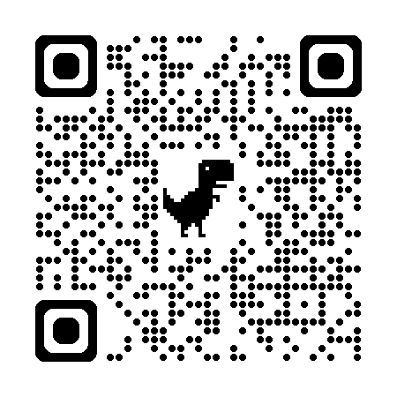
Texas Workforce Investment Council
Adult Education and Literacy Demographic Report

Slide 8
Organization of New AEL Strategic Plan
Fiscal Years 2027-2031

Slide 9
Align with Texas Workforce Investment Council (TWIC) Report
TWIC “establishes the framework for budgeting and operation of the workforce system programs administered by the agencies represented on the Council” (Texas Government Code §2308.104)
The Texas workforce system strategic plan contains goals that the Council and its planning partners use to create actionable objectives to meet the vision and mission of the system (Accelerating Alignment PY2024-2031, p. 15)

Slide 10
TWIC System Goals Areas
Employers
Learners
Agency Partners
Policy and Planning
Notes:
Ensures these system goal stakeholders are at the center of the strategic plans.

Slide 11
Organization: TWIC’s System Goals
Each System Goal Area includes:
Goal
Objective
Strategy
Agency Actions

Slide 12
Proposed TWC AEL System Areas
Learners
Partners
Employers
Notes:
Ensures AEL’s stakeholders are at the center of our strategic plan and the grantees’ efforts/services.

Slide 13
Continuous Connection
Learners
(Students/clients)
Partners
(other agencies, non-profits, stakeholders)
Employers
(entities that employ Learners)

Slide 14
Organization: AEL’s Strategic Plan
Each System Area Includes:
System Strategy
BIG 3 System Objectives
Action Items
Once we develop all the Action Items, we can determine a few core systemwide metrics that help us measure progress on the BIG 3 system objectives

Slide 15
Each System Area Has Same Objectives
System Area: Learners | System Strategy: Increase Workforce, Secondary and Post Secondary Education and Training Options and Outcomes for Adult Learners
System Objective: Improve Program Effectiveness Through Quality Outcomes | Action Items
System Objective: Address Demand By Expanding Access | Action Items
System Objective: Increase Alignment and Coordination | Action Items
However, the Action Items will be specific to the System Strategy.

Slide 16
Metric Development
Will develop metrics after looking at all System Areas
One or two metrics per System Area?
One or two holistic metrics for Strategic Plan as a whole?

Slide 17
Questions?

Slide 18
Committee Discussion
Putting Recommendations Into Action

Slide 19
Discussion Topics
Strategic Plan System Areas
Categories within System Areas
System Strategies
System Objectives
Action Items

Slide 20
Learners: students/clients
System Strategy:
Increase Workforce, Secondary and Post Secondary Education and Training Options and Outcomes for Adult Learners.

Slide 21
Partners: other agencies, nonprofits, stakeholders
System Strategy:
Build and expand system partners' capacity, responsiveness, and support for a unified system that improves outcomes for adult learners.

Slide 22
Employers: entities that employ the workforce AEL prepares
System Strategy:
Provide relevant education and training programs that meet the evolving needs of employers.

Slide 23
Review/Discuss Action Items
Reviewing Action Items in Learners System Area only at this time

Slide 24
System Objective
System Area: Learners
Action Item:
Develop and implement a robust career and college navigation and advising program tailored to AEL student needs
Other recommendations?
Improve Program Effectiveness Through Quality Outcomes

Slide 25
System Objective
System Area: Learners
Action Item:
Expand Recruitment for special populations, including Internationally Trained Professionals, Second-Chance Individuals, and Opportunity Youth.
Other recommendations?
Address Demand By Expanding Access

Slide 26
System Objective
System Area: Learners
Action Item:
Coordinate with TEA on marketing campaigns for HSE voucher program.
Other recommendations?
Increase Alignment and Coordination

Slide 27
Request Before Next Meeting
TWC will send out an email before the next meeting. Review the Action Items for the System Area: LEARNERS
By our next meeting on June 25th:
Think about final recommendations for this system area
You can submit your recommendations ahead of time to Nicole.Stevens@twc.Texas.gov or bring them with you to the meeting.

Slide 28
Questions?

Slide 29
Next Meeting
Wednesday, June 25th, 2025
At 1:30pm

