Slide 1

Education and the Child welfare system: what does the data tell us?
Presented by:
Felicia Penn and Hollye Pickett, Department of Family and Protective Services
Dr. LaTrenda Watson, Texas Education Agency
Dr. Toni Watt, Education Reach and Texas State University

Slide 2

Education Matters Slide and Presenters
Presenters:
Felicia Penn
Hollye Pickett
Department of Family and Protective Services

Slide 3
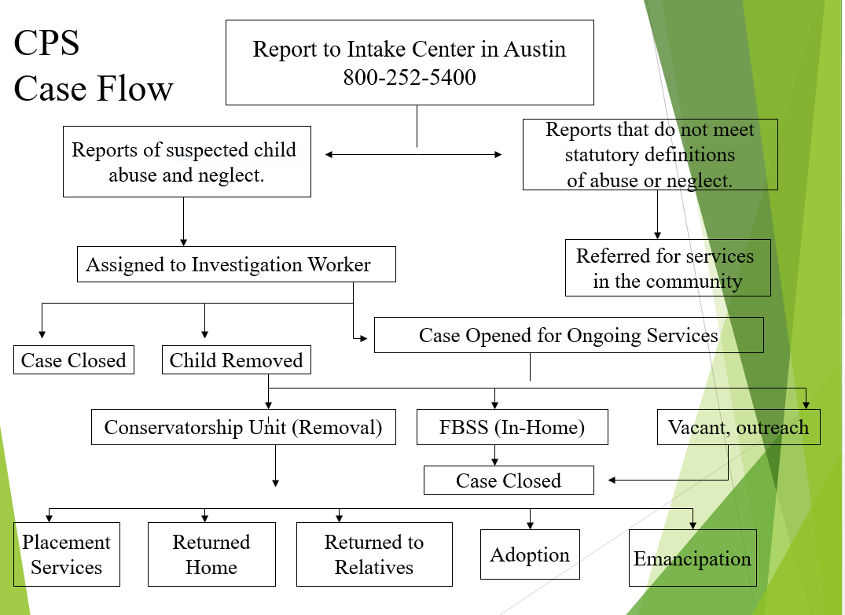
CPS Case Flowchart Slide

Slide 4

Types of Placements
Kinship Home
Foster Home
Residential Treatment Facility
Emergency Shelter

Slide 5


Ever Wonder?
Where am I going/who is going to take care of me?
Will I see my family again?
Do I have to change schools?
Will I see my friends?
Will everyone know I am in foster care?

Slide 6

THE DATA HAS SHOWN….
1 out 5 youth in foster care attend 3 or more schools in one school year
Youth in Foster care school instability is higher than homeless and military children
Youth in Foster care are retained at higher rates than other youth
Youth in Foster care are 4 times more likely to drop out of high school
Youth in Foster care in Texas are 3 times more likely to receive special education services (Emotional Disturbance 31% primary diagnosis)
Youth in Foster care are 4 times more likely to be placed in a Disciplinary Alternative Education Program (DAEP) & Juvenile Justice Alternative Education program (JJAEP)
Foster care youth are 2 times more likely to be expelled

Slide 7


Outcome Image Slide For Case Management
Better Data
Stronger Federal/State Laws
Increase Education Stability
Better Educational Outcomes

Slide 8

How can schools help us be successful?
Enroll us Immediately
Please keep my foster care status on a need to know basis
Please help ensure that I receive my free breakfast/lunch immediately
Please request may records thru Trex
Please help me feel welcomed
Please contact your district Foster Care Liaison for questions regarding foster care

Slide 9

Special Education (SPED)
FUNKY TUNES

Slide 10

Put Initial Request for Evaluation in Writing
15 Calendar Days
Provide parent consent or Prior Written Notice (PWN)
45 School Days
Conduct Full Evaluation (FIE)
30 Calendar Days
Hold ARD to review FIE

Slide 11
Special Education Process Slide 1
Step 1: a parent, teacher, or other professional may request for the student to be tested (send request to principal and school diagnostician, some schools may use counselors to handle referrals)
  Response to Intervention (RTI) cannot be used to delay or deny an evaluation for special education.
Step 2: Notice of Rights and Consent for Services – district must provide notice of the steps the school wants to take or not take
  Prior Written Notice – this is if the school will be evaluating, provided within 15 school days
    Parents must sign the consent form in order for the evaluation process to proceed
  Notice of Action Refused or Prior Written Notice of refusal – this is if the school will not be evaluating
IDEA Manual, 2018

Slide 12
Special Education Process Slide 2
Step 3: Full and Individual Initial Evaluation (FIIE) – determines eligibility for special education services as well as identifies a disability. Must be completed no later than 45 school days (there are variations depending on when consent was signed).
  Answers: does a student have a disability AND what special education and related services are needed as a result of the disability.
  NOTE: consent for evaluation is not consent for services.
Step 4: The ARD Meeting – must be held no more than 30 days after the initial evaluation is completed. During the meeting the IEP is developed.
  Notice of the meeting is provided 5 days in advance, parent can agree to a shorter timeframe
  ARD Meetings should be held once a year.
IDEA Manual, 2018

Slide 13
Special Education Process Slide 3
Step 5: The IEP – this written plan/agreement between the school and parents will be developed and reviewed at least annually.
Step 6: After the Meeting – parent will receive reports that they will need to review to determine if progress is being made or if changes need to be requested during the next ARD/IEP. Parents may request parent/teacher conferences and/or request additional ARD meetings.
IDEA Manual, 2018

Slide 14
More information about ARD meetings
Parents/guardians are allowed to waive a 5 day notice for ARD meetings (i.e. have the meeting sooner), however, this is not advisable for our kids because we also have to notify the other parties.
Parents/guardians may ask for the meeting to be rescheduled to a time that is more convenient to avoid the ARD meeting proceeding without them.
Parents/guardians do have a choice of taking the IEP home to review before agreeing and signing but the school may implement it within 10 days if it is not returned by then.
Copies of the ARD should be provided to all attendees.
IDEA Manual, 2018

Slide 15

DFPS connecting with TWC
Youth & Student Services
Having a disability could results in substantial barriers to employment.
When students are eligible for and receiving special education or related services under the federal Individuals with Disabilities Education Act, or is an individual with a disability for purposes of §504 of the Rehabilitation Act; DFPS is able to receive help in preparing for post-secondary education and employment opportunities through the following individualized services.
Services are based on eligibility and your individual need, and are provided in collaboration with the DFPS, family, high school, community college, or Educational Service Center.

Slide 16



Partnerships Slide
Bring TWC to the planning table with an invite to the transition ARD
When we talk about the transition from childhood to adulthood, the word “plan” comes up a lot. There’s an education plan, a medical plan, planning your child’s income and signing up for services, planning for housing, planning to make sure your children are legally protected, planning for a career, planning a social life, and more….

Slide 17

Thank You
With support and understanding, I can be successful and reach my goals…

Slide 18
Texas Workforce Commission Conference
April 2023

Slide 19
Presenter
LaTrenda Watson, Ed.D.
Highly Mobile State Coordinator
Highly Mobile and At-Risk Student Programs
Phone: 512-463-9414
Email: LaTrenda.Watson@tea.texas.gov
Copyright ©Texas Education Agency, 2023. All rights reserved.

Slide 20


Highly Mobile and At-Risk Student Programs Division
Military Connected
Students
Homeless Children & Youth
Child Abuse & Neglect
Pregnancy Related Services
Foster Care & Student Success
Purpose: To increase awareness, build capacity, and improve TEA supports, resources and tools available for schools to address the unique needs and statutory requirements of highly mobile and at-risk students.
We are committed to improving the school experience and education outcomes of all highly mobile and at-risk students in Texas public schools.
Copyright ©Texas Education Agency, 2023. All rights reserved.

Slide 21
Overview of Foster Care & Education

Slide 22
Students in Foster Care
Foster Care, or out-of-home care, is the system that a child enters when a child cannot live safely at home and a court of law grants custody to the state of Texas.
Conservatorship is a term used in the Texas Education Code and by Department of Family Protective Services to describe the status of a child who is placed in DFPS legal custody by a court order.
Conservatorship:
Temporary or Permanent
Copyright ©Texas Education Agency, 2023. All rights reserved.
Notes:
Note: Youth who turn 18 while in DFPS conservatorship have the option to enter into Extended Foster Care, a voluntary program that offers young adults turning eighteen in DFPS care the opportunity to continue FC placement and facilitate the transition to independence with DFPS supervision.

Slide 23

Students in Foster Care in Texas Schools
There are approximately
15,000 school-aged students in Texas schools who are in foster care on any given day.
Copyright ©Texas Education Agency, 2023. All rights reserved.​
Notes:
Did you know?

Slide 24
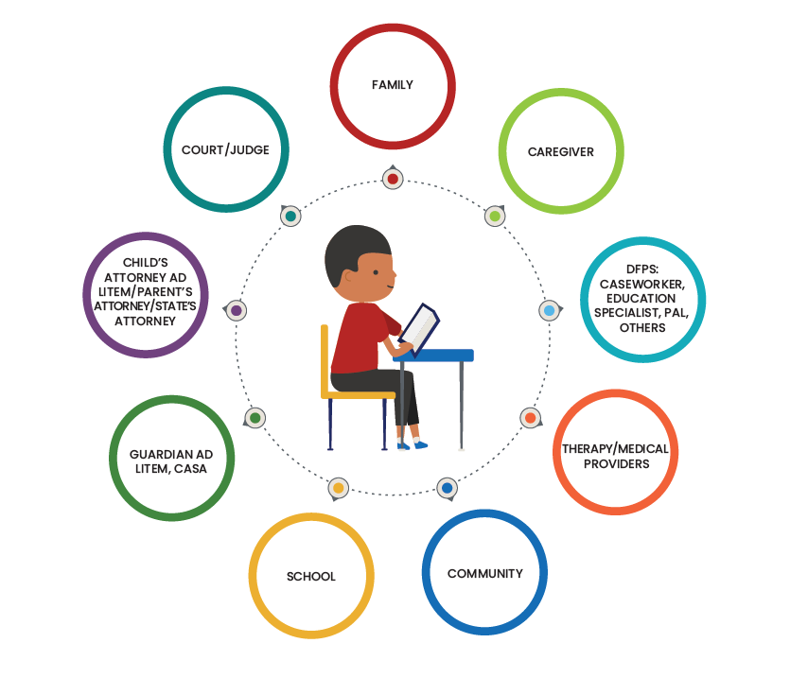
Wheel of Support
Copyright ©Texas Education Agency, 2023. All rights reserved.​
Notes:
Fix the wheel of support

Slide 25
Public Education Information Management System (PEIMS) Coding
Foster Care PEIMS Indicators - C196
0 Student is not currently in the conservatorship of the TX DFPS
1 Student is currently in the conservatorship of the TX DFPS
2 Pre-kindergarten student was previously in the conservatorship of the TX DFPS
3 Pre-kindergarten student is or ever has been in foster care in another state or territory, if the child resides in this state (Texas). TEC, §29.153(b).
Copyright ©Texas Education Agency, 2023. All rights reserved.​

Slide 26
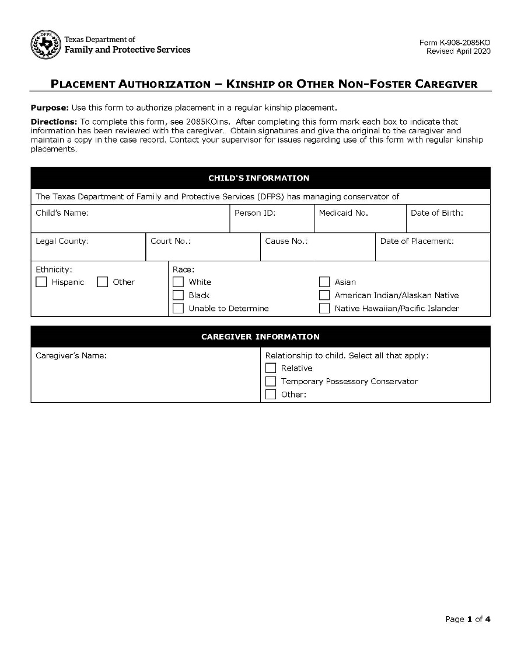
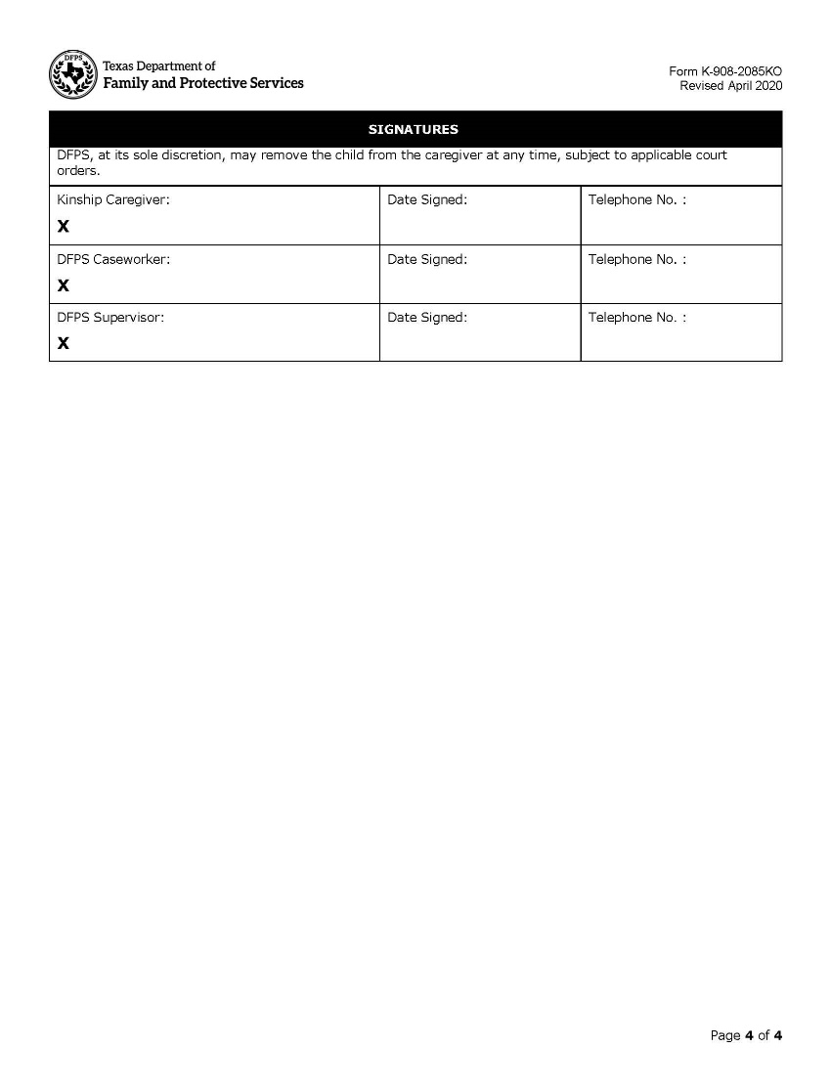
Placement Authorization 2085
All forms in the 2085 series:
Kinship or Other Non-Foster Caregiver - 2085 KO
Legal Risk - 2085 LR
Foster Care/Residential Care - 2085 FC
Copyright ©Texas Education Agency, 2023. All rights reserved.​

Slide 27
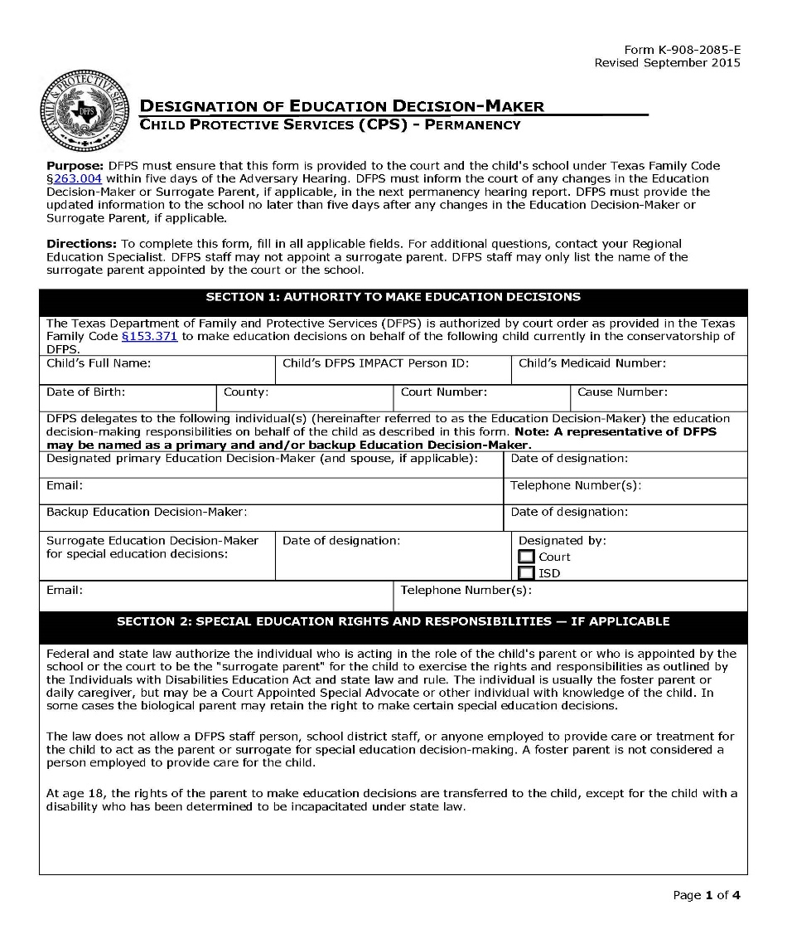
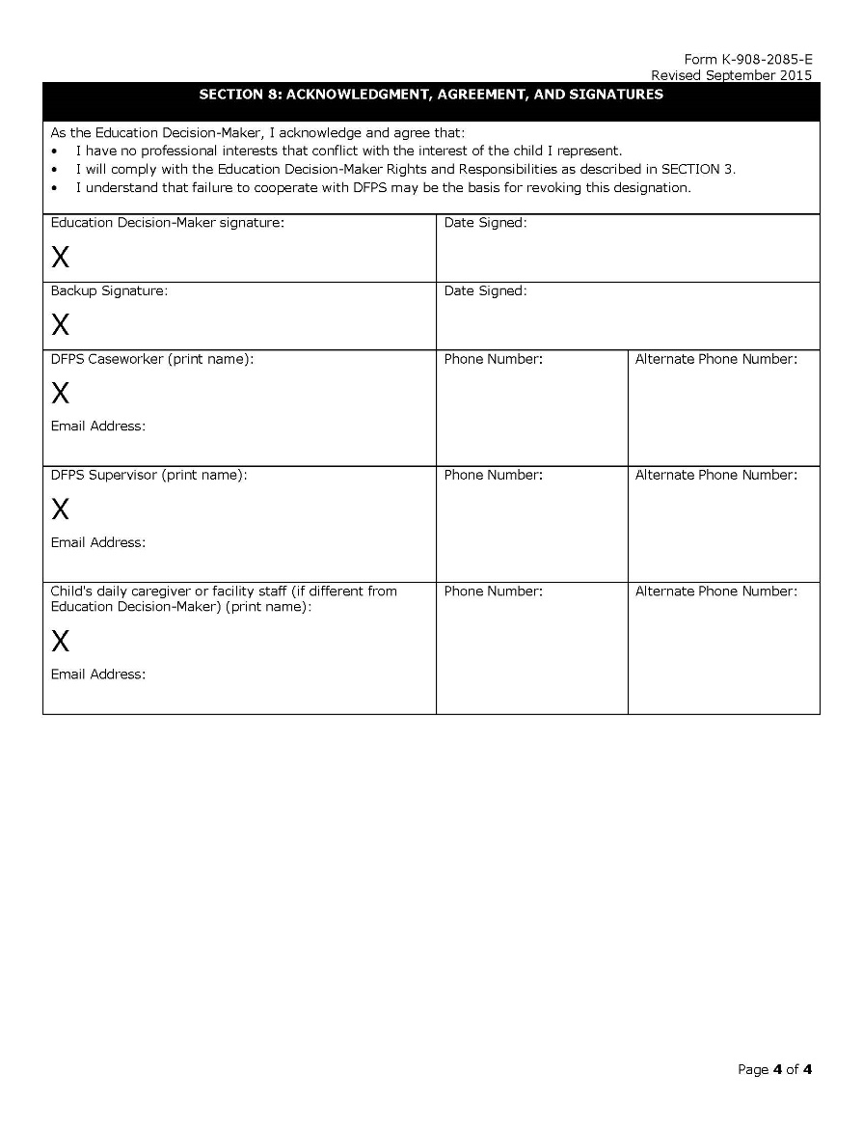
Educational Decision Maker Form – 2085E
Copyright ©Texas Education Agency, 2023. All rights reserved
Notes:
4 page form: front & back page pictured

Slide 28
Foster Care and the Law

Slide 29
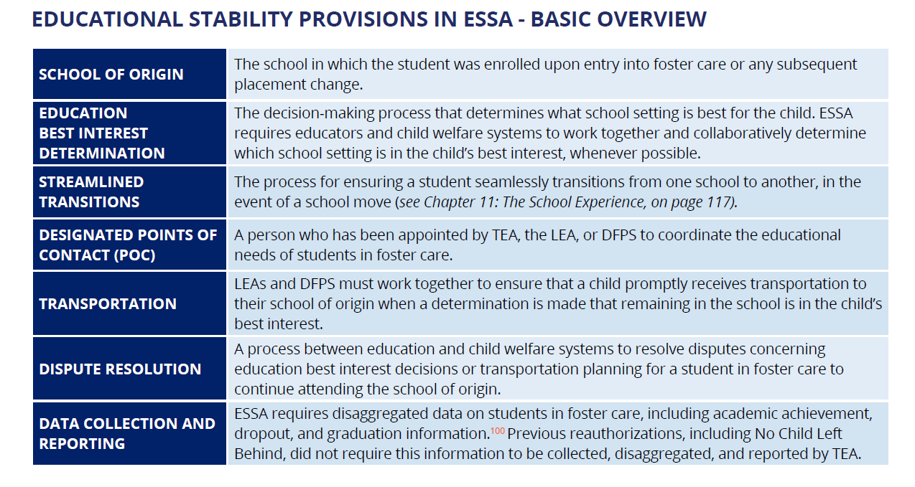
Foster Care/Every Student Succeed Act (ESSA), 2016
Foster Care and Student Success Guide 2022, Chapter 8 ESSA, page 89
Copyright ©Texas Education Agency, 2023. All rights reserved.​

Slide 30
Texas Education Code Slide 1
TEC § 7.029
Data Sharing & Collection requirements
TEC § 25.001 (g)
Attendance when placed outside school zone
TEC § 25.001 (g-1)
Attendance in that school zone regardless of DFPS managing conservatorship
TEC § 29.153(6)(B)
Free pre-kindergarten eligibility to children who are or have been in foster care in another state or territory and reside in Texas
Copyright ©Texas Education Agency, 2023. All rights reserved.

Slide 31
Texas Education Code Slide 2
TEC § 25.007
Transition Assistance Requirements
TEC § 25.087
Excused absences for court-ordered appointments
TEC § 33.904
District & Charter Foster Care Liaison designation, tracking & training requirements
TEC § 54.366
Free college tuition & fee waiver
Copyright ©Texas Education Agency, 2023. All rights reserved.

Slide 32
Foster Care Liaison Requirement
Texas Education Code Sec. 33.904
LIAISON FOR CERTAIN CHILDREN IN CONSERVATORSHIP OF THE STATE
(a) Each school district and open-enrollment charter school shall:
2) submit the liaison's name and contact information to the agency in a format and under the schedule determined by the Commissioner.
(1) appoint at least one employee to act as a liaison officer to facilitate the enrollment in or transfer to a public school or open-enrollment charter school of a child in the district or area served by the charter school who is in the conservatorship of the state; and
(b) The agency shall provide information to the liaisons on practice for facilitating the enrollment in or transfer to a public school or open-enrollment charter school of children who are in the conservatorship of the state.

Slide 33
Texas Administrative Code Slide 1
19 TAC 89 FF Subchapter FF: Transition Assistance for Highly Mobile Students Who are Homeless or in Substitute Care
§89.1603. Transfer of Student Records and Transcripts
§89.1605. Development of Systems to Ease Transitions and Establish Procedures to Lessen the Adverse Impact of Movement of a Student
§89.1607. Evaluation of Student Records for Students Who are Homeless or in Substitute Care
§89.1609. Placement in Educational Programs and Courses
Copyright ©Texas Education Agency, 2023. All rights reserved.

Slide 34
Texas Administrative Code Slide 2
19 TAC 89 FF Subchapter FF: Transition Assistance for Highly Mobile Students Who are Homeless or in Substitute Care
§89.1611. Promotion of Access to Educational and Extracurricular Programs
§89.1613. Promotion of Postsecondary Information
§89.1615. Provision of Special Education Services
§89.1617. Notice to Student’s Educational Decision-Maker and Caseworker.
Copyright ©Texas Education Agency, 2023. All rights reserved.

Slide 35
Data

Slide 36

Context
Total Foster Care Students:
14,183
2021-2022 PEIMS Data
Under Identified
28,753 in DFPS Conservatorship 5-18 years of age
Sexual Abuse
Emotional Abuse
Physical Abuse
Labor and Sex Trafficking
Abandonment
Neglectful Supervision
Physical Neglect
Medical Neglect
RAPR-Refusal to Assume Parental Responsibility
Children in out of home placement for reasons of safety and protection:
Victims of abuse, neglect and exploitation
Court ordered removal intervention
In the Conservatorship of Texas Department of Family and Protective Service
Source: Texas Education Agency, PEIMS Standard Report Data 2021-2022
Source: DFPS Data Book- Children in DFPS Conservatorship in Fiscal Year 2021

Slide 37
Foster Care & Special Populations
PEIMS Fall Snapshot 2021

Slide 38

Graduation & Dropout Data
Students in Foster Care vs. Peers Statewide
90.0 %
Statewide
61.3 %
Foster Care
25.0 %
Foster Care
5.8 %
Statewide
Dropout Rate
2021
Graduation Rate
2021
Source: Grade 9 Four-Year Longitudinal Graduation and Dropout Rates, by Student Characteristic, Texas Public Schools, Class of 2021 p. 106
Notes:
Mandatory collection of data Due to the Every Student Success Act

Slide 39
Foster Care & Dropout Data
Copyright ©Texas Education Agency, 2023. All rights reserved.​
Notes:
All students in foster care – cross tabs data

Slide 40
Graduation
The Graduation Toolkit
House Bill (HB) 5
Foundation High School Program (FHSP) 22
Minimum High School Program (MHSP) 22
Recommended High School Program (RHSP) 26
Distinguished Achievement Program (DAP) 26
Financial Aid Application Graduation Requirement
Texas Education Code (TEC), §28.0256, beginning with students enrolled in 12th grade during the 2021-2022 school year, each student must do one of the following in order to graduate:
Complete and submit a Free Application for Federal Student Aid (FAFSA);
Complete and submit a Texas Application for State Financial Aid (TASFA); or
Submit a signed opt-out form.
Copyright ©Texas Education Agency, 2023. All rights reserved.​
Notes:
In 2013, the 83rd Texas Legislature established the new Foundation High School Program that allows students to receive endorsements in specific areas, as the default graduation program for all students entering high school beginning in 2014-2015.
- MHSP, RHSP, & DAP is only available for students who entered grade 9 before the 2014-2015 school year.
-Students must pass five end-of-course assessments to meet the testing requirements for graduation. Those tests cover Algebra I, English I, English II, Biology and U.S. History.

Slide 41
Foster Care & Graduation Plans
Students in Foster Care
Students in Texas
Copyright ©Texas Education Agency, 2023. All rights reserved.​
Notes:
Cross-tabs data: all students in foster care

Slide 42
Promoting High School Graduation
School staff should would work with students to identify high school completion and credit recovery supports that help students make progress towards graduation.
School staff should work with students & caregivers to determine the appropriate high school graduation plan and to ensure challenging, engaging coursework that will prepare them for college, career, or the military.
Academic monitoring is essential to the success of students in foster care. District and campus staff should develop a data-driven system that will facilitate and drive positive student experiences & academic outcomes.
Copyright ©Texas Education Agency, 2023. All rights reserved.​

Slide 43

Career and Technical Education (CTE) & Students in Foster Care
CTE introduces students to career fields and help them begin to build marketable skills & in some cases, earn credentials.
Post-secondary level, CTE provides an entry point for new or returning students to learn specific knowledge and specialized skills in a particular occupational field.
Texas CTE
Copyright ©Texas Education Agency, 2023. All rights reserved.​

Slide 44
Foster Care Resources

Slide 45

Post- Secondary Education
Education & Training Voucher (ETV) -
Federally funded and state-administered program for youth in foster care or those adopted from DFPS after turning age 16.
Students may be eligible to receive up to $5,000 in financial assistance per year to support them in reaching their post-secondary education goals.
Higher Education Foster Care Liaison –
Every public Higher Education Institution is required to have a Foster Care liaison to support students in foster care in higher education.
College Tuition & Fee Waiver -
Students in foster care may qualify for a lifetime tuition and fee waiver at any Texas state-supported institution of higher education, as long as the student enrolls in at least one college or dual credit before turning 25.

Slide 46
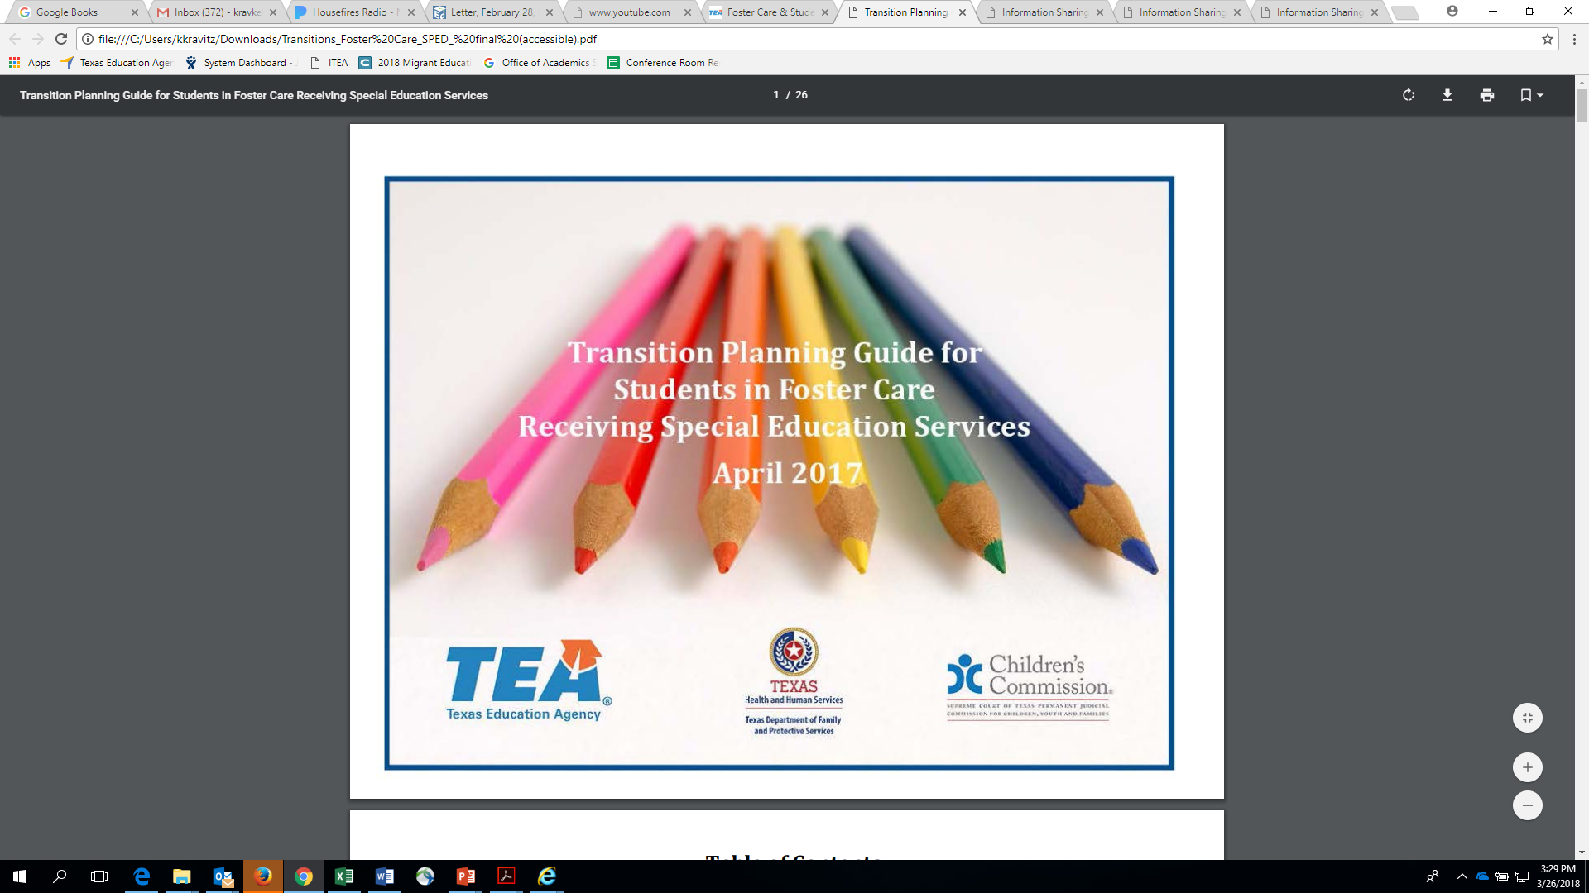
Transition Planning
Transition Planning Guide for Students in Foster Care Receiving Special Education Services
(PDF)
Crosswalk of education and DFPS required activities.
Recommendations for coordination and alignment across systems.
Copyright ©Texas Education Agency, 2023. All rights reserved.

Slide 47
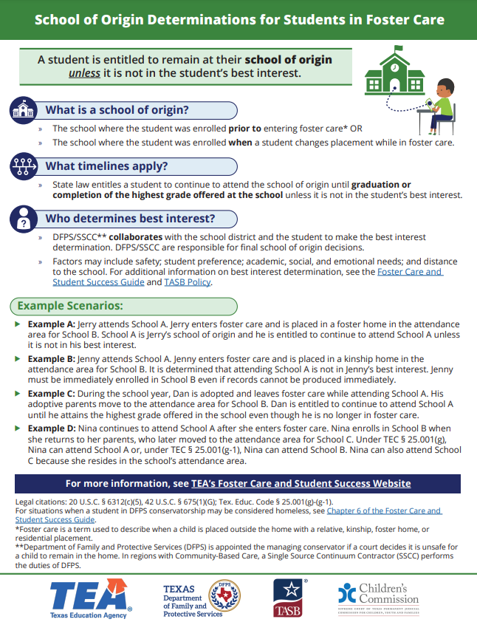
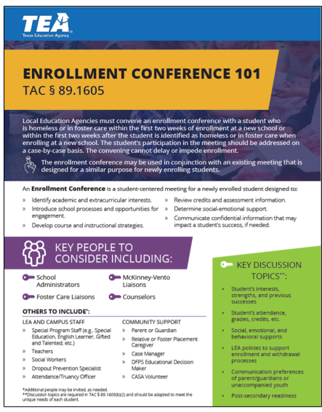
Resources
School of Origin Determination
Transition Assistance Toolkit
Copyright ©Texas Education Agency, 2023. All rights reserved.​
Notes:
Transition assistance toolkit & school of origin

Slide 48
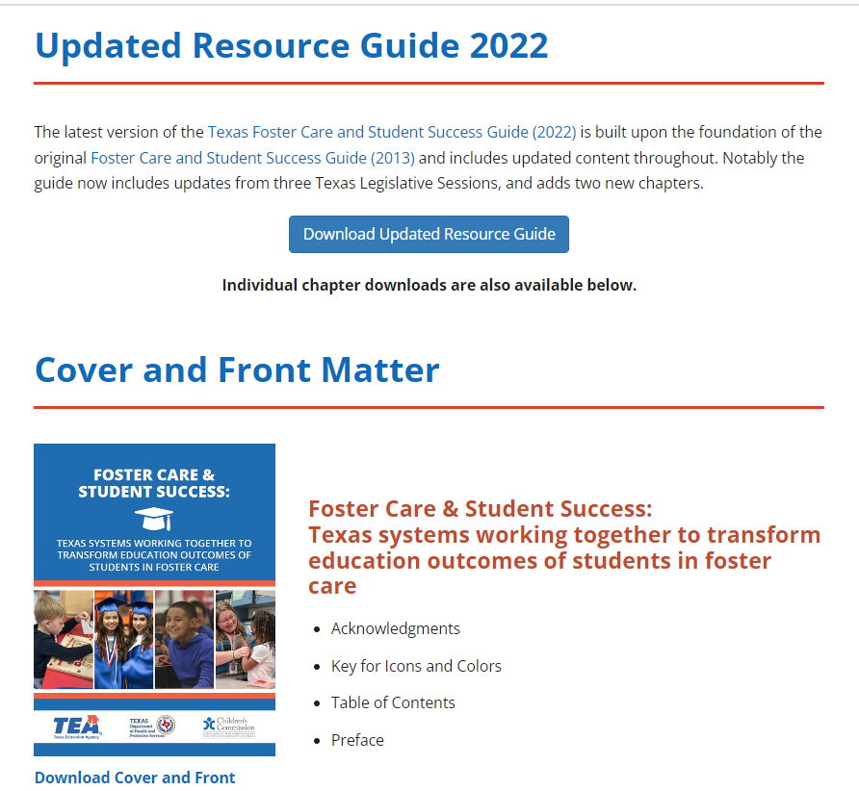
New Foster Care and Student Success Resource Guide Webpage

Slide 49
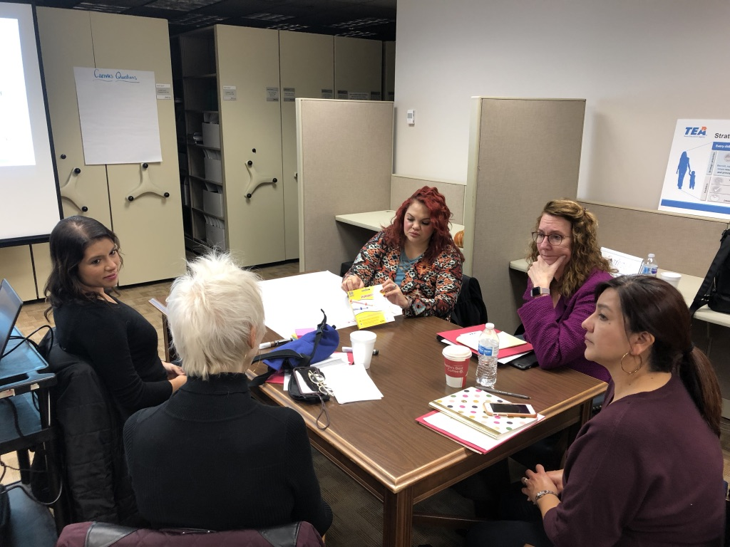
TEA Website Resources
Foster Care 101
Foster Care Guide Training Series

Slide 50
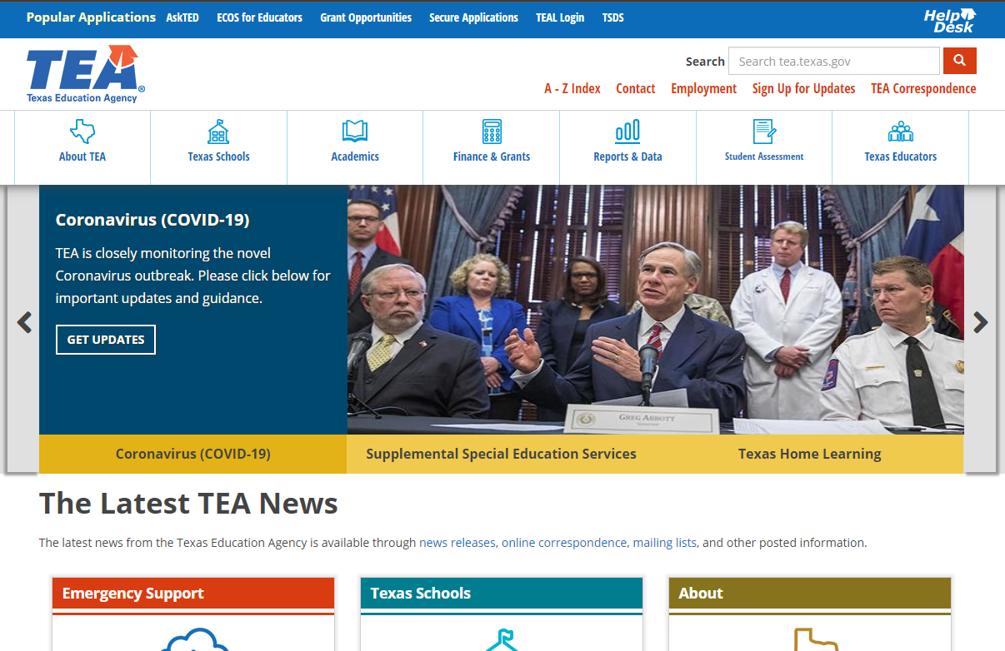
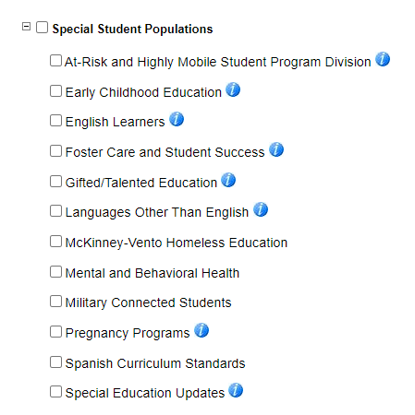
Sign Up for Updates!
Notes:
https://public.govdelivery.com/accounts/TXTEA/subscriber/new

Slide 51

Questions
If you have further questions: please email fostercareliaison@tea.texas.gov
Copyright ©Texas Education Agency, 2023. All rights reserved.

Slide 52

Post Secondary Ed Question Slide
Post-Secondary Education: What Does the Data Tell Us?
Presented by Research Committee of Education Reach for Texas
Chair: Dr. Toni Watt
Members: Christine Norton, Sheila Bustillos, Monica Faulkner, Elissa Madden, Megan Piel

Slide 53

National Data on Foster Youth Outcomes in Higher Education
Low Rates of Post-Secondary Participation & Achievement
  Enroll in Higher Education
    27% of youth who experienced foster care
    60% of general population
  Graduation rates of those who enroll in a four-year University
    26% of youth who experienced foster care
    56% of general student population
  Receive a Bachelor’s Degree (age 18-24)
    3% of youth who experienced foster care
    33% of all youth

Slide 54

Texas Data
Legislative Mandate for DFPS/THECB to track higher education outcomes
First data pull was in 2016
Sample of youth (n=3,855)
  Ever been in foster care in Texas
  Turned age 18 in 2008-2009
  Tracked from 18 to age 24

Slide 55
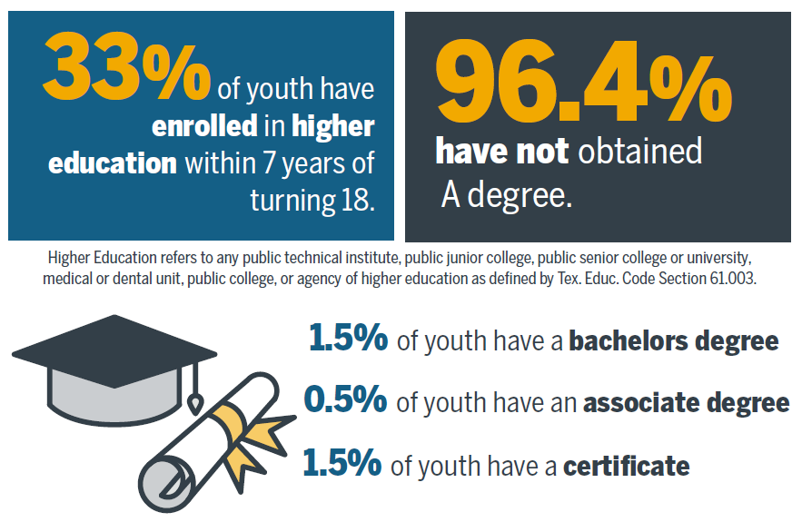
Higher Education Statistics Slide

Slide 56
Texas Data-Round II
Wavier Use and Benefit
Data
  Youth who were in foster care and turned 18 between 2009-2010 (n=4,263), tracked for six years

Slide 57
Enrollment Data

Slide 58
Use of Waivers Bar Graph Slide

Slide 59

Impact of Waiver Use
Former foster youth who used the tuition waiver are 3.5X more likely to graduate with a bachelor’s degree compared to former foster youth who did not use the tuition waiver.

Slide 60
Texas Data-Round III
Evaluation of Campus Support
  Specific attention to legislation requiring a foster care liaison on every campus
Grant from Greater Texas Foundation
Two Phase Study
  Describe quantity and quality of campus support in Texas (2020-2021)
    In-Depth Interviews with small sample of SEFC (n=8)
    Ethnographic content analysis of all campus websites (n=113)
    Online survey of all campus liaisons (response rate of 51%, n=58)
  Evaluate impact of campus support on higher education outcomes

Slide 61
Validation for Liaison Legislation
Students want and value a key point of contact/liaison
  “Often serving as a motivator, coach, organizer and connector of services, I think for me to have that kind of adult in your corner has been very instrumental in my success.”-SEFC
  Some students didn’t know they had a liaison available
  “No, I don’t have—I didn’t know what it was until you said anything.””-SEFC
  “No, no one has reached out to me, I haven’t heard anything about it.”- SEFC
  “I am totally alone”-SEFC

Slide 62
Findings from Website Analysis
Searching for Support
  Half (49%) of campuses have not complied with the legislative requirement to post liaison contact information on their websites
  One-third of campus websites report a campus support program for former foster youth
    Inconsistent offerings
    Little support for housing, social/personal relationships, and cultural/personal identities
      Only 13% of campuses have a student organization
  Websites often do not speak to SEFC but rather about them
    “SEFC need support” versus “We are excited you are here and want to meet you”

Slide 63
Findings from Liaison Survey 1

Slide 64

Findings from Liaison Survey 2
Foster care liaisons (96%) requested more training
One in four said administrators were unaware or unsupportive of their work
Liaisons are demographically dissimilar to the students they serve.
No liaison had lived experience in the foster care system

Slide 65
Preliminary Conclusions and Next Steps
Higher Education Outcomes for SEFC are low
The tuition waiver and liaison legislation have helped
More Needs to be done
  Facilitate tuition wavier access
  Support and evaluate liaison legislation-An unfunded mandate is not enough
    Many campuses have not complied with the legislation
    Those in compliance need more training and resources
    Legislated efforts need on-going evaluation
Next Steps
  Assessment of trends in higher education outcomes
  Evaluate the impact of campus support on higher education outcomes

Slide 66






Questions?

