Slide 1
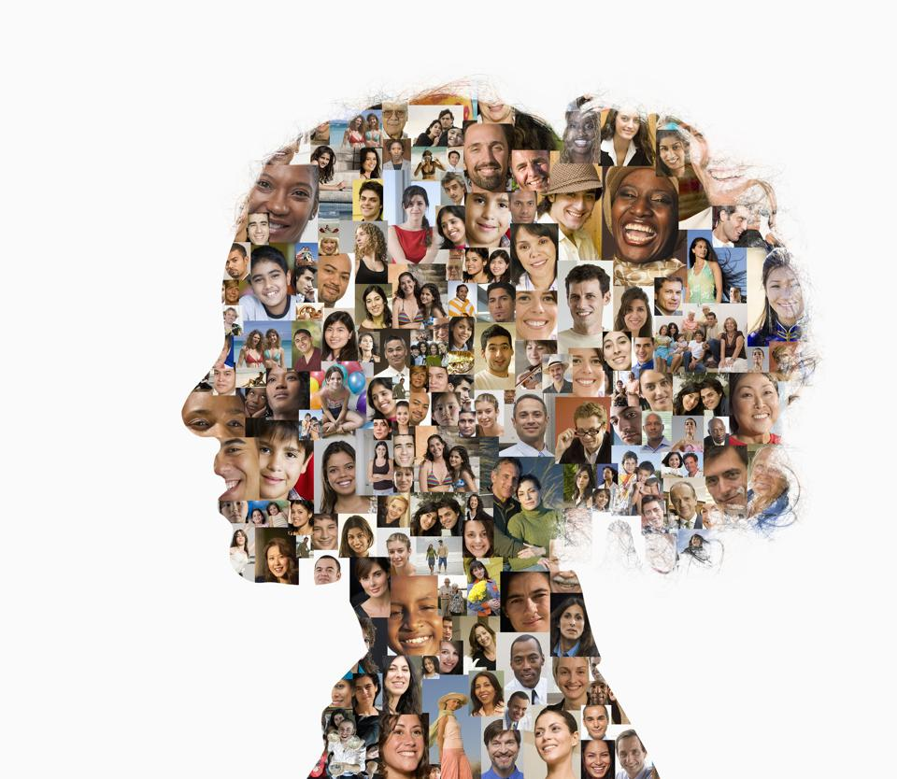
Engagement with Youth with Lived Experiences: How to Provide Trauma and Multiculturally Informed Care from a Social Justice and Affirming Lens
Dr. Carmen Cruz
Foster Youth Conference
April 7, 2023

Slide 2
Why do we need this?
Most people grew up exposed to biases, misinformation and stereotypes
Societies hurt and traumatize people
Cannot change our attitudes and behavior without experiential processes
Pandemic has worsened individual and collective trauma
Human connection

Slide 3
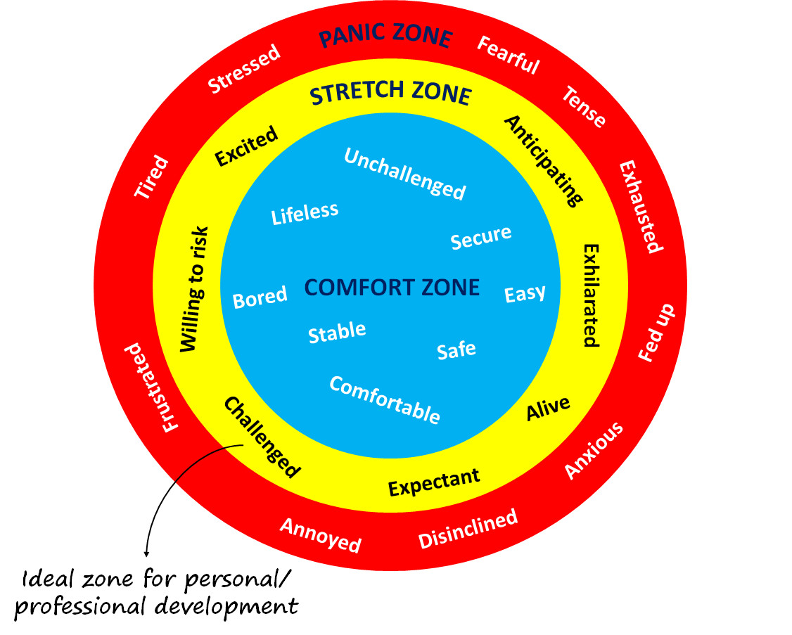
Safety vs. Comfort
Notes:
We always want safety in the group, but we don’t always want comfort. Discomfort happens at the learning edge of our comfort zones, where we are most likely to gain new understanding from our experiences. Conflict of understanding pushes our comfort zones and is a necessary and beneficial part of the dialogue process. It is our job as participants in this dialogue to turn conflict and discomfort into learning and growth for everyone. One of our first steps in this direction involves creating a safe environment where we can push our comfort zones and challenge ourselves to learn and grow.

Slide 4
Why me as a presenter?
Notes:
Psychologist for over 25 years. Have sat with so many TWU students in pain and struggle.
Mental health and identity trauma are two main things I’ve work in
Relational and interactive style
Want to be a role model
Led to my focus and purpose in being an educator, trainer, supervisor
Supervisor story of using his power over me
Power
Judgment
Macroaggression - “You started that club?”

Slide 5
The Impact of Cultural Climate and the Pandemic
IMPACT IMPACT
OF OF
CULTURAL PANDEMIC
CLIMATE
Reflect on how the 5-10 years or so have impacted you.
What are the first few descriptors you thought about?
Notes:
Before COVID, in college mental health, we already knew dep and anxiety were at the top compared to the past main issues for students.
Identity trauma and covid made everything worse.
Of course we are not well. Global pandemic makes it a *somewhat universal experience. Covid also showed the underbelly of USA esp health care and tx of minorities.
Our brains do not do well with ambiguity and fear.
While trauma is an individual experience, an ongoing global pandemic is traumatic for most, if not all of us.

Slide 6
The reality in helping professions
For many of us in the helping professions, the current social-political climate has sparked shock, fear, worry, anxiety, and anger for ourselves and for our clients and patients. Doing the work that we do, and within these social-political realities, can increase our propensity for stress, burn-out, vicarious trauma, compassion and oppression fatigue.
Notes:
http://www.irenegreene.com/

Slide 7
APA Stress in America Surveys
October 2022: Battered American psyche
October 2021: Stress and decision-making during the pandemic
March 2021: Unhealthy weight gains, increased drinking
2020: A National Mental Health Crisis (October/November)
2020: Stress in the Time of COVID-19
2019: Stress over the Election, Health Care and Mass Shootings
2019: Fear of Mass Shootings
2018: Stress and Generation Z
2018: Uncertainty about Health Care
2017: The State of Our Nation
2016: Many Americans Stressed about the State of Our Nation
2016: Technology and Social Media
2015: The Impact of Discrimination
2014: Health, stress and finances
2013: Are Teens Adopting Adults' Stress Habits?
Notes:
Since 2007, APA has commissioned an annual nationwide survey as part of its Mind/Body Health campaign to examine the state of stress across the country and understand its impact. The Stress in America™ survey measures attitudes and perceptions of stress among the general public and identifies leading sources of stress, common behaviors used to manage stress and the impact of stress on our lives. The results of the survey draw attention to the serious physical and emotional implications of stress and the inextricable link between the mind and body.
Concerned for the future, beset by inflation
The October 2022 report shows a battered American psyche, facing a barrage of external stressors that are mostly out of personal control. The survey found a majority of adults are disheartened by government and political divisiveness, daunted by historic inflation levels, and dismayed by widespread violence.

Slide 8
2022 Stress in America Survey
APA incl political stress in poll for the first time in 2017
First nine years, stress had been decreasing
2017 - first year reports of stress increased
2022 Survey details:
U.S. adults over 18
Online within the United States
Aug. 18 and Sept. 2, 2022
3,192 adults
Notes:
http://www.apa.org/news/press/releases/2017/02/stressed-nation.aspx

Slide 9
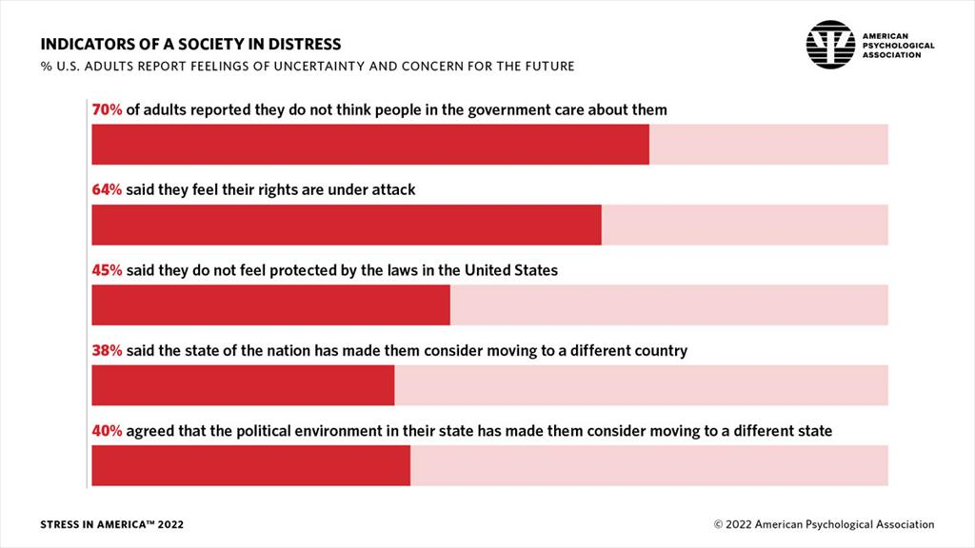
APA Stress in America Survey

Slide 10
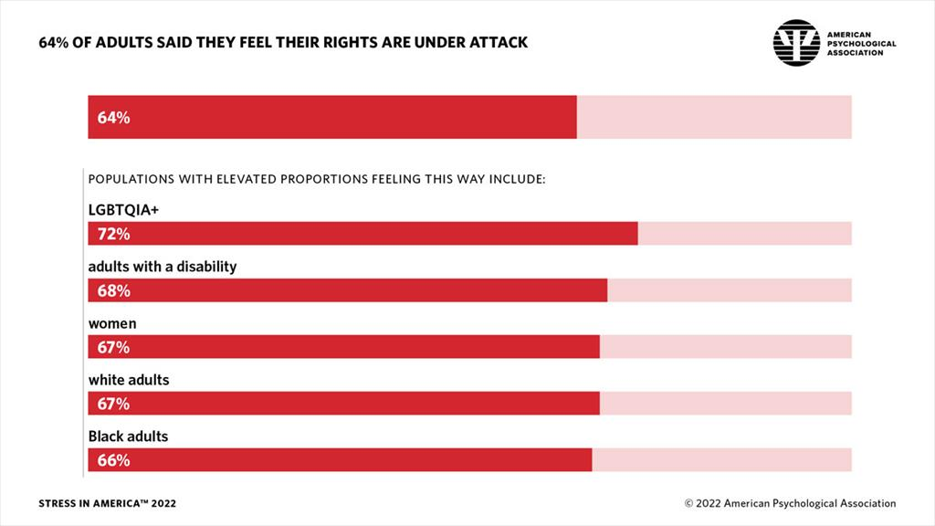
APA Stress in America Survey 1

Slide 11
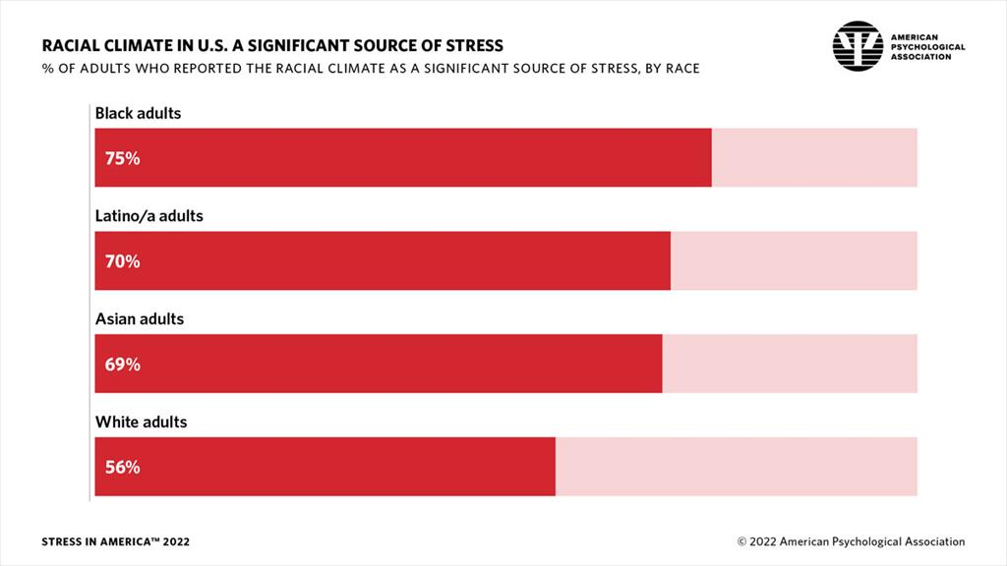
APA Stress in America Survey 2

Slide 12
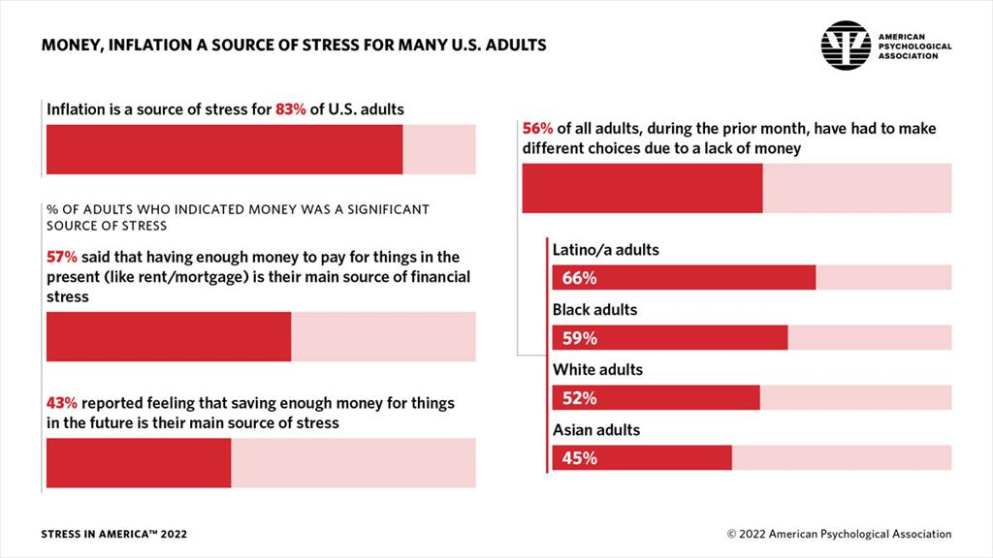
APA Stress in America Survey 3

Slide 13
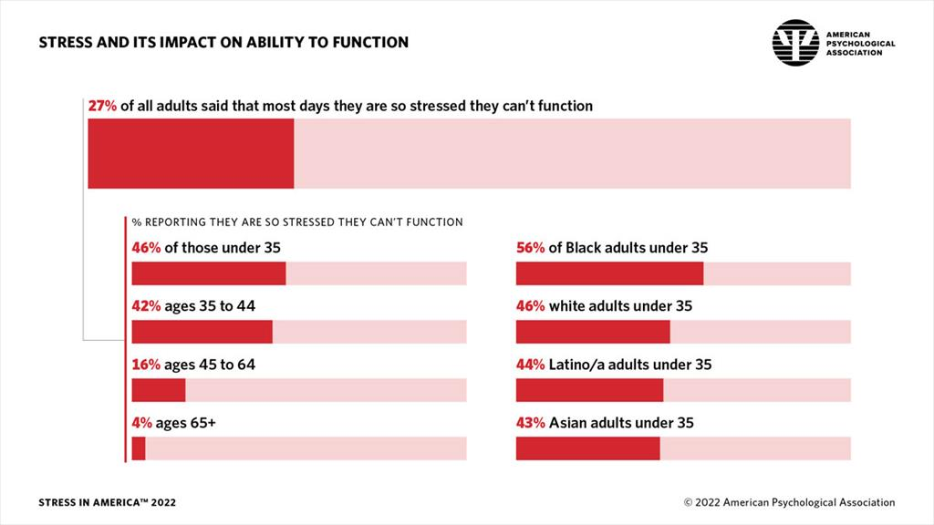
APA Stress in America Survey 4

Slide 14
What is Trauma?
Substance Abuse & Mental Health Services (SAMHSA) definition:
-“an event, series of events, or set of circumstances that is experienced by an individual as physi­cally or emotionally harmful or threatening and that has lasting adverse effects on the in­dividual’s functioning and physical, social, emotional, or spiritual well-being.”
Important to conceptualize trauma broadly
May hear “trauma with a capital T/lowercase t”
Notes:
https://www.nasmhpd.org/sites/default/files/TRAUMA-key_assumptions_and_principles_9-10-18.pdf

Slide 15
Potential Traumatic Events
Notes:
https://www.nasmhpd.org/sites/default/files/TRAUMA-key_assumptions_and_principles_9-10-18.pdf

Slide 16
Givens by Cruz
Everyone’s a little biased
We don’t know what we don’t know until we know it
Meeting people with compassion for their lived experience works – one on one connection.
One cannot define someone else’s mental health, identity experience or trauma.
Must learn our stimulus value

Slide 17
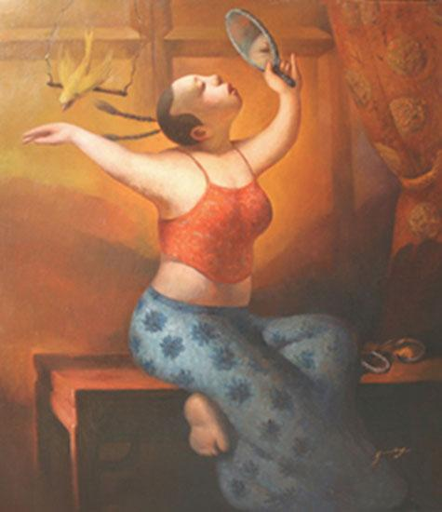
OUR DIVERSE SOCIAL IDENTITIES
Parent Identity
Age
Ethnicity
Gender Identity
Race
Neurodiversity
Relationship Status
Education
National Origin
Size/Appearance
Sexual Orientation
Social Class
Regional/Geographic
Sex
Dis/Ability
Religion/Spirituality
Notes:
Each identity has cultural values within that are more or less seen as valuable, leading privilege and marginalization/oppression
Self-identification; respecting that we each use our own terms to identify ourselves
Identity is changeable and fluid; saliency changes based on context
What is diversity?
-broad inclusive definition (e.g., race/eth, SES, sexual orientation, sex, family system,
nation/region of origin, religion, spirituality, disability, body size/shape, age)
These parts of ourselves/parts of our identity create our Cultural Filter/Lens and color how we see the world; it is important to learn about your own filter so that you can recognize it and learn to take it off at times and try on other filters/points of view when dealing w/people different than yourself as a way to increase understanding
What else creates our Cultural Filter/ where do we learn messages about ourselves and other groups?
-media, family, church, school, family, peers, gov’t

Slide 18
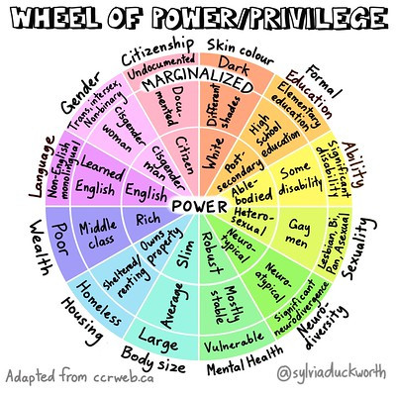
The Wheel of Power/Privilege

Slide 19
Question of What is Positionality?
Notes:
https://engineerinclusion.com/what-is-positionality/
Positionality is the social and political context that creates your identity and how your identity influences and biases your perception of and outlook on the world.
Positionality affects research, teaching, leading, policymaking, as well as common interactions.

Slide 20
Self-reflection
What is your stimulus value?

Slide 21
The Triad Training Model
Triad Training Model (Pederson, 2000)
Knowledge
Skills
Awareness/Attitudes

Slide 22
Process Model of Cultural Competence
Cultural Knowledge - Comprehensive knowledge base about culturally diverse groups
Cultural Awareness – Self-examination of one’s own biases towards other cultures, in-depth exploration of one’s own cultural background
Cultural Encounters – Direct engagement in face-to-face encounters with others from culturally diverse backgrounds, necessary for developing cultural competence
Cultural Desire – Motivation to want to (not, have to) engage in a process of being culturally aware, knowledgeable, and skillful
Cultural Humility – A lifelong process of self-reflection and critique; being honest about what you know and don’t know, deep respect for others experience and perspectives
Cultural Skills - Ability to perform culturally informed assessment, intervention, training/education, supervision, and research
Notes:
- This is the foundational model for the workshop, and we will be working within all of the aspects of the model, and these overlap and mutually impact each other
AKS is foundational – much of what we learn in formal education and training – but also we go beyond this to understand it is a dynamic, lifelong process of growth that takes humility, desire, authenticity, vulnerability…
Campinha-Bacote - Transcultural C.A.R.E. Associates

Slide 23
Thoughts, Attitudes, & Actions
Stereotyping - generalizations based on prominent, typical characteristics of a group
Prejudice – prejudging a person based on his or her membership in a group
Discrimination - actions targeted towards an individual or group based on one’s own prejudice
#implicitbias
Notes:
Now we want you to think about how do these privileges and marginalizations impact your thoughts attitudes and actions??
What do you think when you hear the word stereotype?
Something to ponder….
Categories (What’s the benefit?)
Give order to life; each day we put people in categories based on social (or other) characteristics
May become the foundation for stereotypes, prejudice, & discrimination
A Stereotype is:
“an exaggerated belief, image, or distorted truth about a person or group”
“a generalization that allows for little or no individual differences or social variation”
But, where does it come from?
Media images (omission-“all-white” worlds)
Parents
Peers
Can be positive or negative (examples?) → (one step further)
Prejudice is:
“an opinion, prejudgment or attitude about a group or its individual members”
Often associated with ignorance, fear, or hatred
How do these three things interact??? – Next Slide

Slide 24
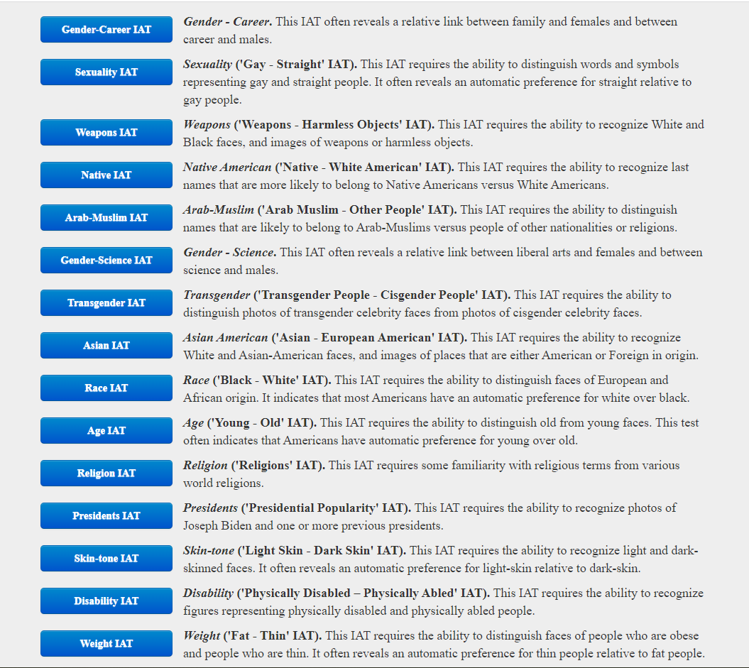
IAT Categories
Notes:
https://implicit.harvard.edu/implicit/selectatest.html

Slide 25
Intention and it’s Impact
Intention
Impact

Slide 26
Process of the impact of Stereotypes.
Impact of Stereotypes
Prejudice
Stereotypes
Violence
Discrimination
Descriptors
Thoughts/Beliefs
Actions
Hate Crimes
Microaggressions

Slide 27
Psychological Effects of Social Stigma
Negative sense of self
Depression
Anxiety
Self-doubt/Self-hatred (Internalized homophobia)
Substance use issues
Self-injury
Suicidal thoughts and attempts
Minority stress arises not only from negative events but from the totality of the minority person's experience in dominant society.
Allostatic load – refers to the cumulative burden of chronic stress and life events. It involves the interaction of different physiological systems at varying degrees of activity. Includes ACES and the subsequent “wear and tear.”
Notes:
Allostatic load refers to the cumulative burden of chronic stress and life events. It involves the interaction of different physiological systems at varying degrees of activity. When environmental challenges exceed the individual ability to cope, then allostatic overload ensues.
Allostatic overload occurs when the cumulative effects of physiological stress response lead to health problems, disease, or death. This is why it's estimated that stress plays a role in anywhere from 50 to 70 percent of all physical illnesses.
The concept of allostatic load provides that "the neuroendocrine, cardiovascular, neuroenergetic, and emotional responses become persistently activated so that blood flow turbulences in the coronary and cerebral arteries, high blood pressure, atherogenesis, cognitive dysfunction and depressed mood accelerate disease progression."^{[6]}

Slide 28
ACE Chart
Notes:
https://www.npr.org/sections/health-shots/2015/03/02/387007941/take-the-ace-quiz-and-learn-what-it-does-and-doesnt-mean

Slide 29
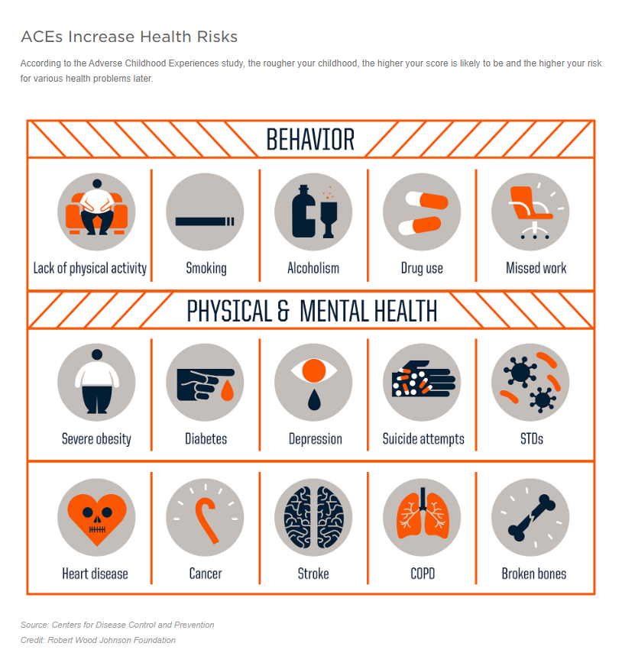
ACE Behavior’s and Their Risks
Notes:
https://www.npr.org/sections/health-shots/2015/03/02/387007941/take-the-ace-quiz-and-learn-what-it-does-and-doesnt-mean

Slide 30
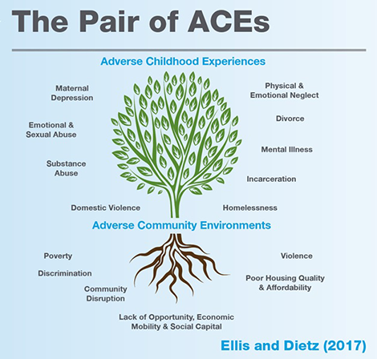
The ACE Tree

Slide 31
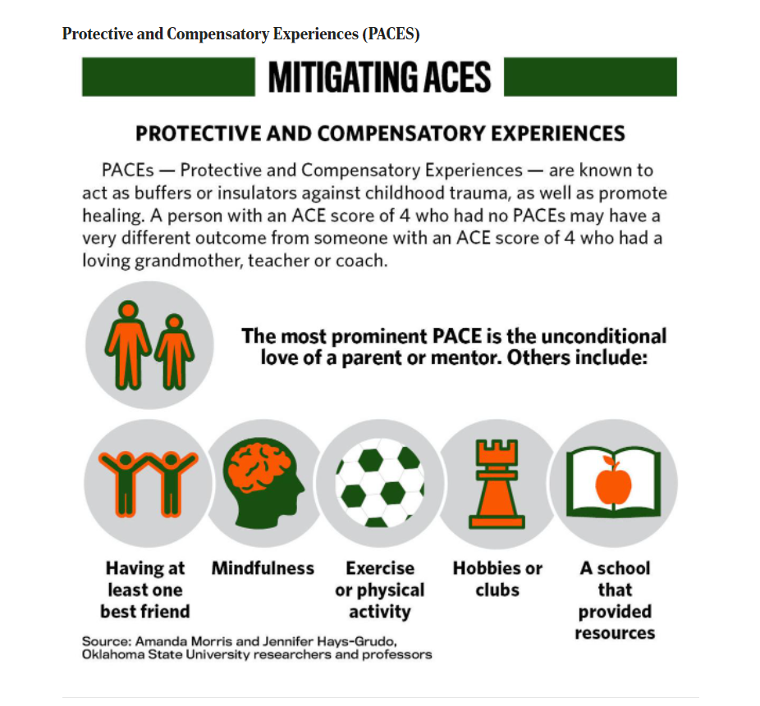
PACES definition and Examples
Notes:
https://tulsaworld.com/what-is-your-ace-score-and-what-does-it-mean-understanding-the-consequences-of-childhood/collection_63a6c896-b94a-550d-8832-9d5365cd195c.html#17

Slide 32
Trauma: Learning and Coping
Trying to work with traumatized youth
It is harder to learn and cope when you are scared & uncertain.
To understand trauma:
When we experience trauma, whether consciously or subconsciously, the limbic system (emotions) hijacks the pre-frontal cortex (reason). Energy, especially neuronal energy, is necessary for learning and coping. The brain feels the fear so learning feels less important to the brain. This is not a conscious process.
HOW DO YOU SEE TRAUMA
MANIFESTING IN YOUR WORK?

Slide 33
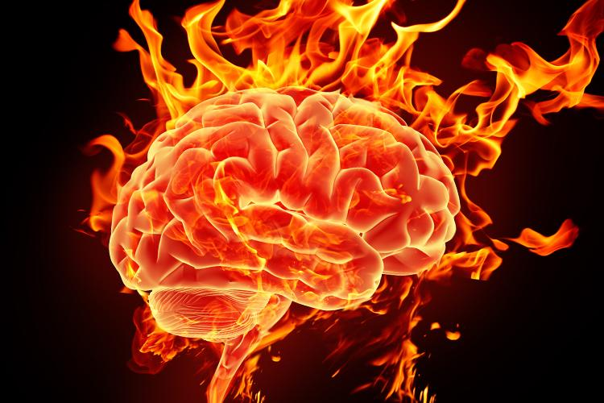
BEING RELATIONAL IN A NON-RELATIONAL WORLD
Hard wired/Biology
Empathy, connection, others/self
Culture/Society
Independence, autonomy, self

Slide 34
Safety and Trust: Building Relational Safety
Authenticity
Self-awareness
Vulnerability
Honest and open communication
Emotional risk taking, with boundaries
Research demonstrates that youth who have experienced silencing as a result of one or more of their identities may be in greater need of relational safety than some peers.

Slide 35
Suggestion 1 Work to ensure the youth’s emotional, cognitive, physical and interpersonal safety
Hard to create trust and safety quickly
Begin with modeling – Ask yourself what makes you feel safe when you feel vulnerable, don’t know what to do.
Being vulnerable ourselves can help
Share a story about how you are handling the situation
Be intentional & present when asking youth how they are doing, what safety means to them and how you can help them feel safer.
Suggest ideas to handle their anxiety and find outlets
Notes:
Using Neuroscience in the Classroom
https://www.insidehighered.com/advice/2020/06/03/seven-recommendations-helping-students-thrive-times-trauma

Slide 36
Suggestion 2 Foster trustworthiness & transparency through connection & communication
Human beings do best when expectations are clear. Most of youth we work with do not have the role models for clear connection and communication.
Clearly communicate the steps in their current process.
Directly address limits of helper relationship.
Notes:
https://www.insidehighered.com/advice/2020/06/03/seven-recommendations-helping-students-thrive-times-trauma
https://tilthighered.com/

Slide 37
Suggestion 3 Intentionally facilitate peer support and mutual self-help
Peer relationship building
Encouraging them to check up on each other if appropriate
Invite youth to share their own stories and strategies to help each other cope and progress
Remind them that connections helps bidirectionally
Offer some space to check in as needed
Notes:
https://www.insidehighered.com/advice/2020/06/03/seven-recommendations-helping-students-thrive-times-trauma

Slide 38
Suggestion 4 Promote collaboration and mutuality by sharing power and decision making with youth when possible
Power With versus Power Over
Be curious about them
What matters to them - What interests them.
Try to incorporate some of their ideas into your process
Ask them their opinions
Notes:
https://www.insidehighered.com/advice/2020/06/03/seven-recommendations-helping-students-thrive-times-trauma
https://thecheapestuniversity.org/wp-content/uploads/2018/08/bell-hooks-teaching-community-a-pedagogy-of-hope.pdf (the whole book)

Slide 39
Suggestion 5 Empower voice and choice by identifying and helping build their strengths
Validate and normalize their concerns about fear, anxiety, trauma
Losing agency and control is very uncomfortable
During the pandemic, it has been “normal” to have lack of motivation and energy as our physiology and neurology were impacted greatly. Binge watching streaming does not mean lazy~
Provided modeling on how to advocate for self in systems
Empower youth to use their voices
Notes:
https://www.insidehighered.com/advice/2020/06/03/seven-recommendations-helping-students-thrive-times-trauma

Slide 40
Suggestion 6 Attend to cultural, historical & gender issues
We do not want to retraumatize youth we serve
Use an intersectional lens – they are not all the same
Minority communities may experience trauma more severely due the impact of intergenerational traumas and ongoing oppression and marginalization
Be aware of microaggressions - They are daily traumatic stressors
Consider forming a consultation group of peers to process issues and solutions
Notes:
https://www.insidehighered.com/advice/2020/06/03/seven-recommendations-helping-students-thrive-times-trauma
Webinar: Responding to microaggressions in an online environment
https://www.youtube.com/watch?app=desktop&v=9cEWQJ32nqU
https://www.academics4blacklives.com/

Slide 41
Suggestion 7 Impart to youth the importance of having a sense of purpose
Share your passion for your work and why you continue to do this hard and meaningful work
Invite them to identify or connect with a sense of purpose
Life is an existential process for all humans
We must pass through solitude and difficulty, isolation and silence in order to reach forth more intra and inter connection
1980, Irvin Yalom defined the four “givens” of the human condition - death, meaning, isolation, and freedom
Notes:
https://www.insidehighered.com/advice/2020/06/03/seven-recommendations-helping-students-thrive-times-trauma

Slide 42
Self-care

Slide 43
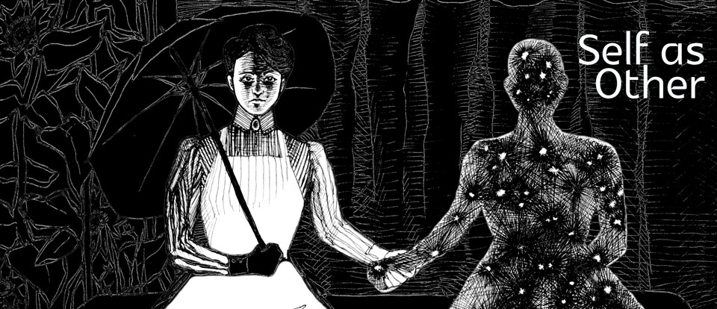
Self / Other Care

Slide 44
Self / Other Care 2
Have to care for self primarily to keep going
Airplane example helps a lot!
Mixed messages depending on cultural variables
Gender
Social class
Race/Ethnicity
Religion
Etc…
One of my greatest areas of growth!!
Bicultural messages

Slide 45
Self / Other Care 1
Value laden
Messages to do more for others
Live in a world with tremendous and overwhelming need
Plus we value people who are selfless, giving, compassionate
Social psych shows us altruism is not without personal benefit
Engaging in volunteer and charitable works makes us feel good and can even improve our physical and mental health
Messages to carve out “me time” & go do self-care
So how do we balance that tension?
Hard to do in our culture and our chosen professions
People need to learn that balance
Overfocus in either direction is not healthy
Some people taught better than others
Where do we learn this balance? Where did you learn?

Slide 46
Self / Other Care 3
Redefining self-care
Care: women and people of color are disproportionately responsible for the care that keeps this society functioning, yet have disproportionately little say.
For some, shifting to focusing on self would be a huge change, perhaps taking better care of selves than they/we’ve been taught. Others could benefit from a shift to more other care.
This plays into the kind of advocate you are and merits some reflection time.
Notes:
https://crimethinc.com/2013/05/31/for-all-we-care-reconsidering-self-care

Slide 47
Self / Other Care 4
Macro Self-care
Typically our first thoughts
Require more time and money
Examples → vacation, play/concert, meditate 45 minutes
Can lead to feeling bad or overwhelmed as it is not often
Micro Self-care
On demand self-care / always available
Small changes, frequent, repetitive
Examples → brief relaxation/connection exercises, access PRM’s, 10 minute stroll to be outside, push ups/squats, something to recalibrate
Notes:
https://crimethinc.com/2013/05/31/for-all-we-care-reconsidering-self-care

Slide 48
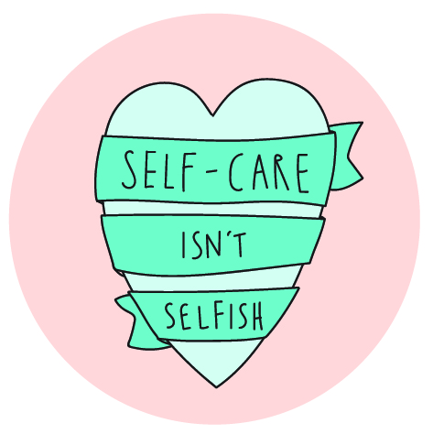
Self-Care Images

Slide 49
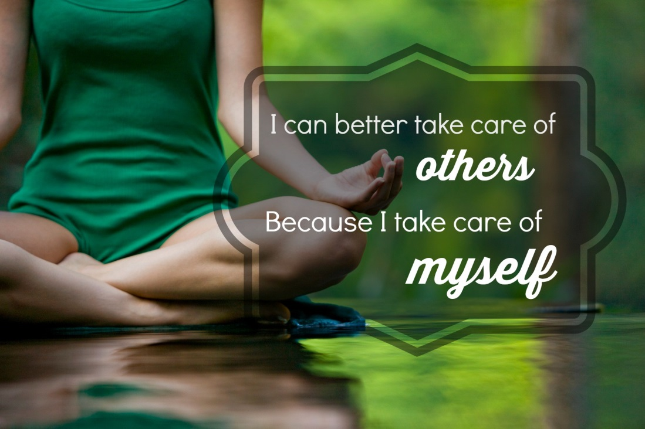
SELF-CARE as an Ethical Imperative
Self-care part of all ethical codes.
ESSENTIAL for ethical professional behavior.
Ethical behavior is an active process that involves
increasing awareness and constant questioning.
Few of us can engage in this process if we are emotionally drained, overwhelmed, or demoralized.
Collectivistic versus Individualistic viewpoints
Notes:
APA 2002 Ethics Code:
Instructs psychologists to maintain an awareness “of the possible effect of their own physical and mental health on their ability to help those with whom they work.”

Slide 50
SELF-CARE as an Ethical Imperative 1
Feminist Therapy Code of Ethics, 1999 also recognizes the importance of self-care as part of practice.
5 Categories
Cultural Diversities and Oppressions
Power Differentials
Overlapping Relationships
Therapist Accountability (self-care below)
Social Change
A feminist therapist engages in self-care activities in an ongoing manner outside the work setting. They recognize their own needs and vulnerabilities as well as the unique stresses inherent in this work. They demonstrate an ability to establish boundaries with the client that are healthy for both of them. They also are willing to self-nurture in appropriate and self-empowering ways.

Slide 51
SELF-CARE as an Ethical Imperative 2
Pope & Vasquez suggest lack of self-care can lead to the following:
Disrespecting clients, e.g., talking about client in derogatory ways, becoming judgmental, complaining about their needs
Disrespecting work, e.g., trivialize, ridicule, or become overly self-critical about our work; see our work as meaningless
Make more mistakes
Lack energy thus not emotionally present with clients, supervisees, students
Using work to block out unhappiness, pain, discontent
Becoming anxious and afraid, question if we can deal with the challenges of our work
Losing interest: work no longer a source of joy

Slide 52
Race-based trauma
Social media impact
"Race-based trauma literally leaves bruised spots on your brain. By continuing to enter online conversations, as important as you warrant them to be, you are allowing the bruise to be pressed on over and over. You are harming yourself if you do not step away and heal. These conversations are impacting your emotional and psychological well-being.”
http://www.colorlines.com/articles/4-self-care-resources-days-when-world-terrible
Notes:
http://www.colorlines.com/articles/4-self-care-resources-days-when-world-terrible

Slide 53
Steps to Self Care after Trauma Chart

Slide 54
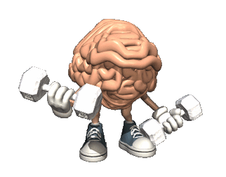
Neuronal Exercise
Build new pathways…exercise nervous system
Positive relational moments
Mind and photos
Mindfulness
Enhance connection with self
Increase contact with others
Integrate daily movement
Increase authenticity and relational risk
Cuddle with a pet
Call a friend
Practice kindness and compassion
SELF and OTHERS

Slide 55
Paulo Freire Quote
It is imperative that we maintain hope even when the harshness of reality may suggest the opposite.
—Paulo Freire

