Slide 1
Evidence-Based Grant-Making, Part Two
Texas Workforce Commission (TWC), Texas Workforce Investment Council (TWIC), Results for America, Rural Capital Area Workforce Development Board, & Third Sector Capital Partners
Improving Texas Outcomes
Notes:
The blank slides in this presentation are there to show you the layout options. Feel free to delete slides you do not want or to change the layout of the slides (right click then choose Layout from the menu).
To change the slide background picture or TWC logo on this slide, go to View > Slide Master

Slide 2
Goals
Continue to discuss evidence-based grantmaking in Texas
Provide opportunities to experience evidence tools
Answer questions around evidence-based grantmaking
Notes:
Jen – Welcome! We’re so happy you’ve joined us again for our second session on evidence-based grant making. Thank you for being here!
Today, we’ll continue the evidence conversation with you all, and we’ll do that by providing interactive opportunities for you to see the tools upclose
We’ll have time to answer your questions and we’ll close with next steps.
So, let’s dive in!

Slide 3
Agenda
Introductions and Quick Recap
Quick Review of Evidence Framework
Review CLEAR Database
Review Decision Tree
Understand Performance Based Granting
Review Cash Flow Model
Questions and Answers

Slide 4
Welcome!
  Jen Troke, Director, Workforce Grants and Initiatives, Texas Workforce Commission
  Kaki Leyens, Program Specialist, Texas Workforce Investment Council
  Ben Holquist, Manager, Strategic Workforce Initiatives, Texas Workforce Commission
  Emily Fabiaschi, Director, Third Sector
  Temi Oyowe-Carrington, Manager, Third Sector
  Chelsea Haley, Senior Associate, Third Sector
Notes:
Jen will welcome speakers – It’s my honor to announce our speakers today including some new voices to the conversation from Third Sector Partners and TWC. Ben joins us as our resident grant writing guru and he’s been leading our efforts to incorporate evidence-based grantmaking into our pilot RFA as well as supporting the writing of the framework, so we’re happy he’s here to talk us through a few of the tools today. And Third Sector Partners is here today – they have been providing technical assistance to our team! I can assure you, we’re a tough group to manage, but they’re doing a great job! Founded in 2011, Third Sector is a 501(c)3 organization that has worked with more than 40 communities to deploy more than $806 million of government resources towards outcomes
And you’ll hear from our friend and colleague Kaki Leyens, a Program Specialist from TWIC – she’s been an instrumental part of our evidence team as we’ve worked to build out the framework.
Finally, I’m Jen Troke, the Director of Workforce Grants and Initiatives, and I’m so pleased to bring my perspective on grantmaking to this conversation and have learned an incredible amount from this all-star team!
OK, a little warm-up now that you know who we are!!!

Slide 5
Polling Question #1
Were you able to attend the first webinar in November?
Yes
No
Notes:
We’ll start with an easy one – who’s here today!? Take a moment and click on the best response for you! No wrong answers!

Slide 6
Polling Question #2
On a scale of 1-5, what’s your comfort level with evidence based grantmaking?
  5 = extremely comfortable
  1 = not sure what this is about!
Notes:
Jen – Now that we know who you are, we want to know why you showed up! So, we’re asking this question, what words come to mind when you hear the term ‘evidence-based’? Put your answers in the chat please!

Slide 7
Quick Recap of 1st Webinar
Evidence Framework completed!
Grant Application for Building Construction Trades to be Released January 2021 including evidence tiers and performance outcomes NEW!
TWC Webpage for Evidence Resources at https://twc.texas.gov/agency/texas-workforce-commission-evidence-based-grantmaking
Notes:
Jen – If you missed the first webinar, I’m going to give you the Cliff Notes right now! The team shared an evidence framework that will be discussed momentarily and we’ll show you how to use it. The framework essentially outlines the need for building the evidence base and a way for programs to determine where they sit on the evidence spectrum.
Our Chair also announced that we will be releasing our first Request for Application, the Building and Construction Trades program, that will include the evidence framework, so applicants will get a chance to use the evidence framework and performance outcomes when that Request for Application is published this Fall. We’ll be hosting a prospective applicant conference once the Request for Application is published, so you’ll be able to ask more specific questions once you have a live document in your hands.
Finally, we shared a new webpage on the TWC website where we’re housing all of our evidence resources including the first webinar recording and slideshow if you missed it!

Slide 8
Using the Evidence Framework
Five levels:
New Program Tier
Experience Program Tier
Performance Program Tier
Moderate Evidence Program Tier
High Evidence Program Tier
Notes:
Here you see the five levels or tiers of the framework, which will be included in applications for the grants. The first tier – NEW – requires no evidence. The evidence requirements increase for each tier, with the HIGH EVIDENCE tier requiring the most rigorous evidence.
The goal is for applicants to provide the best evidence to support their application whether that evidence be anecdotal, OR performance data from a similar program, OR an external evaluation that meets certain criteria and demonstrates that the program had a positive and meaningful outcome.
And for those applicants who are developing a new program that cannot be supported by any of the evidence I just mentioned, applications are still strongly encouraged.
Applicants will be asked to select an evidenced tier based on the information and data that the applicant can include in the application to support the strength of their ability to implement the proposed program to achieve the outcomes specified.
To assist in the selection of a program tier, a decision tree – which Ben will walk you through in a moment – will be included in the application to help you determine which tier is appropriate for your proposed program. An applicant must select one and only one program tier and provide information and data to support that selection.
THIS FIRST TIER of the evidence framework, as you can see, is the new program tier. New by virtue of its very definition means that there will be no evidence to support the proposed program … so there's no evidence – no anecdotal evidence, data, or evaluations required.
THE NEXT TIER is the experience tier. On this tier of the evidence framework, an applicant will have had experience implementing the program or a very similar program - and while the applicant will not have evaluations or performance data - they will be able to provide testimony as to program effectiveness based on anecdotal information such as success stories and other testimonials …evidence could also include participant surveys.
Next you see the performance tier. On this third tier of the evidence framework, applicants will have implemented the program that they're proposing or one that is very similar and they will have performance data and in the application will be required to document that performance data.
Now, we understand that you may not have all of the data sets that we're asking for in the performance chart in the application. So, we ask that applicants complete the chart to the greatest degree possible with data from at least the last two years.
THE FOURTH TIER is the moderate evidence program tier. The moderate evidenced tier requires that an applicant identify and submit one evaluation study of a program that is essentially similar to the program being proposed in the application. Essentially similar means that the program proposed in the application is very similar in program design and outcomes, with only limited modifications, to the program in the evaluation study. Additionally, the evaluation study must show that the evaluated program had a positive and meaningful outcome on program participants AND be rated by the study source as having at least moderate evidence. For this moderate evidence tier one evaluation study is required.
There are three sources where applicants can find evaluation studies. Ben will show you the preferred source in his part of the webinar.
THE FINAL TIER is the high evidence program tier. This tier is very similar to the moderate evidence program tier. However, for the high evidence program tier, applicants will need to include not one but two or more evaluation studies of programs that are essentially similar in design …and that demonstrate a positive and meaningful outcome. The study must also be designated by the study source as a high-evidence study.
For the high evidence program tier, the proposed program must be implemented with no or extremely limited modifications. One way to think of the requirement for this tier is that your proposed program should be a replication of the program in the evaluation studies.
The moderate evidence and high evidence program tiers are the tiers where we hope to help applicants move to in the future by building evidence and helping applicants access relevant resources.
That concludes my remarks and I’ll hand it over to Jen.

Slide 9
Using Clearinghouses
Clearinghouse for Labor Evaluation and Research (CLEAR) https://clear.dol.gov/study_database
Pathways to Work Evidence Clearinghouse https://pathwaystowork.ach.hhs.gov/studies
CrimeSolutions https://www.crimesolutions.gov/asvsearch.aspx
Notes:
If you are looking for inspiration to test out a new program model and want to find what works, the federal government has pulled together several evaluation clearinghouses whose sole purpose is to share the research on program models. This can be useful whether you are just looking for ideas to modify your existing program, or if you are specifically looking to implement n essentially similar high-fidelity replication of a program.
For our demonstration today, we’re going to use DOL’s CLEAR website whose mission is to make research on labor topics more accessible to practitioners, policymakers, researchers, and the public more broadly so that it can inform our decisions about labor policies and programs.
You’ll find a lot of resources in CLEAR - CLEAR identifies and summarizes many types of research, including descriptive, implementation, and impact studies. So let’s take a look!

Slide 10
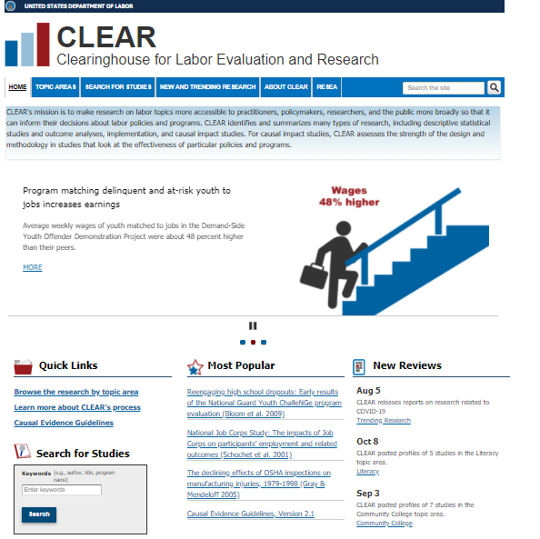
CLEAR
Notes:
CLEAR includes information on not just the research studies reviewed, but also more general information on the state of research. From this webpage you can either go straight to the research studies if you know what you are looking for specifically (there is a search tool like you would find in a library catalog), but you can also browse by topic areas.

Slide 11
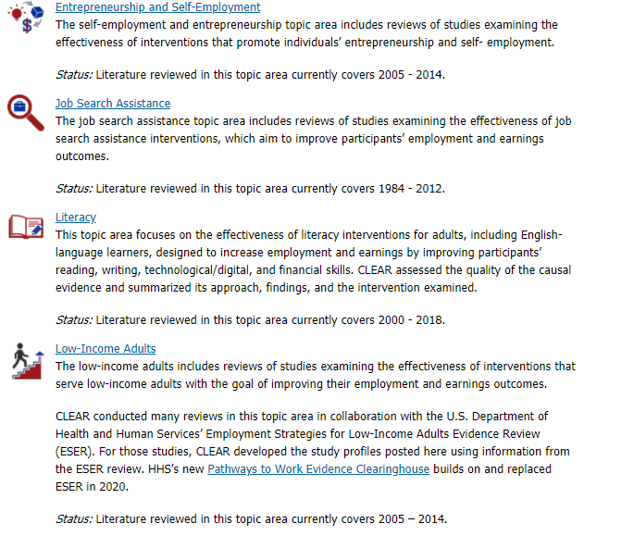
Topic Areas
Range of topics including:
Apprenticeship
Behavioral Insights
Career Academies
Community Colleges
Literacy
Older Workers
Reentry
Veterans
Notes:
There are a variety of topic areas. Depending on what your organization is doing or planning to do, you should be able to find a topic that fits you. If you are just looking for concepts and ideas, you can also find good information on how to support participants with different challenges, even if your program is not targeting them specifically.

Slide 12
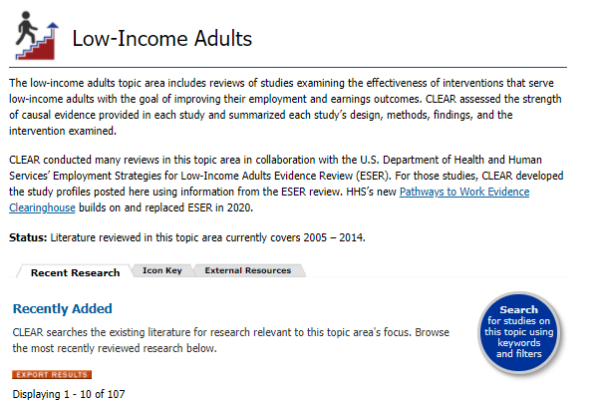
Low-Income Adults
Notes:
In this example we are looking at evaluations of programs targeting low-income adults. It includes tabs of the most recent research in this category, a key to the Icons used throughout the evaluations, and additional resources related to low-income adults.

Slide 13
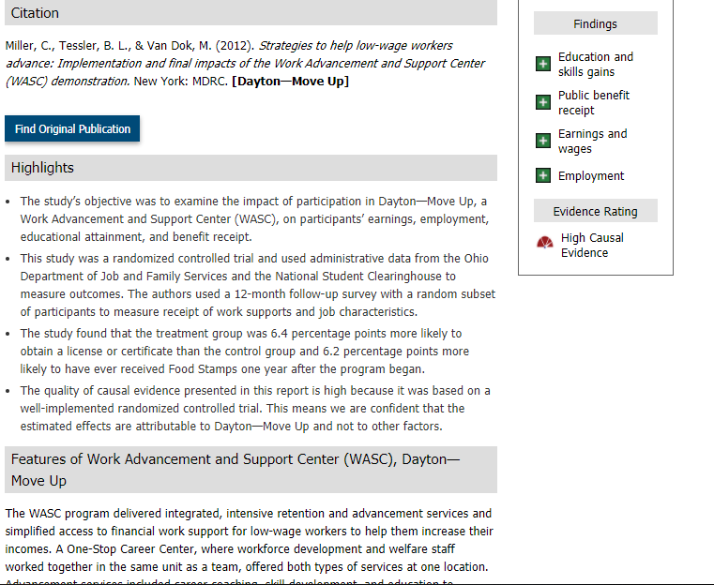
Evaluation
Notes:
This shows an evaluation of a specific program. At the top is the full citation, with a link to the full article (there are both freely available and paywall articles through this site). To the right this shows that this program increased participant outcomes in 4 areas, and that there was high evidence. In the middle is a summary of the highlights of the study, and at the bottom there is a more detailed summary of the program itself and its methods. Please note that CLEAR’s evidence rating (unlike ours) focuses purely on the quality of the research. It is perfectly possible to have a CLEAR study with high evidence that shows the program had no effect or had a negative effect. Our model only gives credit to programs that show positive outcomes (like this one does). Please note that to achieve the High rating, you would need to find a second study showing positive outcomes at a high evidence rating. By itself, one study at either high or moderate level would support moderate.
In order to get credit for the High Evidence tier, you would need to demonstrate that your model is an implementation of the specific evaluated program, that is essentially similar with very limited or no changes. You will be asked to explain in detail any changes you’ve made to the program in your implementation. We want to emphasize that this is optional, not a required part of the application. To get credit for the moderate evidence tier, you would need to show that your program is essentially similar, but may have some minor changes.
As Lee said and I want to again emphasize, Texas values and will consider awards to programs at all levels of the evidence continuum and expects programs to improve data collection and evaluation methods in order to improve a program’s evidence over time. You should know that the collection of evidence is being implemented across state workforce grant programs. The evidence tier approach recognizes the different capabilities between potential program developers and grant applicants at this time. Applicants that do not have current performance data or evaluation reports as evidence that supports the proposed program design or intervention are encouraged to apply.
The team has developed a decision tree to help applicants determine where they fit on the evidence continuum. We really tried to make this as straightforward as possible.
So, we’ve created a scenario that we’re going to walk through throughout this process that

Slide 14
Scenario
Community based organization in Austin, TX serving low-income workers
Current model is to provide standard case management to all participants who receive career and training services
Tracking employment outcomes for 4 years via spreadsheet and capture success stories to share with stakeholders as needed
Apply for public and private grants frequently and model shifts to meet the requirements in the RFA but core program model elements remain
Meet Maggie the Director and Head Grant Writer
Notes:
But today’s all about applicant of the evidence tools, so we’ve created a simple scenario that we’ll use to guide us as we work through each decision point along the evidence path.
Imagine a fictional community based-organization right here in Austin who serve low-income workers – they currently provide standard career and training services to their participants and each participant is assigned a case manager. They do track outcome data but not in a systemic way. Because they are dependent on public and private funds for operations, they frequently adjust their training model to comply with the requirements outlined in the RFA. The good news is that they do collect some outcomes on an excel spreadsheet, and they capture success stories each year when it’s time to send the annual holiday newsletter.
Maggie, their overworked Director and head grant writer, recently sat in on webinar about career coaching and she is interested in exploring how this model might improve their outcomes, which have been fine, but they’d really like to take them next level. In fact, her Board members have been asking tougher and tougher questions about outcomes so she’s excited to dig in and figure out some options.

Slide 15
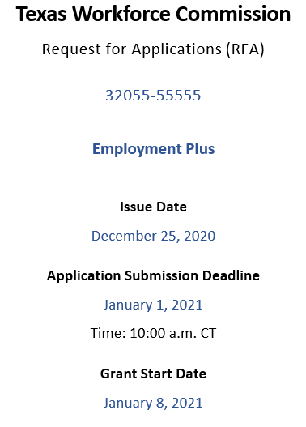
News Flash!
New RFA just published looking for employment and training programs
Maggie knows this is her moment to add career coaching into her program model!
She locates an evaluation from CLEAR and starts working through the decision tree in the RFA
And she cancels holiday plans…
Notes:
So here’s the scenario we are going to use. We are going to talk through Maggie’s process of using the decision tree to identify her evidence tier. TWC promises that any RFA we publish will give you more time ☺.

Slide 16

Evaluation
Boss, check out this article I found on serving low-income adults! I’ll set up a meeting with you to discuss my ideas further, Maggie
Notes:
There are essentially two ways you can approach the studies that are available through the evidence clearinghouses listed previously. The first is replicate a program and produce an essentially similar version. This would mean not using an existing program, and so for many organizations with established programs its not very appealing. But these studies can also be used as ideas for adding new components or improving your own program with best practices. The goal of the evidence based grantmaking is to establish strong programs here in Texas, and we would love to see the existing programs you are already running grow and develop their own evidence base.
Throughout this scenario we will mostly assume that Maggie is using the studies she finds as sources of best practices for her CBO’s programs.

Slide 17
Using the Decision Tree
Thinking about Maggie’s current program…
1. Is the program developed internally, or is it based on the program design of another program or organization?
Yes, it is developed internally. Go to Question 2.
No, it is based on the program design of another program. Go to Question 5.
2. Is the program new or has it been offered in an essentially consistent and comparable way in past years?
Yes, the program is new.
Because the program is new and developed internally, select the New Program Tier.
No, the program has been offered in past years. Go to Question 3.
Notes:
The first questions of the tree address specifically what your program does currently. Question one is the starting point: Is the program developed in house by your organization, or is it an implementation of a program developed elsewhere. If your program is primarily done in house you’ll continue with the questions in order, if you are implementing an external program, you’ll skip too question 5. Maggie’s program is developed in house (though she may be looking at adding external components), so she answers Yes.
Question 2, which is specifically about a program you developed in house, asks whether you have offered the program before. If you’ve never offered the program before, you’re done! There is no way you could have data on a never before offered program, so you will be in the New tier. Maggie’s program has been in existence for several years, so it is not New. She moves to question 3.

Slide 18
Decision Tree – Question #3
3. In prior years, has data been collected on the outputs and outcomes of the program? Please refer to the Performance Chart for the relevant data sets.
Yes, data has been collected on the performance metrics. Go to Question 4.
No, data has not been collected on the performance metrics.
Because the program has been delivered previously but data was not collected on the performance metrics, select the Experience Program Tier.
Notes:
Question 3 distinguishes between programs that have historical data of outcomes and outputs, vs programs that have not. Maggie’s program has collected data, so she answers Yes, and goes to question 4. For organizations that have not collected performance data in the past, to score points for the Experience tier you will be asked to provide testimonials, recommendations, participant feedback to surveys, or any other feedback you have received demonstrating the positive impact of your program.

Slide 19
Decision Tree – Question #4
4. Has an evaluation of your program been reviewed by DOL’s Clearinghouse for Labor Evaluation and Research (CLEAR)/Other Entity?
Yes, a program evaluation has been submitted to CLEAR/Other Entity.
If the program evaluation received a “high” rating and demonstrated both a positive and meaningful outcome and there is another review from CLEAR or Other Entity that supports the same, select the High Evidence Program Tier, and complete the Documentation of Evidence Chart for the High or Moderate Evidence Program Tier to reference the CLEAR/Other Entity Review Study.
If the program evaluation received a “moderate” rating and demonstrated both a positive and meaningful outcome, select the Moderate Evidence Program Tier and complete the Documentation of Evidence Chart for the High or Moderate Evidence Program Tier to reference the CLEAR/Other Entity Review Study.
If the program evaluation has not yet been reviewed, or received the “low” rating, select the Performance Program Tier, submit performance metrics, and complete the Performance Chart.
No, a program evaluation has not been reviewed by CLEAR/Other Entity.
Select the Performance Program Tier and submit performance metrics and requirements in the Performance Chart.
Notes:
Question #4 gets into the moderate and high evidence tiers. To answer yes for your program, you need to have had your program publish a study, and have that study evaluated by CLEAR (or another evaluating entity from the list above). If you have had 2 different studies show a positive outcome and achieve a high evidence tier, you are “high evidence”, and answer Yes. If you have one study that demonstrates positive outcomes, and that study is rated as moderate or high, you have “moderate” evidence on our decision. For almost everyone (possibly for everyone) the answer will be no to this one.
Maggie’s organization has not had a published study done, so her answer is No, and she goes to the Performance program Tier Chart.

Slide 20
Performance Chart
History |  | Training Data |  |  | Employment Data |  |  |  |  | Wage Data
History of Initiative (Grants, Program, Service) | Year | Number of Participants | Number of Completers | % Completion | Number of Industry Based Certifications | Number Employed at 6 months | % Employed at 6 months | Number employed at 12 months (Q3+Q4) | % Employed at 12 months | Average Wage increase (Q2, Q3, Q4) | Average Wage increase %
Expansion Grant | 2018 | 100 | 90 | 90% | 90 | 89 | 99% | 87 | 97% | $5.00/hr | 20%
Pilot Grant | 2017 | 105 | 76 | 72% | 76 | 60 | 83% | 65 | 85% | $3.50/hr | 15%
Notes:
The Performance Program Tier that you have selected must be supported by data and information showing that the program creates an intended change in participants, and that participants show a positive outcome following the program. Fill out the chart on the following page as completely as possible with the data of previously implemented programs. Historical output and outcome data must represent at least two years of program implementation, either directly collected or from the similar program being used as evidence. Also, provide information that will support demonstration of your organization’s ability to manage grant programs to significant and strong outcomes such as an evaluation from this or a similar program to support the design and anticipated outputs and outcomes. The chart shown will be included in the application. Information from previous grants, programs, and services may be included in the application. Please group your information first by funding source or type of grant. Include information from previous grants directly related to the RFA, and list at least two years or more of data. Please note that data does not need to be from the same funding source both years, but should be from the same program (which also needs to be the program you are proposing in your application!). In the example here, Maggie has received funding from two different funding sources in two different years, but both supported the same program.

Slide 21
Evaluation Table
Evaluation Source (from list below) | Please list name of entity
Study #1 name: | Please copy/paste from CLEAR/Other Entity.
Study Full Citation: | Please copy/paste from CLEAR/Other Entity.
Findings: | Please copy/paste from CLEAR/Other Entity.
CLEAR/Other Entity Causal Evidence Rating: | Please copy/paste from CLEAR/Other Entity.
Key elements of the study program that will be implemented:
Elements of the study program that will be changed or not implemented, and why these changes do not affect the validity of the comparison:
Data to be collected to compare outcomes between the study and proposed programs:
Appropriateness of proposed geography and population to be served:
Notes:
For High or Moderate Evidence Program Tiers Complete this chart to reference the CLEAR or Other Entity (listed below) reviewed study of the comparable, replicable program. Only studies that have been evaluated by Clearinghouse for Labor Evaluation and Research (CLEAR) or by an Other Entity listed below may be used to support a proposed program. Attach the complete study or studies to your application. Please remember that you will need 2 studies if you are going for High Evidence and 1 study if you are going for Moderate Evidence.
So far we have only been looking at in-house developed programs, so many of these questions will be very easy to answer. Assuming you are not making any changes to your program, since the study was of your program directly you will be implementing 100% of the program as described, and you will not be changing anything so there will be nothing that is changed or not implemented. Data to be collected would be the same type of data previously collected, and the geography and population would be appropriate, since it’s the same geography and the target population would be the same.
If you are implementing changes, you will need to provide more detail where appropriate. If you are simply replicating an existing program at a new site, you would provide information on why you expect the new geography and population to still be appropriate for your program. If you are changing the structure of your program, you would need to explain why, and why you do not think it would decrease the effectiveness of your program.
You would also use this table if you are implementing another organizations evaluated program, but I will discuss that in a little more detail in a moment. When you are implementing another organization’s program, you would need to address all the questions, and explain how you are taking their program and producing an essentially similar program for your organization.

Slide 22
Decision Tree - Question #5
FOR PROGRAMS THAT ARE IMPLEMENTING THE PROGRAM DESIGN OF ANOTHER PROGRAM AND EXPECT SIMILAR PERFORMANCE OUTPUTS AND OUTCOMES ONLY:
5. Is the design of your program essentially similar to the program design and theory of change of the original program that this application proposes to implement?
Yes, our program will be essentially similar and have high fidelity to the original. Go to Question 6.
No, our program will incorporate significant changes from the model program.
Because your program is not a high-fidelity implementation of an existing program, select the New Program Tier.
Notes:
Question 5 is the start of the track for determining the level if you are implementing a program that is replicating another organizations’ program. The first key point is that for you to be able to use the date/evaluations from another organization, you need to be able to demonstrate that your program will be essentially similar and your implementation will be high-fidelity enough that you could reasonably expect the same results. If the replicated program has career coaches, you would need to have people (either staff or volunteers depending on the model) fulfilling the career coach role. If you wanted to name the position “Career advisor”, that would not be a substantial change. If you are increasing the average caseload of the positions, that would be a substantial change. If the model program offered training in plumbing and your program offers training in dry wall installation, you would need to be able to justify why the change in the type of training is not substantial change (depending on circumstances it could go either way).
Maggie’s program is in house, so she wouldn’t normally answer this question, but if she decided to implement the model that was found in the study, and the plan was to create an essentially similar program, she would answer Yes. If she was only pulling a small element (for example, if she wanted to add career coaches, but wasn’t going to replicate the exact model), the answer would be No.

Slide 23
Decision Tree - Question #6
6. Was an evaluation of the original program reviewed by CLEAR/Other Entity and there is another study from CLEAR or Other Entity that supports the same, and demonstrated both a positive and meaningful outcome?
Yes, an evaluation was reviewed by CLEAR/Other Entity and there is a second study that supports the same.
If the program evaluation received a “high” rating, select the High Evidence Program Tier, and complete the Documentation of Evidence Chart for the High Evidence Program Tier to reference the CLEAR/ Other Entity Review Study.
If the program evaluation received a “moderate” rating, select the Moderate Evidence Program Tier and complete the Documentation of Evidence Chart for the Moderate Evidence Program Tier to reference the CLEAR/ Other Entity Review Study.
If the evaluation has not yet been reviewed or received the “low” rating, select the Performance Program Tier and complete the Performance Chart.
No, an evaluation was not submitted. Go to question 7.
Notes:
This question is similar to question 4, as it asks whether the program you are implementing in an essentially similar manner has received High or Moderate studies from CLEAR or one of the other entities. If I has, you would fill out the table I showed a moment ago and include information on how you are implementing the program, and why any changes you are making are not substantial and should not effect the expected outcomes.
If the program you are implementing was evaluated, but is not high or moderate, you should have enough data from the evaluation to provide Performance data for 2 years, and can fill out the chart shown previously. If the evaluation doesn’t give you sufficient data, or if the program has not been evaluated by CLEAR or one of the other entities, you would answer No, and go to question 7.
In Maggie’s case, if she was implementing the study we referenced above, she would answer Yes. If she was getting her program information from some other source she would answer no.

Slide 24
Decision Tree - Question #7
7. Do you have performance data or a detailed evaluation from the original program?
Yes, we have performance data from the original program.
Select the Performance Program Tier and complete the Performance Chart as completely as possible with data from the original program.
No, we do not have performance metrics data from the original program.
Because your program does not have data from the original program, select the Experience Program Tier.
Notes:
This is the last question, and it addresses whether you have data from a source other than an evaluation by CLEAR or one of the other entities. If your cousin runs a program in Utica New York and you want to implement it here in Texas, you can gather the program model, program outcomes, etc and provide that information directly from the other organization. If the other program does not have data, or is not willing to share it, you will be operating on the Experience Program tier, and can use testimonials, survey feedback, or other statements from that program about why it is a successful program.

Slide 25
Scoring by Tier
High Evidence Program Tier: The study provided has been reviewed and the proposed program is comparable to the study. Points given: 10
Moderate Evidence Program Tier: The study provided has been reviewed and the proposed program is comparable to the study. Points given: 6
Performance Program Tier: Data has been collected sufficiently for either employment, credential, or wage outputs and outcomes based on the Performance Chart. Points given: 3
Experience Program Tier: The program has no performance data to consider as evidence. Anecdotal evidence, such as and opinion survey and testimonials on services provided for at least one year prior to the application, must be provided. Points given: 1
New Program Tier: The program has no performance data or history of services provided; therefore, the application cannot be considered for bonus scoring. Anecdotal evidence of success in similar interventions may be included. Points given: 0
BONUS!
Notes:
Here is how the scoring will be implemented. Please note that this scoring assumes 100 points as the base score, with these as Bonus. In the event that an RFA is released with a different base number of points, the exact value of the bonus points may change, but the relationships between them will not. High evidence will receive 10 points, Moderate 6, Performance 3, Experience 1, and New 0.
As a reminder, these are Bonus points. Each RFA will still have a typical application, with evaluation criteria summing to (most likely) 100 points. Applicants with strong applications can easily score sufficient points to be competitive with zero or 1 bonus points. There is no specific preference beyond the scoring for the evidence tier, so a brand new program that scored 11 points higher in base points than a high evidence tier program would end up with a higher total score.
We DO NOT expect most applicants to be high or moderate evidence. We would be thrilled to see programs achieving High or Moderate, but this is a long-term goal, not a starting point. TWC wants to use these evidence tiers to help programs improve and grow and will work with programs to help them build an evidence base when possible. If your organization is just starting to collect data, please apply.
We’re going to ask another question in a moment, and then I will hand this off to Emily, who will explain a little about third sector and talk about Outcome based granting.

Slide 26
Polling Question #3
If your organization were to apply for a grant,
what tier are you on?
High Evidence
Moderate Evidence
Performance Program
Experience Program
New Program
Notes:
Ben – Time for another polling question. If you were to apply to a current and familiar RFA, where would you place yourself on the evidence continuum? High, moderate, where? Honestly, we do not have expectations that we’ll be seeing examples of high evidence in these initial pilots – that’s something we’re building towards in coming years.

Slide 27


Who is Third Sector?
Third Sector has helped shift $806 million in public funding towards outcomes-oriented contracts and grants that improve community wellness
18
Launched Outcomes Contracts and Grants
60+
Community
Engagements
Notes:
Emily – 2 mins
-Hi everyone, thanks for having us. I’m from Third Sector and we are a non-profit, we work with government agencies all across the country to help them improve their social services programs so that they get better outcomes for the people accessing these services.
-Our work with TWC is funded by a grant from the Prudential Foundation
-We work across many different issue areas housing/homelessness, early childhood programming and the child welfare system, mental health services, etc. and a big portion of our projects focus on the workforce development system. We’ve worked with numerous WIOA-funded government agencies and WIBs, as well as several TANF-funded agencies and community colleges
-We believe that organizations providing services in communities, like many of you on the call, and government agencies providing the funding for these services, like TWC, all care very deeply about the outcomes of the people in the programs they work on. Everyone wants to see people’s lives changing for the better.
-We know that great outcomes don’t just happen on their own and we also know that we need to look at outcomes data disaggregated by race and other demographic characteristics to ensure that everyone is achieving these positive outcomes.
-We come in as technical assistance providers to help everyone focus on these outcomes more with some different tools.
-One of those tools is to create an outcomes grant, where the government agency and its grantees are all clear on the outcomes everyone is focused on achieving together

Slide 28
Granting Spectrum
For example, TWC will provide 85% of funds requested through cost reimbursement, 5% as payment for an output, and 10% as payments for outcomes
Cost
Reimbursement
The grant specifies that funds are released based on invoices or a disbursement schedule for costs incurred
Traditional
granting
Payments for Outputs
The grant specifies that funds are released based on the reporting of outputs (e.g. number of youth that received a service)
Outcomes
grantting
Payments for Outcomes
The grant specifies that funds are released based on the reporting of outcomes (e.g. number of youth that secured employment)
Notes:
Emily – 3 mins
-As I mentioned on the previous slide, one of the ways we think about helping communities achieve better outcomes is to focus on the grants between a government agency and the service providers that the government funds, the grantee
-Grants focused on outcomes can have many different components, including how data is used for continuous improvement, how the grantees and government will work together collaboratively, etc. My colleague Chelsea will talk about some of these aspects in a bit
-For now, this slide focuses on the financial side of things, how money can go out the door in an outcomes grant
-You’re likely familiar with the top box here, which is cost reimbursement, where a grantee is reimbursed for the amount they spent to run the program, usually based on invoices or a disbursement schedule. If you’re familiar with logic models, this is payment for inputs
-Next, in the middle, we have Payment for Outputs, where a grantee reports to the government on an output metric such as the number of youth enrolled in their job training program and they are paid a certain amount for each person who enrolled
-Last, at the bottom, we have Payment for Outcomes, where a grantee reports to the government on an outcome metric, such as the number of youth from their program who secured employment within 2 months of the program finishing.
-Because there is a time delay in terms of measuring outcomes and therefore paying for outcomes, this last box is usually a small percentage of a grant, for example the yellow box at the top of the slide contemplates a scenario where TWC provides 85% of funds requested through cost reimbursement (inputs), 5% as payment for an output and 10 percent as payment for outcomes
-Next slide please

Slide 29
Metrics
Existing WIOA performance metrics
Percentage of program participants who are in unsubsidized employment during the second quarter after exit from the program
Percentage of program participants who are in unsubsidized employment during the fourth quarter after exit from the program
Median earnings of program participants who are in unsubsidized employment during the second quarter after exit from the program
Percentage of program participants who obtain a recognized postsecondary credential during participation or within one year after program exit
Percentage of program participants who are in an education or training program that leads to recognized postsecondary credential or employment
New output and outcome metrics tied to payments
Number of participants that complete the program compared to the target number of participants to complete the program
Number of participants that receive industry-recognized certification compared to the target number of participants to receive industry-recognized certification
Number of participants employed in an occupation in the field of training compared to the target number of participants to become employed in field
Notes:
Emily – 2 mins
-To carry forward the example of the 85% cost reimbursement, 5% payment for output, and 10% payment for outcomes, we wanted to illustrate what that might look like alongside existing WIOA performance metrics
-This slide shows an example where TWC has chosen 3 metrics to tie payment to, see the bottom box
-The first metric is an output - participants who complete the program. Grantees are likely already providing data on this output metric to TWC, however, it has not been tied to funding in the past
-The second metric in this example is an outcome –participants in the grantee’s program that receive an industry-recognized certification. This is very similar to the WIOA metric is the upper box about credentials, however, it might be more specific on the type of credential, it might also have a shorter timeframe.
-The WIOA metric has grantees reporting within a year of program exit. However, when tying this outcome to payment, a year would be a long time to wait for payment, so the timeframe might be shorter for payment, for example, a few months after program exit
-Last but certainly not least is the outcome that nearly all workforce development programs focus on – are participants in the program employed in the field they trained in. Again, this is similar to existing WIOA performance metrics, but now there will be funding tied to it.
-Remember selecting the exact output and outcome metrics to tie payment to is only one aspect of outcomes-based grants, I’ll turn it over to my colleague, Chelsea to talk about some of the other aspects of outcomes grants
-Next slide please

Slide 30
Why Outcomes Granting
Reasons why outcomes granting could be a good fit for us
Better collaboration with TWC and other grantees
Build an evidence base
Focus on equity
We are all aligned on the same goals
Maggie
Notes:
Chelsea- 7 mins
Thanks Emily, as you mentioned there is more to outcomes grant making than just the payment structure. Outcomes grants can be beneficial to community, governments, and service providers for a variety of reasons. Going back to the example of Maggie from earlier in the presentation, she is thinking about the reasons why her organization might be attracted to outcomes contracting, including:
Better collaboration with TWC: Outcomes grants can result in a different type of relationship with TWC and other service providers that is more collaborative and focused on program improvement.
A focus on equity: Outcomes grants can help providers identify achievement gaps across races, genders, geographic areas, or other populations with disproportionately lower outcomes, creating accountability to help all groups of people achieve the designated outcomes
A stronger evidence base: Providers may have the opportunity to build or strengthen an evidence base with the help of rigorous evaluation by a third party to document the program’s success. In this hypothetical example, TWC might retain an evaluator to help in building this evidence base
Access to new data: Outcomes grants often require new data and data-sharing structures, building the service provider’s capacity to track their performance and improve over time.
Aligned partners: A focus on outcomes can make sure everyone involved the training program: your whole organization, the other service providers and TWC are all working towards the same goals. [next slide please]

Slide 31
Common provider questions
Costs: What if we need to spend money (i.e. hire more coaches) to improve outcomes for harder to serve populations?
New baseline performance: What if we don’t meet the targets set for the outcomes during this pilot of 2021-2022 because of the lingering effects of COVID-19?
Questions my boss may have.
Maggie
Notes:
Chelsea & Jen - 5 mins
Maggie starts to think about what questions her boss and coworkers may have. Luckily we have Jen from TWC here to answer some of the common questions Maggie and other providers might have about outcomes grants.
[Question 1] and Jen’s response: Great question from Maggie! If Maggie is set on including career coaches in her model, then she would want to make sure and include a discussion about the efficacy of career coaches in her application and a reference to the study she found in the CLEAR database. What’s great about this new evidence-based grantmaking is that we are placing real value on trying out new models that will maximize their impact on people’s lives. Keep in mind that all costs are reviewed through the lens of Uniform Guidance to ensure they are reasonable and necessary, and this certainly fits that bill!
[Question 2] and Jen’s response: Most importantly, we always encourage applicants to be realistic when setting outcomes. We’re invested in your success, so be sure and set achievable outcomes using all the data you have available to make those commitments. One great feature of outcome payments is that you’ll still receive some portion of your funding regardless of outcomes for managing your project. We understand that you have costs, too! As for COVID, we have seen impacts to project outcomes…In some cases, we’ve actually seen increases in outcomes through the use of technology. In other cases, we’ve had to make adjustments, which is why it’s important to make sure you set achievable goals.
[next slide]

Slide 32
Outcomes Payments Structure
Four payment categories:
one is a given based on grant amount for cost reimbursement
three are output/outcome payments to be earned for progress to target

Slide 33
Outcomes Payments Structure - Example
85% available for cost reimbursement
Paid during the 18-month grant implementation as benchmarks are achieved
Outcome:
entered
employment
to target
Grant and
performance
metrics
Output:
completion
to target
Outcome:
IBCs earned
to target
85 percent of
granted amount
Report on all metrics,
including:
Completion (# completers/# enrolled)
IBCs (# IBCs/# completers)
Employment (#employment/# completers)
All other metrics…
No further calculation on these metrics.
Up to 5 percent of
granted amount
Report only on:
Completion (# completers/target # completers)
Further calculation required:
Completion ratio multiplied by 5 percent dollar
amount to arrive at amount of payment.
Up to 5 percent of
granted amount
Report only on:
IBCs (# IBC/target # IBCs)
Further calculation required:
IBC earned ratio multiplied by 5 percent dollar
amount to arrive at amount of payment.
Up to 5 percent of
granted amount
Report only on:
Employment (# employed/target # employed)
Further calculation is required:
Entered employment ratio multiplied by 5
percent dollar amount to arrive at amount of
payment.
Notes:
Temi- 4 mins
In this hypothetical payment structure, the grant period is 18 months, and 85% of the funds requested are paid as cost reimbursement available at grant commencement and 15% are paid based on performance.
The grantee sets targets at the beginning of the grant period for the number of participants that will complete the program, receive industry-based certifications and enter employment.
Output metric = (#completers/target # completers)
Outcome metric = (#IBC/target # IBCs)
Outcome metric = (# employed/ target # employed)
To get the payment amounts the three metrics are multiplied by 5% of the total funds requested. Each of the three performance-based payments can only go up to a maximum of 5% of the total funds requested.

Slide 34
Hypothetical Cash Flow
This shows the cash flow for a hypothetical grantee with the following assumptions and targets
Notes:
Temi- 3 mins
This shows the hypothetical cash flow for a grantee. It is based on the payment structure outlined in the previous slide. The model uses assumptions, based on Maggie’s example, for actual and target numbers for the outputs and outcomes selected.
The grantee is requesting over $224,000.
The grantee enrolled 100 participants, 90 completed the program and received certificates and 89 became employed in the field. The grantee had set a target for 95 participants to complete the program and receive certificates and 90 to become employed. As they were close to their targets set, the grantee was awarded 99.42% of the total funds requested.
This model shows that one important factor for getting the majority of the total funds requested is setting realistic target numbers, that can be attained.

Slide 35
Hypothetical Cash Flow Cont.
Notes:
Temi- 3 mins
The slide shows the quarterly payments the grantee would receive based on the prior information.
The grantee submits a report at 6 months, 12 months and 18 months detailing how many participants have completed the program, received a certificate, and entered employment. The next quarter they receive a payment for the progress on each of the three metrics to that point.
This shows that the timing of when participants enroll and complete the program is important. It will take some time for participants to become employed in the field. So this has to be taken into account as performance payments are made based on the outcomes achieved, and reported on, during the 18-month grant period.
In the model the grantee enrolled participants in the first year of the grant period and the program ran for three weeks.

Slide 36
Polling Question #4
Do you already collect data for these three new metrics (Participant completion, Certifications, and employment)?
Yes
No
Notes:
Temi

Slide 37
Polling Question #5
Do you collect documentation verifying these metrics (such as industry based certifications and pay stubs)?
Yes
No
Notes:
Temi

Slide 38
Next steps
Release of RFA: January 2021
Evaluator Announced: Spring 2021
Grantees announced: Spring 2021
Notes:
Jen

Slide 39
Q+A
What are your questions?
What other topics would you like to explore?
Notes:
Jen – OK, so now I’m opening it up for questions. We’ll answer as many as we can with the time remaining!

Slide 40
Contact Us
Email us at evidence@twc.texas.gov
Thank you for joining us!
Notes:
Jen- If you have additional questions, please send us an email at evidence@twc.state.tx.us

