Slide 1
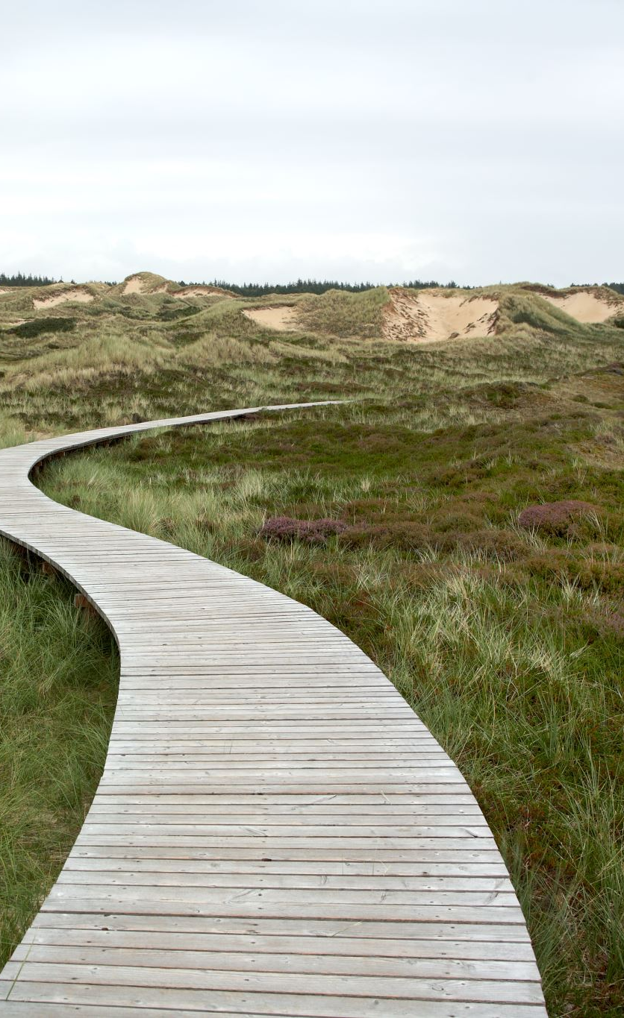
Trauma Informed Support and the Path to Healing
Karyn Harvey, Ph.D.

Slide 2


THANK YOU!!!

Slide 3

UNSEEN VIRTURE BRINGS VISIBLE REWARD
Nichren Daishonin – Buddhist teacher of the 13th Century

Slide 4

STOP AND REFILL YOUR BUCKET!

Slide 5
Trauma in the World of Intellectual Disabilities
McNallly et al – People with intellectual disabilities are more vulnerable to psychological trauma than people without intellectual disabilities
Gentile, J. – People with intellectual disabilities are often not diagnosed with post traumatic stress disorder when it is their most dominant condition
Keesler – Trauma and PTSD are underdiagnosed and undertreated in adults with intellectual disabilities

Slide 6
Sources of Trauma for People with Intellectual Disabilities
Sexual Abuse
Physical Abuse
Bullying
Exclusion
Institutionalization

Slide 7
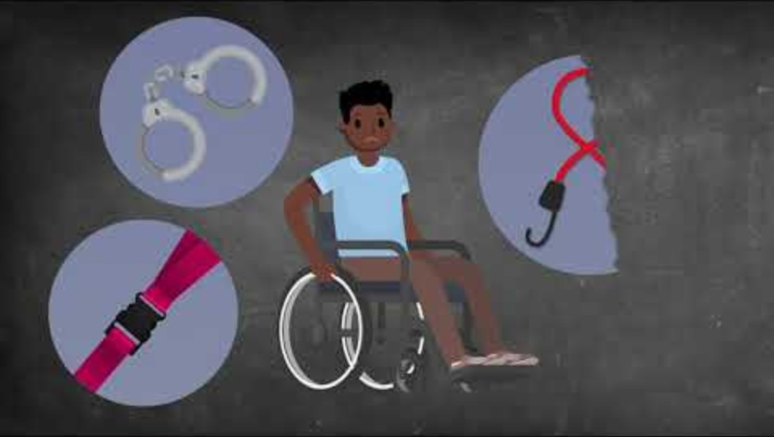
Sources of Trauma for People with Intellectual Disabilities Visuals

Slide 8
Big T and Little “t”
Traumas
Major Events | Little “t” Trauma
Sexual Abuse | Discrimination
Physical Abuse | Neighborhood Violence
Neglect | Social Exclusion
Negative Events | Exclusion from Family
Grief and Loss | Frequent foster care or group home placements and lack of stability

Slide 9

Bullying
https://youtu.be/iOwPQAVjhWQ

Slide 10
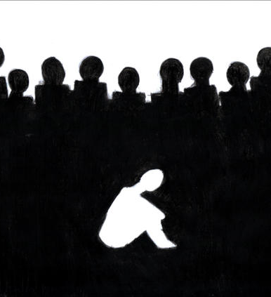
Bruce Perry
Don’t ask what’s wrong with you – the real question is
What happened to you?
This Photo by Unknown Author is licensed under CC BY-NC-ND

Slide 11
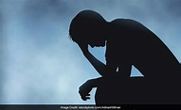
ASSUME TRAUMA

Slide 12
RESULTS:
Issues: | Institution | Foster Care | Biological
Axis 1 Disorders | 55% | 35% | 13%
Emotional Disorders | 49% | 29% | 8%
Behavioral Disorders | 32% | 25% | 6.8%
Intellectual Disability Average IQ Score | 73 | 85 | 110

Slide 13
Children Who Stayed in Institutions –Nathan Fox
Gray matter in brain actually shrunk
Lower brain activity measured by EEG
Impairments in Executive Functioning
Increased Adrenaline levels after 1 year – affects heart, behavior, ability to focus ( looks like ADHD)
Often abnormally small physically
At higher risk for premature deaths
Neglect is more devastating than any other type of abuse

Slide 14
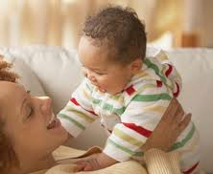
MIRROR NEURONS: Interaction during infancy is needed for brain wiring

Slide 15

TRAUMATIC EXPOSURES
In-utero Drug exposure
In-utero Drug/Alcohol exposure

Slide 16
“Nearly 1 in 12 newborns in the United States in 2020 – or about 300,000 infants – were exposed to alcohol, opioids, marijuana or cocaine before they were born. Exposure to these substances puts these newborns at a higher risk for premature birth, low birth weight and a variety of physical and mental disabilities.”
Amna Umer
Associate Professor of Pediatric Epidemiology, West Virginia University

Slide 17
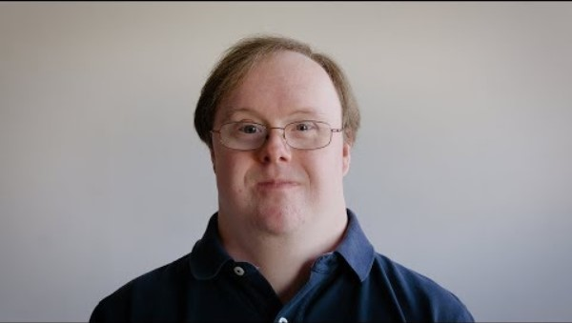
Awareness

Slide 18
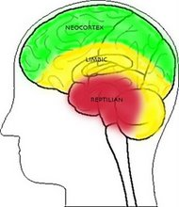
Psychological Trauma – Past is Present
Neocortex
The rational brain: Intellectual tasks
Limbic
The intermediate brain: Emotions
Brain Stem
The primitive brain: Self preservation, aggression
The Triune Brain

Slide 19
Trauma Responses
Trigger Response – Something happens in the present that reminds the person of the negative past - person goes into fight, flight or freeze mode:
Thinking he or
she is in
Danger!
Trauma
Trigger
Fight
Freeze
Flight
Fawning
Attachment
Issues

Slide 20

COMMUNICATION IS EMPOWERMENT

Slide 21
Sometimes the “Behaviors” we see are really symptoms of
Post-traumatic Stress Disorder

Slide 22
Symptoms of PTSD
Re-experiencing
Avoidance
Negative Alteration in Cognition and Mood
Arousal

Slide 23

Family Trauma

Slide 24
Ingredients Necessary for Post traumatic Recovery
Perceived Safety
Connection
Empowerment

Slide 25
Best Technique Ever:
LISTENING
Hearing
Validating feelings
Reflecting
Paraphrasing
Giving Empathy
Being Present
Not advising
Not instructing
Not shaming

Slide 26
Positive Identity Development
Negative Identity
Positive Identity
NOT the person who gets married
NOT the person who drives
NOT the person who plays on a high school sport team
NOT the person who is popular or liked
Not the cool one
Who I am
What I do well
Who my friends are
What my preferences are
Where I make a difference
What I am proud of

Slide 27
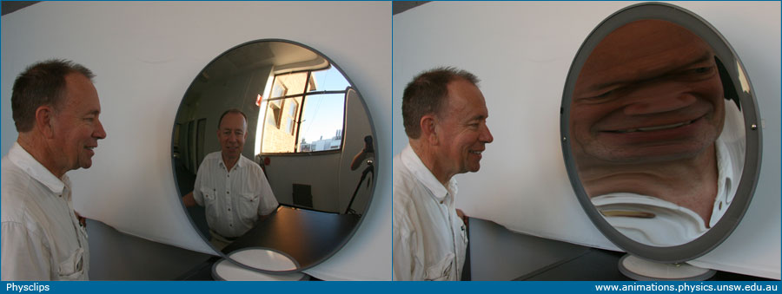
We can hold up 2 possible mirrors
This Photo by Unknown Author is licensed under CC BY-NC-ND

Slide 28

Resiliency Studies

Slide 29
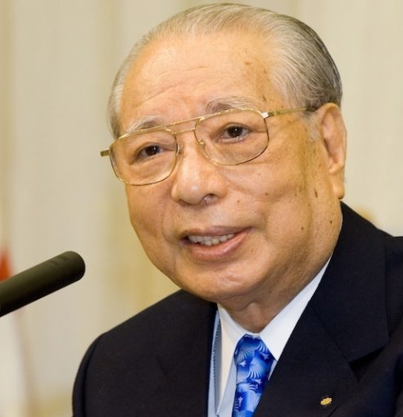
Daisaku Ikeda Quote
“Every Life is as Valuable as the Universe .”
Daisaku Ikeda
This Photo by Unknown Author is licensed under CC BY

Slide 30
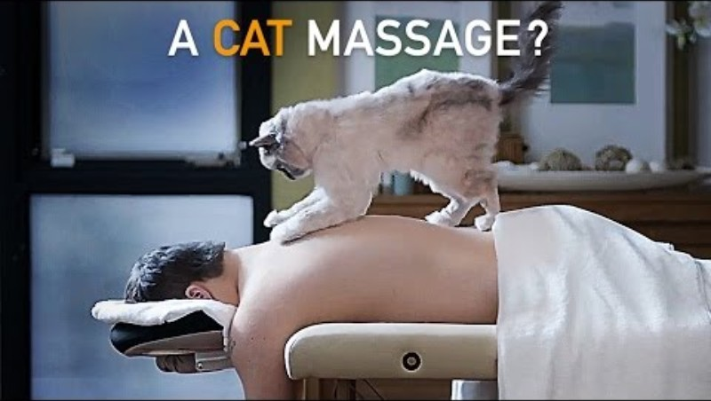
Cat Massage Photo

