Slide 1
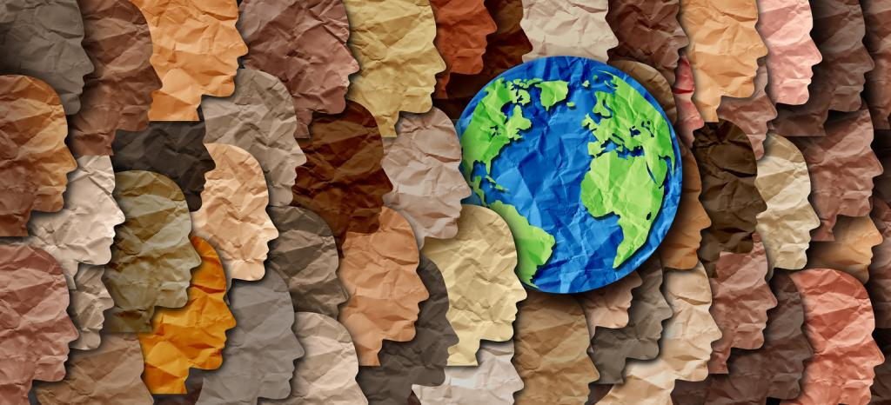
How to Keep Working on my Multicultural Competence in a Divisive Cultural Climate
Dr. Carmen Cruz
Foster Youth Conference
April 6, 2023

Slide 2
Purpose
How to Keep Working on my Multicultural Competence in a Divisive Cultural Climate
The purpose of this training is to provide a space for participants to engage in intentional self-reflection regarding their personal/professional work on multicultural competence. Presenter will review key concepts in the development of cultural competence and lead participants in an experiential learning exercise. Attention will be focused on personal/professional intersections, which impact the work we do with others, from a helper/healer perspective. Particular consideration will be devoted to continuing to develop insight about how personal intersectional cultural identity variables impact alliances. Lastly, participants will reflect on how the current divisive social, cultural and political climate influences their professional practice.

Slide 3
Frame
Impact of Cultural & Social stress
Multicultural Competence & Stimulus Value
Helper/Healer perspective
Personal/Professional intersections

Slide 4
How I hope we will experience the learning objectives…
Feel freedom in the learner and reflective role today
Engage in self-reflection from a curious, compassionate, open and challenging space
Share your knowledge about the challenges and joys of advocacy work
Refresher regarding your impact
Intentionally choose how you will engage

Slide 5
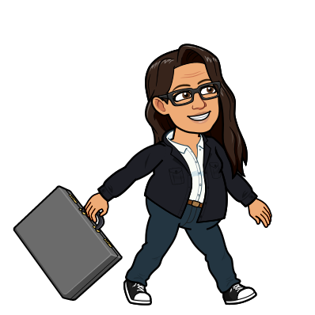
Why me as a presenter?
Notes:
Psychologist for over 25 years. Have sat with so many TWU students in pain and struggle.
Mental health and identity trauma are two main things I’ve work in
Relational and interactive style
Want to be a role model
Led to my focus and purpose in being an educator, trainer, supervisor
Have been doing this prof over 20 years
Feel I was an activist since youth, for self and others
Paul story to celiac advocacy
Try to lead with compassion and education
Many micro and macro aggressions in my life (grad school)
I have also microaggressed – we are not immune
My personal identity variables (model for them)
Want to be a role model

Slide 6
Triad Training Model Slide
Knowledge
Skills
Awareness/Attitudes
Triad Training Model (Pederson, 2000)

Slide 7
Multicultural Competence
Research indicates that the awareness component of MC training may be most indicative of attaining multicultural competence.
The development of self-awareness through personal reflection and experiential training is a critical element of becoming multiculturally competent.

Slide 8
Process Model of Cultural Competence
Cultural Knowledge - Comprehensive knowledge base about culturally diverse groups
Cultural Awareness – Self-examination of one’s own biases towards other cultures, in-depth exploration of one’s own cultural background
Cultural Encounters – Direct engagement in face-to-face encounters with others from culturally diverse backgrounds, necessary for developing cultural competence
Cultural Desire – Motivation to want to (not, have to) engage in a process of being culturally aware, knowledgeable, and skillful
Cultural Humility – A lifelong process of self-reflection and critique; being honest about what you know and don’t know, deep respect for others experience and perspectives
Cultural Skills - Ability to perform culturally informed assessment, intervention, training/education, supervision, and research
Notes:
- This is the foundational model for the workshop, and we will be working within all of the aspects of the model, and these overlap and mutually impact each other
AKS is foundational – much of what we learn in formal education and training – but also we go beyond this to understand it is a dynamic, lifelong process of growth that takes humility, desire, authenticity, vulnerability…
Campinha-Bacote - Transcultural C.A.R.E. Associates

Slide 9
Givens by Cruz
Everyone’s a little biased
We don’t know what we don’t know until we know it
Meeting people with compassion for their lived experience works
The singlemost effective way to eradicate bias is one on one connection
Must learn our stimulus value

Slide 10
Safety VS Comfort
Notes:
We always want safety in the group, but we don’t always want comfort. Discomfort happens at the learning edge of our comfort zones, where we are most likely to gain new understanding from our experiences. Conflict of understanding pushes our comfort zones and is a necessary and beneficial part of the dialogue process. It is our job as participants in this dialogue to turn conflict and discomfort into learning and growth for everyone. One of our first steps in this direction involves creating a safe environment where we can push our comfort zones and challenge ourselves to learn and grow.

Slide 11
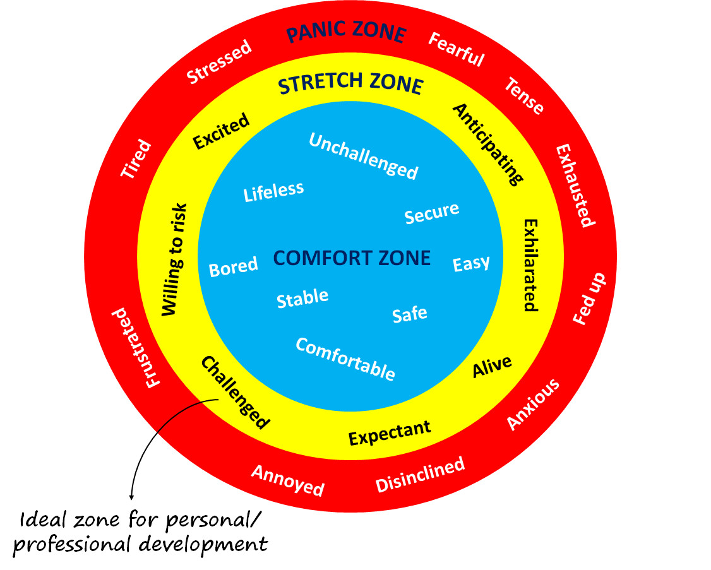
Safety vs. Comfort
Notes:
We always want safety in the group, but we don’t always want comfort. Discomfort happens at the learning edge of our comfort zones, where we are most likely to gain new understanding from our experiences. Conflict of understanding pushes our comfort zones and is a necessary and beneficial part of the dialogue process. It is our job as participants in this dialogue to turn conflict and discomfort into learning and growth for everyone. One of our first steps in this direction involves creating a safe environment where we can push our comfort zones and challenge ourselves to learn and grow.

Slide 12
Vulnerability…
We ask the kids and adolescents to be vulnerable, so we need to step up also.

Slide 13
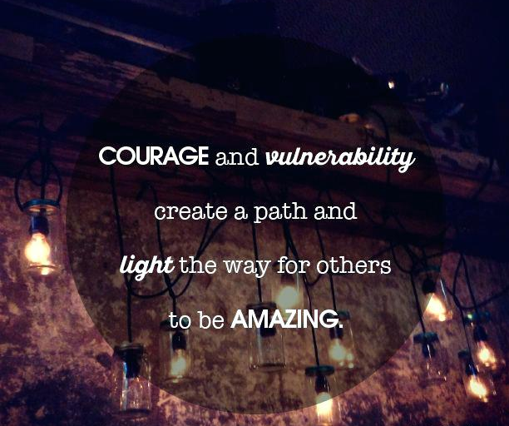
Inspirational Quote Slide

Slide 14
Impact Slide
IMPACT IMPACT
OF OF
CULTURAL PANDEMIC
CLIMATE
Notes:
Reflect on how the last 5-10 years have impacted you.
What are the first few descriptors you thought about?

Slide 15
Intersectional concepts within cultural/social/political stress
Power
Gender (women, Trans/NB)
Race
Skin tone/Colorism
Sexual orientation
Religion
Social class/income
Ability & Health status
Immigration/Citizenship status

Slide 16
Audre Lorde Quote Slide

Slide 17
Reflection Exercise Slide
Reflection…
Write 2-3 reflections about what you have been feeling since this talk started

Slide 18
My Reflections Review Slide
My reflections…
-This work is so hard
-Complex
-Must hold multiple truths
-WE HOLD SO MUCH
Check in with one another
-Secondary trauma
-Compassion Fatigue
-Still hopeful

Slide 19
Awareness Question Slide
How am I really working on my multicultural awareness and competence?

Slide 20
Four Corners
Of the four people profiled, whose life would you choose to live if you had to choose one?

Slide 21
Breakout Content Exercise Slide
Person 1 Cisgender woman Asian 22 years old Heterosexual Agnostic Middle-class Undocumented partner Paraplegic, uses a wheelchair | Person 2 Cisgender man White 45 years old Heterosexual Jewish Lower-income/poor Parent of a trans/NB teen Able-bodied
Person 3 Cisgender man African-American/Black 30 years old Gay Christian Upper-middle class Married Has a mild reading disability | Person 4 Cisgender woman Latina 65 years old Bisexual Weighs over 300 pounds Upper-class Widow Able-bodied

Slide 22
Experiential Activity
SMALL GROUPS WITH OTHERS
What are some ways your agency is discussing current cultural and social stressors among the staff?
What are some ways your agency is responding to current cultural and social stressors to your constituency?
What do you want to be different in your agency?

Slide 23
Karen Lang Quote Slide
“Isolation is the glue that holds oppression together.”
~Karen Lang
Feminist scholar
Radical psychiatry: Central principle is that psychiatric problems are manifestations of alienation as a result of oppression

Slide 24
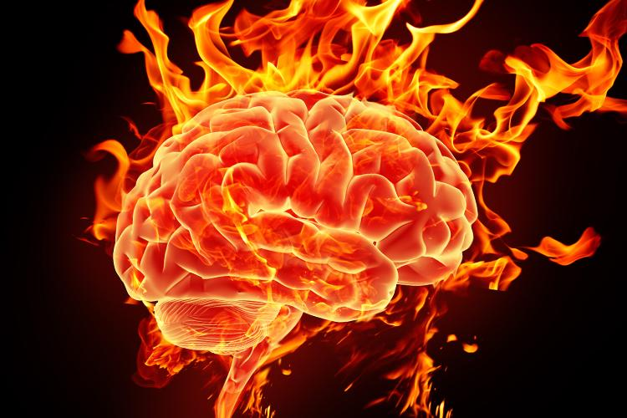
Being Relational in a Non-Relational World
Hard wired/Biology
Empathy, connection, others/self
Culture/Society
Independence, autonomy, self
Everyone suffers, the dominant and minority group

Slide 25
Relational Neuroscience Concepts
SPOT Theory (social pain overlap theory) Eisenburger/Leiberman research
SOCIAL PAIN IS REAL PAIN! “US VS. THEM”
Social exclusion and physical pain share the SAME pathway in the dorsal anterior cingulate part of the brain!
This part of the brain is stimulated when we “perceive” social exclusion
Cultures that value separation/individuation and competition have the potential to increase minority stress and pain
STRESS
Low or moderate stress enhances plasticity and learning
Chronic stress leads to “wear and tear” = bad for the brain

Slide 26
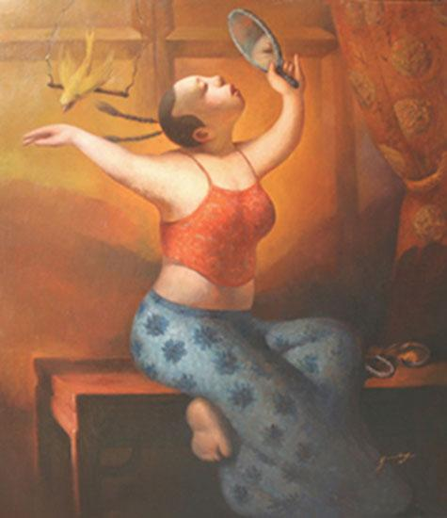
OUR DIVERSE SOCIAL IDENTITIES
Parent Identity
Age
Ethnicity
Gender Identity
Race
Neurodiversity
Relationship Status
Education
National Origin
Size/Appearance
Sexual Orientation
Social Class
Regional/Geographic
Sex
Dis/Ability
Religion/Spirituality
Notes:
-Each identity has more or less social value and/or power
-WHAT IS YOUR STIMULUS VALUE????
Each identity has cultural values within that are more or less seen as valuable, leading privilege and marginalization/oppression
Self-identification; respecting that we each use our own terms to identify ourselves
Identity is changeable and fluid; saliency changes based on context
What is diversity?
-broad inclusive definition (e.g., race/eth, SES, sexual orientation, sex, family system,
nation/region of origin, religion, spirituality, disability, body size/shape, age)
These parts of ourselves/parts of our identity create our Cultural Filter/Lens and color how we see the world; it is important to learn about your own filter so that you can recognize it and learn to take it off at times and try on other filters/points of view when dealing w/people different than yourself as a way to increase understanding
What else creates our Cultural Filter/ where do we learn messages about ourselves and other groups?
-media, family, church, school, family, peers, gov’t

Slide 27
Positionality Question Slide
Notes:
https://engineerinclusion.com/what-is-positionality/
Positionality is the social and political context that creates your identity and how your identity influences and biases your perception of and outlook on the world.
Positionality affects research, teaching, leading, policymaking, as well as common interactions.

Slide 28
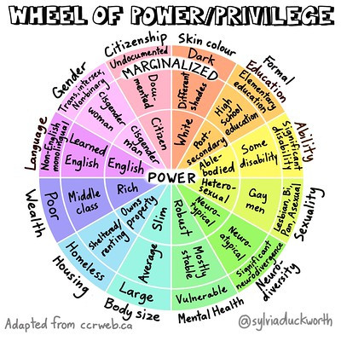
Wheel of Power/Privilege Slide

Slide 29
Intention and Impact Slide
Intention
Impact
Notes:
Story about young man at twu…smartest hispanic I ever met…
How do we hold minority fatigue with majority good intention?
Advocacy comes from a personal identity we hold or because it matters for some reason…so we are motivated.

Slide 30
What gets in the way?
DOUBT
DRAINED

Slide 31
DOUBT
Navigating with fear
Don’t want to use the wrong words
Don’t want to be uncomfortable
Don’t want to make a mistake
Not believing it applies to you
You really believe things are equitable in society
Privilege identity fragility- this pains me too much to think about
Notes:
Everyone feels fear. Not everyone chooses courage.

Slide 32
Fear/Courage Slide

Slide 33
DRAINED
Minority fatigue
Lifelong microaggressions
Lack of adequate self-care, too much other care
Desire to give up
Tired of history repeating itself
Not seeing any potential for improvement
Anger, hopelessness, frustration
Just damn over it

Slide 34
DOUBT or DRAINED
Did you feel yourself more in doubt or drained? Or even a little of both?
LIFE STRESSORS FOR ALL!!!
Cultural stress, personal stress, commutes, work demands, family roles, eating well, etc.
Conflict and divisiveness can arise given people are in different places within the same system.

Slide 35
What do we do when doubtful or drained?
Numbing/Binging behaviors
Avoidance of true connection
Escapism
Take out our stress on others
Lack of adequate self and other care
Notes:
All of us have life stress!!!

Slide 36
Self-care

