Slide 1
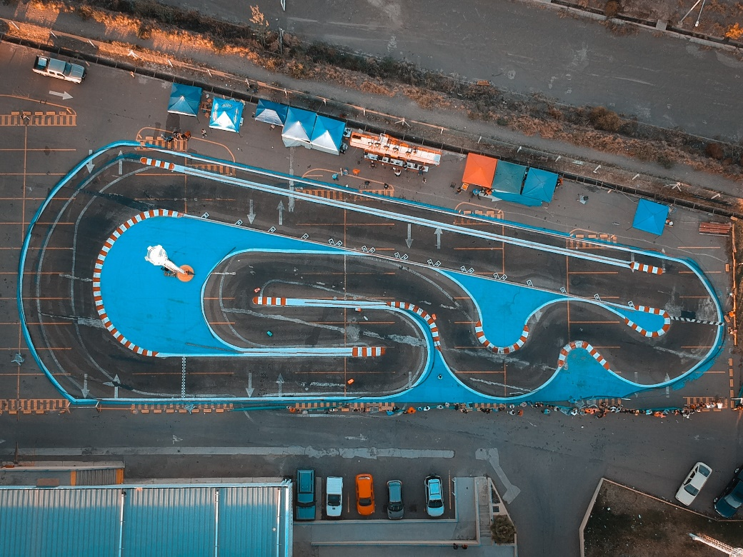
Collaborate and Accelerate with AEL
Maria Morrow
Adult Education and Literacy
Program Specialist
Texas Workforce Commission

Slide 2
OBJECTIVES
Explain the Adult Education and Literacy (AEL) System
Contact your local Program using Move Ahead With Adult Ed (Statewide Campaign)
Review the Integrated and Education Training model
Describe Program Goals
Explore what to expect from an AEL Program
Examine how AEL can help

Slide 3
Adult Education and Literacy System
Statewide multi-year grants
Sole and Consortia
Open to new partnerships
Over $80 million investment

Slide 4
Program Goals
Programs will provide support and basic education that enables them to effectively:
Improve their literacy and obtain the knowledge and skills necessary for employment and economic self-sufficiency;
attain a high school equivalency or secondary school diploma for marketability
Participate in or provide an opportunity to transition to postsecondary education and training
prepare for in-demand industries and occupations that lead to stable employment or progress into a higher wage position; or

Slide 5
Who is eligible?
Those showing a need to improve foundational skills after taking an NRS approved test.
and/or
English Language Learner based on a state approved assessment
and/or
Those lacking a high school diploma or equivalent
**additional document requirements are needed for ages 16-18

Slide 6
Additional Document Requirements

Slide 7
What to expect
Eligibility Review & Verification
Assessment/ Testing
Orientation (3-12 hours)
ITEC Plan
Assigned Classes

Slide 8
AEL Instruction

Slide 9
Intensive Services
ESL for Professionals or Internationally Trained Professionals (ITP)
Reentry Corrections
Workplace Literacy

Slide 10
Fully Integrated Model

Slide 11
Serving Youth Populations

Slide 12
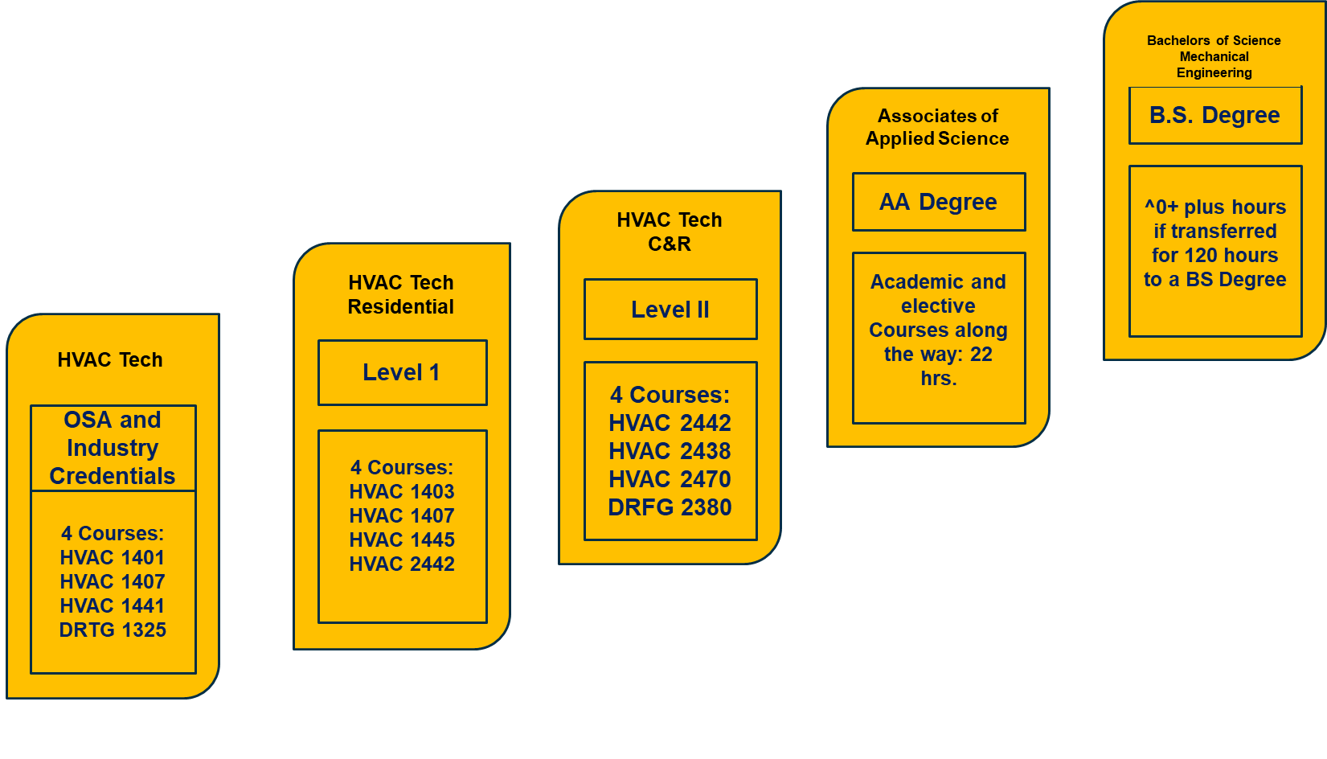
Career Pathway
integrated education and training

Slide 13
The Integrated Education and Training Model
Workforce Preparation Activities
Occupational Training
Contextualized Basic Education

Slide 14
Contextualized Basic Education
CAD
Computer-Aided Design
Coronary Artery Disease

Slide 15
IET HVAC

Slide 16
Story time!

Slide 17
Move Ahead with Adult Ed
https://tcall.tamu.edu/docs/mawae/AEL_MAWAE_FactSheet_Template_Program.pdf

Slide 18
Find A Program
https://tcall.tamu.edu/search.aspx

Slide 19
Finding A Program
https://tcall.tamu.edu/search.aspx

Slide 20
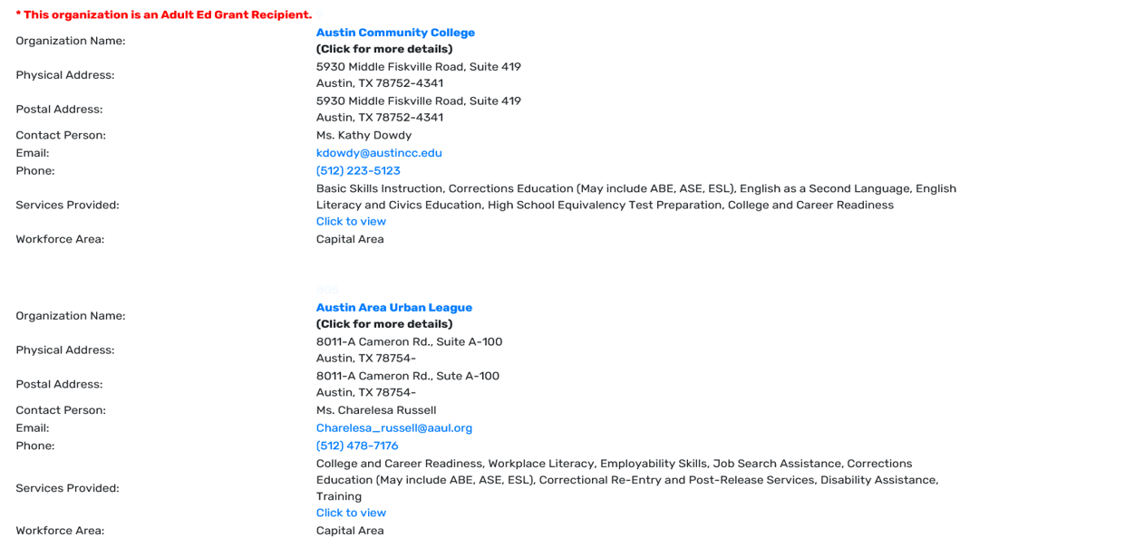
What is AEL doing in your Community?

Slide 21
Questions?
Maria Morrow
AEL Program Specialist
AdultEducation@twc.texas.gov

