Slide 1
U.S. Interagency Council on Homelessness
All In: The Federal Strategic Plan to Prevent and End Homelessness

Slide 2
How We Got Here…
80+ listening sessions
1,500 public comments, including 500 from people with lived experiences of homelessness
Input from expert key informants who reviewed with a lens for: racial equity, lived experience, tribal, and LGBTQI+
Nearly 2,000 comments from our 19 member agencies

Slide 3
What We Heard: Biggest Challenges
Lack of Housing Supply | Severe shortage of safe, affordable, and accessible housing NIMBY movement Impact of climate change
Rising Rent Amid Slow Income Growth | Slow wage growth for lowest-paid workers 70% of lowest-wage households spend more than ½ income on rent Disproportionate impact of housing unaffordability Non-employment income cannot keep up with rental costs
Inadequate Access to Supports | Limited availability of culturally appropriate, accessible supportive services Fragmented systems Disproportionate outcomes for people of color and other historically marginalized groups
Unsheltered Homelessness Rising | Limited alternatives to unsheltered homelessness Shelters at capacity, or high-barrier and not culturally appropriate
Criminalization of Homelessness | Harmful public narratives “Out of sight, out of mind” policies ineffective & create more trauma
Fatigue and Trauma Among Providers | Strained capacity High-turnover

Slide 4
What We Heard: Greatest Opportunities
Unprecedented Investments | American Rescue Plan CARES Act FY2023 President’s Budget Request
Demonstrated Commitment | Housing Supply Action Plan National Mental Health Strategy National Drug Control Strategy Executive Orders
Lessons Learns | Non-Congregate Shelter Emergency Rental Assistance Eviction Moratoriums Direct Cash Transfers
Focus on Racial Equity | Biden-Harris Administration Equity-Focused Executive Orders Opportunity for greater accountability & more equitable outcomes
Unwavering Dedication | Passionate and compassionate providers Continued perseverance

Slide 5
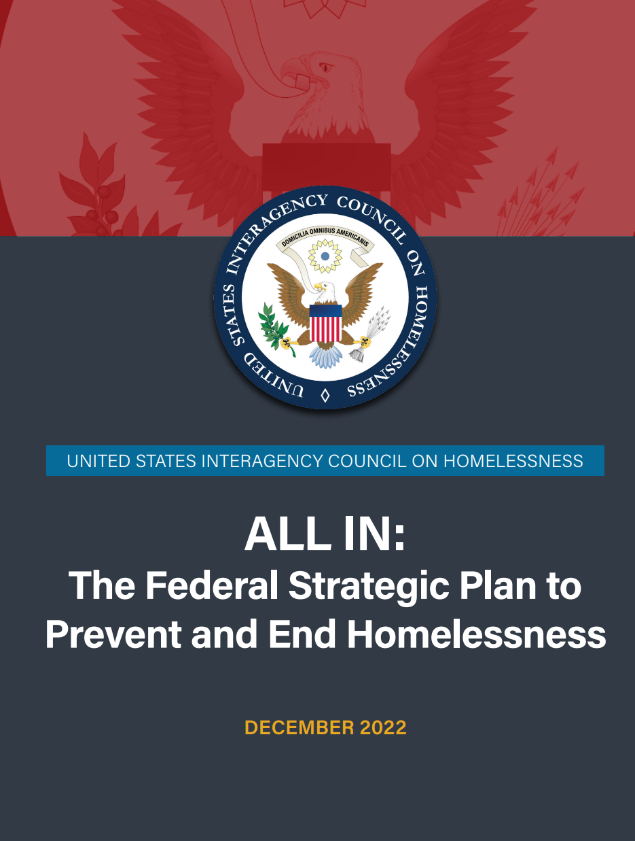
USICH Plan/Guide Image Slide

Slide 6
All In: Vision For the Future
This plan is built upon our vision of a nation in which no one experiences the tragedy and indignity of homelessness, and everyone has a safe, stable, accessible, and affordable home.
GOAL: Reduce homelessness 25% by 2025

Slide 7
Key Populations and Geographic Area Image Slide

Slide 8
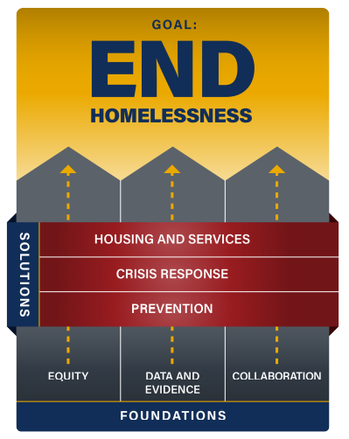
Ending Homelessness Image Slide

Slide 9
Foundation Pillars
Lead With Equity | Use Data and Evidence | Collaborate at All Levels
Pursue equitable outcomes | Increase federal government capacity | Promote collaborative leadership
Promote inclusive decision-making | Increase local and state capacity | Improve information sharing
Authentic collaboration | Create opportunity for innovation
Increase access to AI/AN | Build research and evidence base
Change policies and practices

Slide 10
Solutions Pillars
Scale Up Housing and Supports | Improved Homelessness Response | Prevent Homelessness
Maximize federal housing assistance | Government wide effort on unsheltered homelessness | Increase access to employment, education, mainstream opportunity
Increase supply of affordable housing | Improve coordinated entry | Reduce housing instability for those existing institutions
Increase supply of PSH | Increase availability of low-barrier shelter | Reduce housing instability for older adults and people with disabilities
Improve effectiveness of RRH | Improve coordination with public health and disaster management | Reduce housing instability for transitioning service members
Support enforcement of Fair Housing | Expand use of housing problem-solving | Reduce housing instability for AI/AN
Better serve needs of people with disabilities | Remove/reduce programmatic barriers | Reduce housing instability for youth and young adults
Expand availability of voluntary and trauma-informed supports |  | Reduce housing instability for survivors

Slide 11
How USICH Will Implement All In
Develop implementation plans with specific actions, milestones, and metrics
Partner with and solicit feedback from people who have experienced homelessness and other stakeholders
Publish annual performance management plan
Update plan annually to reflect evolving metrics, input, and lessons

Slide 12
How USICH Will Measure Progress
People (including subpopulations) experiencing sheltered and unsheltered homelessness (HUD PIT)
Children and youth experiencing homelessness during school year (ED)
Length of time of homelessness (HUD)
Returns to homelessness within 6 to 12 months and within 2 years (HUD)
People who become homeless for the first time (HUD)
Overall homeless population (HUD)
Placement in and retention of housing from street outreach (HUD)
Racial disparities in homelessness (HUD)

Slide 13
How All In Can Be Used Locally
Develop local and systems-level plans
Set state and local goals to reduce homelessness by 2025
Educate partners on the causes of homelessness, challenges, and opportunities
Hold the federal government accountable
Learn about federal programs, existing federal actions, and new federal strategies

Slide 14
Web link for USICH
Visit usich.gov/fsp

