Slide 1
Evidence-Based Grant-Making
Texas Workforce Commission (TWC), Texas Workforce Investment Council (TWIC), Results for America, & Rural Capital Area Workforce Development Board
Improving Texas Outcomes
Notes:
The blank slides in this presentation are there to show you the layout options. Feel free to delete slides you do not want or to change the layout of the slides (right click then choose Layout from the menu).
To change the slide background picture or TWC logo on this slide, go to View > Slide Master

Slide 2
Agenda
Texas Vision – How? When?
National Vision – Why?
Evidence Framework – What?
Q & A – Who?

Slide 3
Welcome!
  Jen Troke, Director, Workforce Grants and Initiatives, Texas Workforce Commission
  Bryan Daniel, Chairman and Commissioner Representing the Public, Texas Workforce Commission
  Celeste Richie, VP, Workforce Development, Results for America
  Courtney Arbour, Director, Workforce Development Division, Texas Workforce Commission
  Lee Rector, Executive Director, Texas Workforce Investment Council

Slide 4
Polling Question #1
What type of organization are you representing today?
Education
Workforce Development
Economic Development
Employer
Community-Based Organization
Other

Slide 5
Polling Question #2
What words come to mind when you hear the term “Evidence-Based?”
Please respond to question in the Chat!

Slide 6
Polling Question #3
Why did you join today?
I want to learn more about the use of evidence in grant-making, but it makes me nervous!
I have dabbled in evidence usage, so I want to align my work to yours.
I love the idea of using evidence, but I need to learn more about how to do it.
Evidence Schmevidence – I have no idea what this is about!
Other – Put your reason in the chat!

Slide 7

Texas Vision for Use of Evidence
Goal of this work is to discover innovative approaches and replicable models that lead to better outcomes for workers

Slide 8
Building Evidence in Texas
TWC approved Building and Construction Trades Request for Application (RFA) that will:
  focus on the priority population of opportunity youth – those youth not in school or work
  include an evidence framework to improve the measurement of success of the grant program
  incentivize program models with demonstrated track record of effective outcomes
  encourage building the evidence base for those models with little to no evidence – all grants will be evaluated

Slide 9
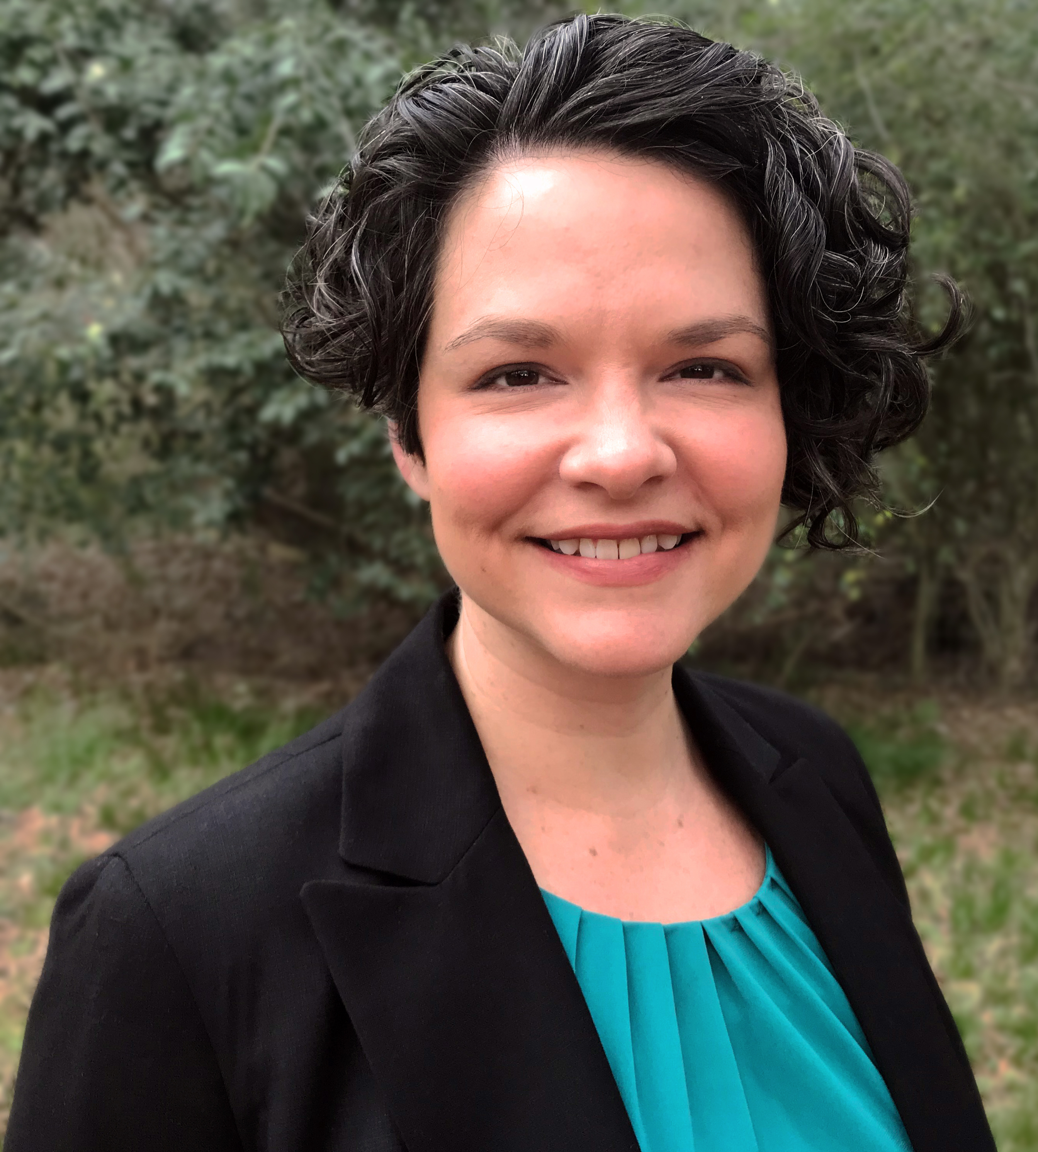
Data and Evidence Can Help States Invest in What Works
Celeste Richie
VP Workforce Development
Results for America

Slide 10






RFA’s Mission
To make investing in what works the “new normal” so that government decisionmakers will regularly and effectively use evidence and data to increase the impact of the over $1 trillion that governments spend each year to improve the lives of young people, their families and communities.

Slide 11
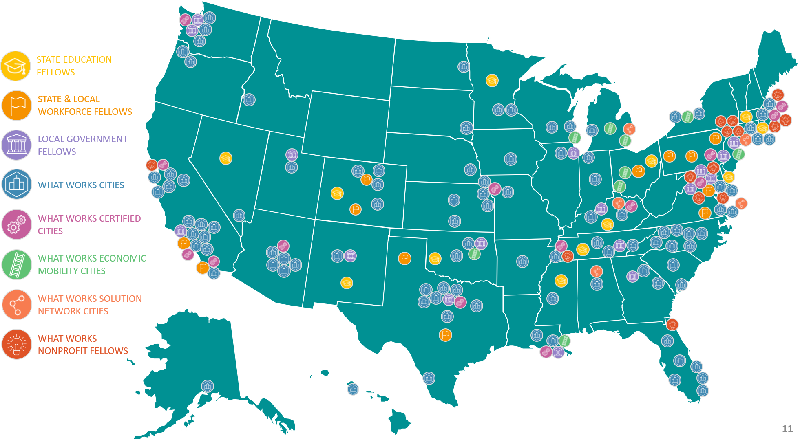
WHERE WE WORK

Slide 12


WORK LAB ROADMAP:
ADVANCING SEVEN POLICY STRATEGIES
1. Link funds directly to priority outcomes through performance-based contracts.
2. Offer flexible award sizes, time periods, and performance measures.
3. Award preference points to providers offering models with high or moderate causal evidence.
4. Set aside funding for contracts that pay directly for outcomes and providers offering models with high or moderate causal evidence.
5. Build evidence by promoting, conducting, and financing external evaluations.
6. Highlight effective strategies in state and local WIOA plans.
7. Establish a policy of transparency about funding and program performance.

Slide 13






STATE AND LOCAL WORKFORCE FELLOWSHIP
WHAT IS IT?
First to convene senior workforce leaders from state and local workforce agencies into a single network to accelerate the generation and use of evidence.
Creating new champions to invest in what works and make evidence-based policymaking the new normal in workforce development.
WHO IS INVOLVED?
23 Fellows from 7 states
State Workforce Representatives: Workforce policy advisors to Governors, state workforce board executives
Local Workforce Representatives: Policy directors for Mayors, county, and regional workforce development boards.
WHAT DO THEY DO?
State and local teams applied together, identifying 2-3 evidence-based strategies of interest.
Co-created learning agendas & action plans to advance chosen strategies.
Test strategies at local level and look to scale at state level.

Slide 14
WE NEED AN EVIDENCE-DRIVEN WORKFORCE SYSTEM NOW MORE THAN EVER
Limited funding combined with unprecedented need means we need to focus funding where we can achieve the greatest impact.
This is not about excluding programs that have not yet built evidence; it is about continuous improvement. Each grant or contract should be an opportunity to learn more about what works and what needs improving.
Federal requirements for evidence-based programs are growing. Now is the time to get ahead of the curve and lead the way in evidence-driven workforce solutions.

Slide 15
WHAT IS EVIDENCE-BASED GRANTMAKING?
Define “evidence of effectiveness” so there is a common understanding of “evidence-based”
Outcomes- and performance-based payments. Payments are linked directly to priority outcomes (e.g. increased wages, long-term employment in related industry)
Use data to determine how well we are serving constituents through our services

Slide 16
State and Federal Programs Increasingly Prioritize Evidence of Effectiveness
The Department of Labor: RESEA, WIOA Pay-for-Performance
Workforce Agencies in CO, OH, PA, TX, VA
  Pittsburgh’s Partner4Work issued an RFP for training programs leading to industry-recognized credentials employment.
    To incentivize credential attainment, “payment will be made 50% on enrollment into a training program and 50% when documentation of a credential earned is provided to Partner4Work.”
  Central Ohio issued two RFPs for their one-stop provider and main career services contract that will link payments to priority outcomes.

Slide 17
Where are we today?
Framework completed
Revised Grant Application for Building Construction Trades to be Released November 2020 including performance outcomes
New TWC Webpage for Resources

Slide 18
What To Expect in Applications
New Language in RFAs
  New Vocabulary
  New Forms

Slide 19
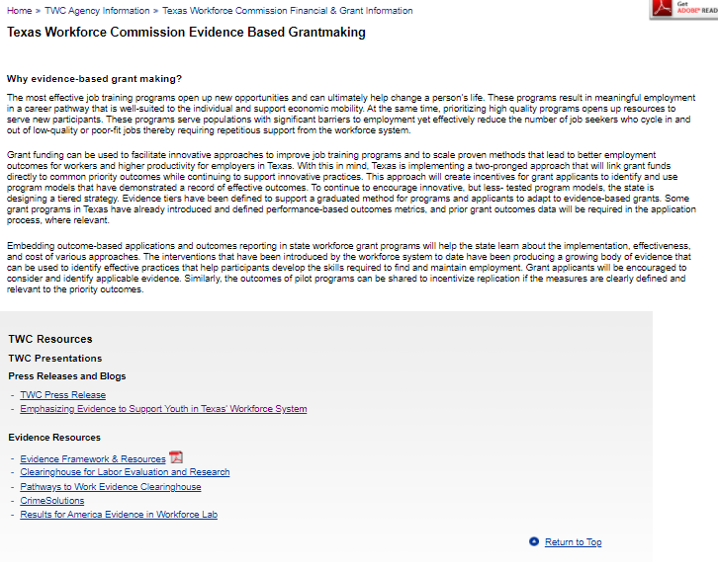
TWC Evidence Webpage
https://www.twc.texas.gov/agency/texas-workforce-commission-financial-grant-information

Slide 20
Evidence Framework
Five levels:
New Program Tier
Experience Program Tier
Performance Program Tier
Moderate Evidence Program Tier
High Evidence Program Tier

Slide 21
Evidence Framework
New Program Tier
new and are not similar to an existing program
no evidence of effectiveness, has not been evaluated, no data
An applicant must explain why the proposed program will achieve the outcomes specified in the main body of the application and demonstrate that there is capacity to collect sufficient data to track outcomes from the program.

Slide 22
Evidence Framework
Experience Program Tier
not a new program
no evaluations of participant success in the program
no performance data
Primary support for these programs’ effectiveness is provided through anecdotal participant success stories or other testimonials. Experience programs must have been providing services for at least one year prior to grant application.

Slide 23
Evidence Framework
Performance Program Tier
have performance outputs and outcomes data
conduct assessments of participants to demonstrate program effectiveness
documentation of performance data over at least two years
Primary support for these programs’ effectiveness is provided through historical data showing that the program creates an intended change in participants, and that participants show a positive outcome following participation in the program.

Slide 24
Evidence Framework
Moderate Evidence Program Tier
supported by rigorous evaluations of the program or of an essentially similar program design and outcomes
conducted at least one evaluation study that includes both a comparison group and a statistically valid technique
the program had both a positive and meaningful outcome
study rated by CLEAR/Other Entity as moderate evidence or equivalent
proposed program design and anticipated outcomes must be consistent with the program in the evaluation cited by CLEAR/Other Entity
implemented with limited modifications
Evaluation study information will be required in application.

Slide 25
Evidence Framework
High Evidence Program Tier
supported by rigorous evaluations of the program or of an essentially similar program design and outcomes
conducted two or more studies that include both a comparison group and a statistically valid technique
the program had both a positive and meaningful outcome
studies rated by CLEAR/Other Entity as high evidence or equivalent
proposed program design and anticipated outcomes replicate or are essentially consistent to the program in the evaluation studies cited by CLEAR/Other Entity
implemented with no or extremely limited modifications
Evaluation study information will be required in application.

Slide 26
Evaluation Study Sources
Clearinghouse for Labor Evaluation and Research (CLEAR) https://clear.dol.gov/study_database
Pathways to Work Evidence Clearinghouse https://pathwaystowork.ach.hhs.gov/studies
CrimeSolutions https://www.crimesolutions.gov/asvsearch.aspx

Slide 27
Polling Question #4
If you were to apply to a current and familiar RFA, where would you place yourself on the evidence continuum?
New Program Tier
Experience Program Tier
Performance Program Tier
Moderate Evidence Program Tier
High Evidence Program Tier

Slide 28
Evidence Framework
Why now?
Building Evidence for the Future

Slide 29
Polling Question #5
Do you see the benefits of using an evidence-based approach?
Yes, we’re ready!
We’re not quite there but we’ll review the evidence-based RFAs when they’re published!
We’ll be ready next year!

Slide 30
Q+A
What are your questions?

Slide 31
Contact Us
Email us at evidence@twc.texas.gov
Thank you for joining us!

